Slide 1
Agrivoltaics Canada
Conference
December 2023

Slide 2
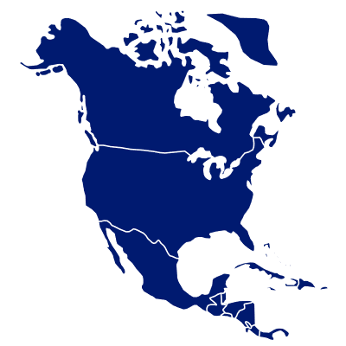
Overview
EDF Renewables North America
EDF Renewables North America is a project developer, owner, and operator with end-to-end solutions for every market…
16 GW developed
Grid-Scale Power
As developer, owner and operator of one of the largest renewable energy portfolios and second largest project pipeline on the continent, EDF Renewables is active in every market across North America.
13 GW service contracts
Distribution-Scale Power
With our history of innovation, and deep experience developing and operating renewable energy assets, we bring a full-suite of solutions for grid-scale, distribution-scale, asset optimization and onsite energy.
44 GW pipeline
Onsite Solutions
Our outstanding capabilities allow us to utilize our in-house experts, providing maximal efficiency and end-to-end oversight of any size of energy project.
35+ years experience
1,650+ employees
Asset Optimization
…with the capabilities, financial strength and global footprint to help you secure your energy future.
as of 12/31/22

Slide 3
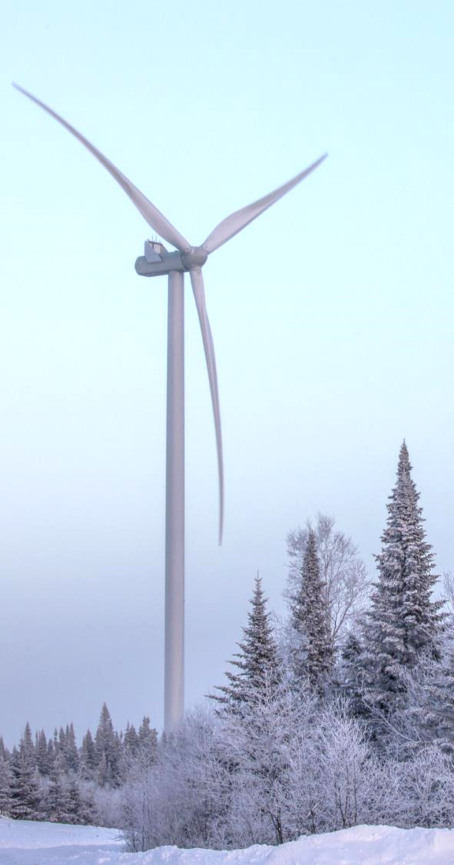
Experience in Canada
15 Years
in Canada
1,880 MW
of projects
EDF Renewables has been developing and operating clean energy projects across the country.
Put into service, under construction or contracted across the country.
4,172 MW
pipeline
$5.2+B
invested
We continue to expand our energy expertise with projects in various stages of development.
Since 2008 in Canada, including support of local wildlife habitats for bats, honeybees and Monarch butterflies.

Slide 4
EDF Renewables in Canada
Nicolas-Riou
224 MW
2018
Mont-Rothery
74 MW
2015
Riviere-du- Moulin
350 MW
2015
~1,880 MW
developed
Lac Alfred 300 MW
2012
Saint-Robert Belarmin
80 MW
2012
Wind – In Operation
Wind – Under Construction
Solar – In Operation
La Mitis
25 MW
2014
Le Granit 25 MW 2014
Massif du Sud
150 MW
2012
Blackspring Ridge 299 MW
2014
Cypress
247 MW
2023
Romney 60 MW
2019
Arnprior 19 MW
2010
Barlow 10 MW
2019
Pendleton 12 MW
2019

Slide 5
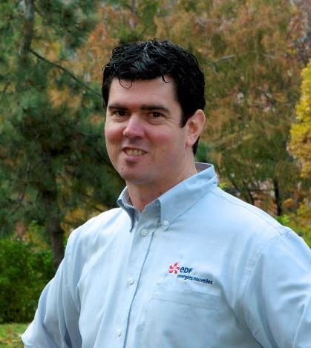
Kevin Campbell
Joined EDFR: 2010
Renewable energy background:
Started with EDF Renewables in 2010, developing ground mount solar projects in Ontario, Canada
Worked on utility scale wind and solar projects in Ontario and Eastern Canada until 2018
Working exclusively on solar projects in New York State since 2018, including 177 MW now under construction
Managing a portfolio of nearly 2,000 MW in New York State
ASGA advisory board member; NYSERDA Agricultural Technical Working group member
Education: Environmental Chemical Engineering from the University of Waterloo
Previous work: Various engineering roles with Shell Canada in Calgary Alberta
Director, Development
Kevin.Campbell@edf-re.com

Slide 6
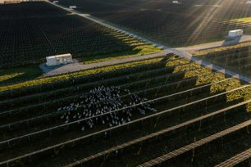
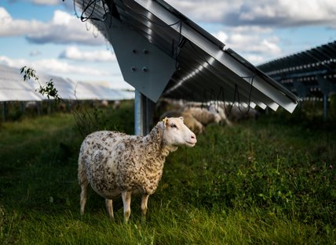
3 Key Elements to Solar Project
Solar Project
Land
Community Support
Interconnection and Transmission

Slide 7
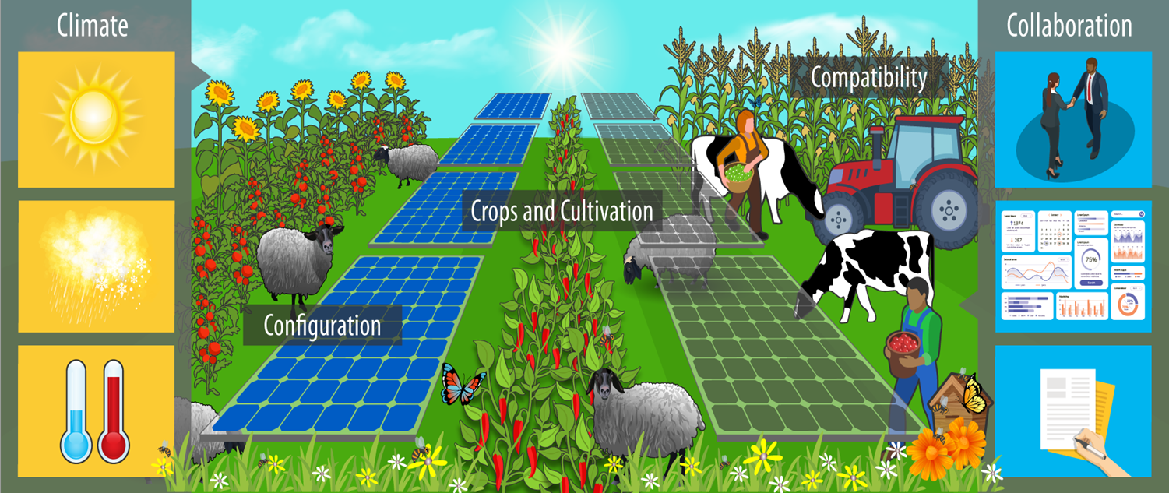
5 C’s of Agrivoltaics
The 5 C categories has multiple determinants that can lead to success in agrivoltaic projects and/or research
A 6th ‘C’ for Cost?
Source: Macknick, Jordan, et al., The 5 Cs of Agrivoltaic Success Factors in the United States: Lessons from the InSPIRE Research Study. NREL/TP-6A20-83566. https://doi.org/10.2172/1882930

Slide 8
Basics of Agrivoltaics
A synergistic solution to improved environment, energy and economy
Preserves farmland and agricultural livelihoods
Promotes carbon sequestration
Regenerative grazing
Market growth for livestock
Workforce development
Maintained or higher crop yield from microclimatic conditions under panels
Improves to access to farmland among new farmers and disadvantaged communities
Restoring native vegetation promotes
Higher soil health
Pollinator habitat
Stormwater management
Reduced erosion
“Widescale installation of Agrivoltaic systems can lead to a carbon dioxide (CO2 ) emissions reduction equivalent to removing 71,000 cars from the road annually and the creation of over 100,000 jobs in rural communities”
- Agrivoltaics Align with Green New Deal Goals While Supporting Investment in the US’ Rural Economy

Slide 9
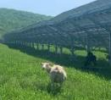
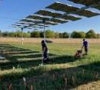
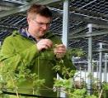
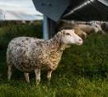
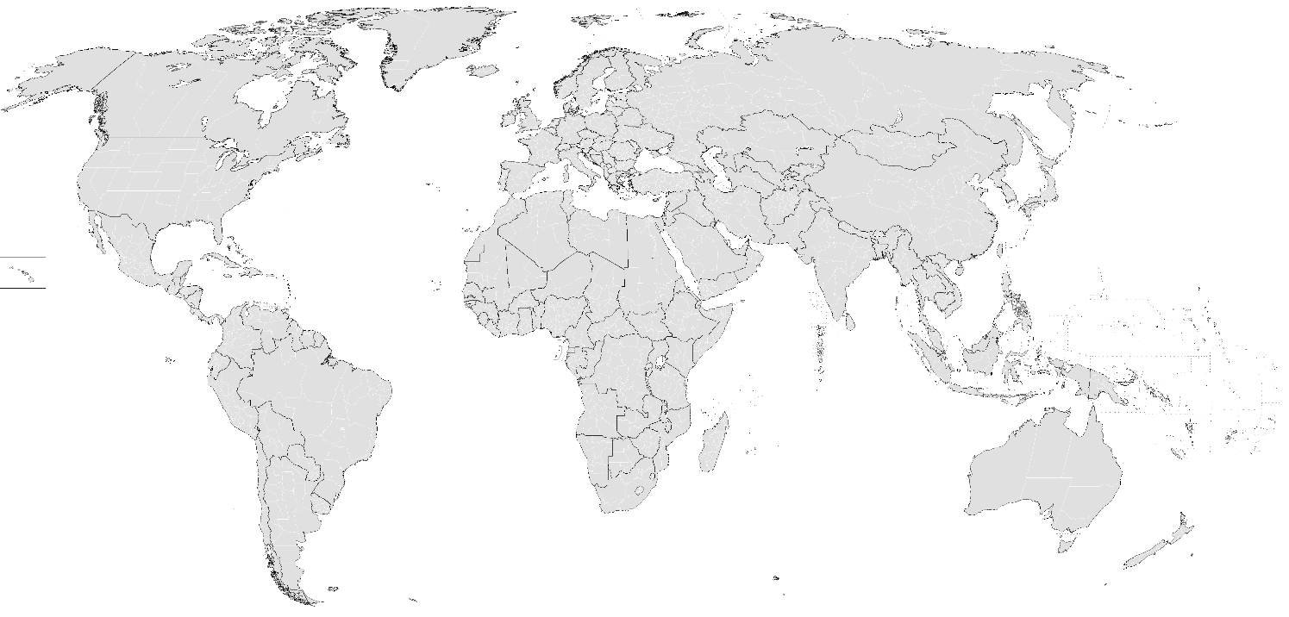
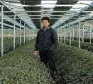
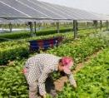
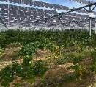
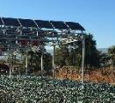
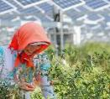
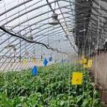
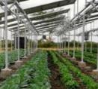
Agrivoltaics Across the World
Maine, USA
Crescent Run Farm
Sheep Grazing
Île-de-France, France
EDFR R&D Alfalfa
Vlagtwedde, Netherlands
Blueberries
Ontario, Canada
EDFR’s Arnprior Solar
Sheep Grazing
Paderborn, Germany
Raspberries & Blueberries
Shizuoka, Japan
Tea & Assorted Crops
Occitanie, France
Solar Vineyards
Colorado, USA
Jack’s Solar Garden
Assorted Crops
Ningxia, China
Alfalfa & Goji Berries
Beijing, China
Solar Greenhouses
Curacaví, Chile
Broccoli & Cauliflower
Note: This map highlights innovative global agrivoltaic projects, it is not a comprehensive list. Inspired by the U.S. DOE Report (2022).
Kajiado, Kenya
Assorted Crops

Slide 10
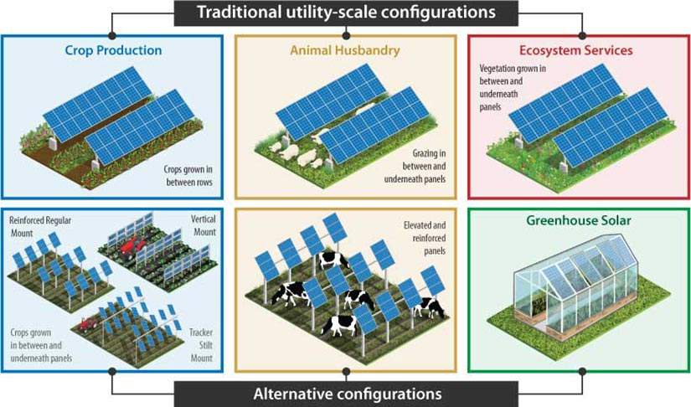
Agrivoltaics: Configuration Types
Agrivoltaics is the co-development of solar photovoltaic energy and agriculture.
Also called:
Agriphotovoltaics (AgriPV)
Solar grazing
Solar sharing
“Widescale installation of Agrivoltaic systems can lead to a carbon dioxide (CO2) emissions reduction equivalent to removing 71,000 cars from the road annually and the creation of over 100,000 jobs in rural communities”
- Agrivoltaics Align with Green New Deal Goals While Supporting Investment in the US’ Rural Economy
10
Agrivoltaics Canada Conference
Notes:
Kevin

Slide 11
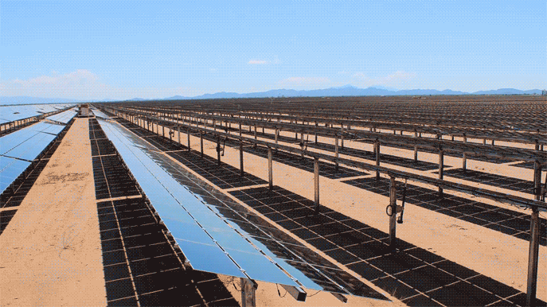
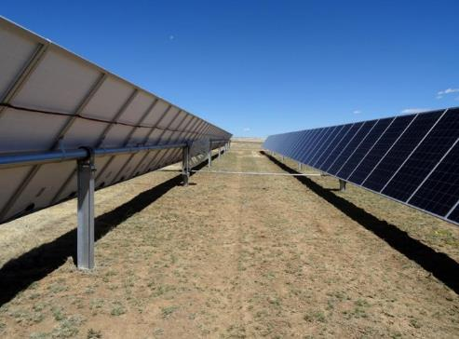
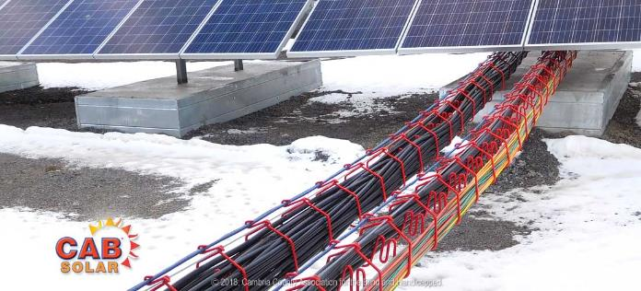
Shade Profile Example and Compatible Crops
Depends on shade tolerance (C3 crops)
Leafy greens (lettuce and spinach)
Root crops (potatoes, radishes, sugar beets, carrots, yam)
Squash (pumpkins, cucumbers, zucchini)
Fruit (tomatoes, blueberries, peppers)
Herbs (basil, lavender)
Hay/cover crop (alfalfa, oats)
Source: https://www.greensworld.swiss/project-02​
​
Racking drive shaft
CAB Cabling
11
Agrivoltaics Canada Conference
Notes:
Josh

Slide 12
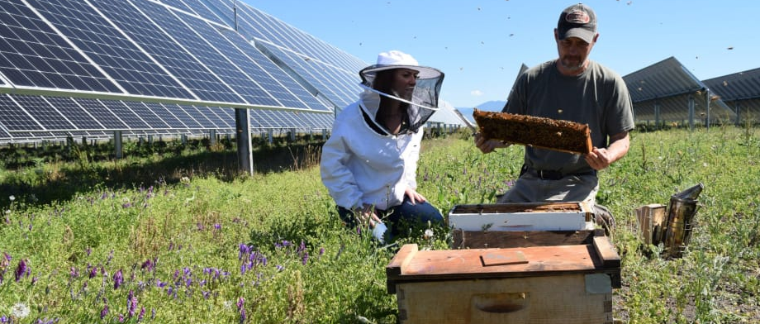
Agrivoltaics Design: Pollinator habitat
Design
Seed mix
Mowing 1-2 times per year
Optional:
Pollinator-friendly trees as vegetative screening
Contracts with beekeepers in setback areas
Pros
Cons
Co-exist with other APVs
Potential for lower mowing costs
Meet pollinator scorecards for permitting
No design changes, just cover crop + wildflowers
Carbon sequestration and supports local agriculture and ecosystem services
Higher capex for seed mix
No revenue stream to displace farmer/beekeeper costs
Lower community support than more intense forms of APV

Slide 13
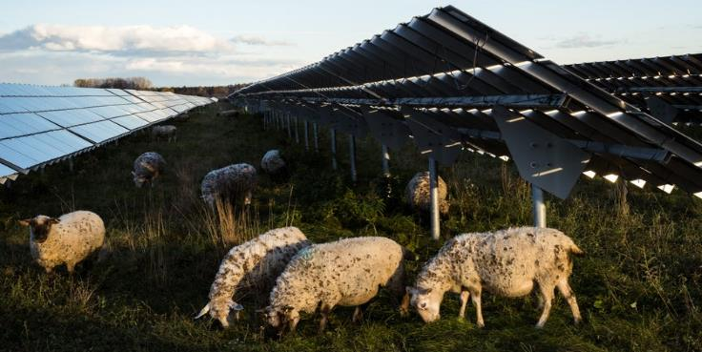
Agrivoltaics Design: Sheep Grazing
Design
Scenario: No infrastructure
Sheep grazier contracts: Higher opex
Preferred if short-term
Scenario: Infrastructure
Higher capex, lower opex
Seed mix site prep
Water wells
Fences and gates
Electricity for hot wires
Sheep grazier contracts: Lower cost
Optional: Unobstructed rows
Pros
Cons
Tried and true APV solution
May be more cost effective than contracted mowing if site prep
Sheep are small and docile
Lower heat stress, less predation
Carbon sequestration, nutrient cycling, potential carbon credits
Seed mix can meet pollinator scores with “fuzz and buzz” mix
Ancillary markets: cheese, marrow
Smaller market for lamb and wool, but 70% is imported from NZ and Australia
Few processing facilities for sheep

Slide 14
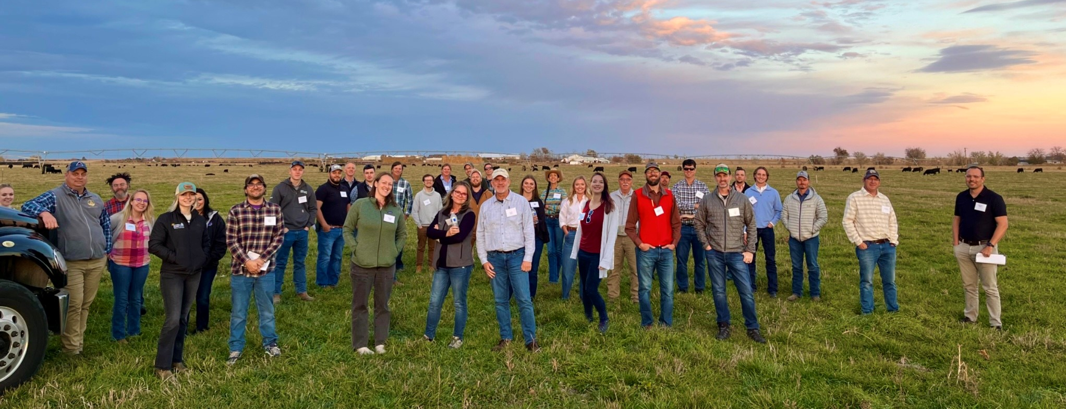
Agrivoltaics Design: Cattle Ranching
Design
Either raise piles and/or keep panels in table position
Cover crop seed mix
Water wells, fences and gates, electricity for hot wires
Unobstructed rows (no CAB cabling or drive shafts)
Pros
Cons
Cattle rancher landowners can keep livelihood
More profitable, higher market demand than sheep
Lower heat stress
Carbon sequestration, nutrient cycling, preserving farmland
Not widely established practice
More water consumption than sheep (50 vs 1 gal/day/head)
Grow larger than sheep, may need to elevate piles
Can be less docile than sheep and may damage panels

Slide 15
Agrivoltaics Design: Crop Cultivation and Haying
Design
Subcontracts with farmer workers
Higher piles or wider rows for lower GCR
Fencing and gates
Water wells for irrigation
Unobstructed rows
Crops: cool season, low-lying, low-spraying
Negotiated lower lease, smaller equipment, 40ft buffer zones
Pros
Cons
Haying provides forage for local livestock
Could maintain ag assessment preferred taxation
Provides land access to disadvantaged communities
Lower heat stress for crops and workers
Evapotranspiration increases panel efficiency
Community organic orchards for veg screening
Community support and local food security
Large labor force required for hand-harvesting
Risk of crop yield decline (or improvement) compared to land for only ag
Industrial crops produce debris: pesticide, fertilizer, machine harvesting
May need investment in smaller planting/harvesting equipment – reduced economies of scale

Slide 16
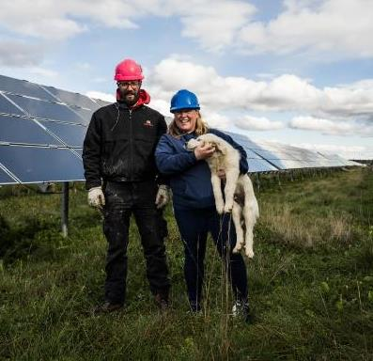
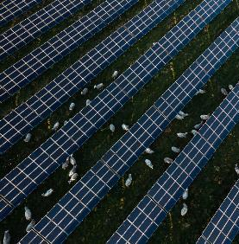
Case study: Arnprior Solar in Ottawa, Canada
1
2
3
Sheep Grazing
Pollinator Habitats
Monarch Conservation
We’ve been able to grow our flock every year, and in 2021, we took on a second site for EDFR. We expect to lamb 500+ ewes in 2022, which is wonderful!
- Chris, Shady Creek Lamb
Arnprior Solar & Shady Creek Lamb Co.
Site built in 2009 on 200-acres
Young couple near Ottawa, Ontario wanted to grow flock by grazing outdoors – needed 400-500 animals to sustain business
Solar grazing PILOT project in 2017
Today, graze Arnprior and other sites – expect to lamb 500+ ewes in 2022
Selling meat to local restaurants and wool to make blankets
See virtual site tour: https://www.youtube.com/watch?v=6dvL_dvu9OA&t=7s

Slide 17
Land Use Considerations– Corn for Ethanol
CORN ETHANOL: One acre of corn produces 551 gallons of ethanol (this is on the high end), which is the equivalent of 386 gallons of gas (70% translation efficiency). Using the average miles per gallon of a US automobile, this equates to 9,691 miles driven per acre of corn per year
SOLAR PV: In Iowa, an acre of solar panels produces 198,870 kilowatt hours each year. A typical EV drives approximately 3.6 miles per kilowatt hour. So, each year, an acre of solar panels produces enough energy for an EV to drive 710,250 miles.
Conclusion: 73x more efficient
Source: Bill Nussey Freeing Energy Study: Efficient Use of Farmland, March 2021
Considerations
Solar
Combined with AgriPV leads to additional benefits – food, fuel and fibre
Will we electrify our transportation sector?
Ethanol
Byproducts can also include distiller grains and glycerine
What is the future and long-term demand?

Slide 18
Start the Conversation - Solar Community Benefits
Offers many benefits on its own – can be amplified when combined with agrivoltaics
People
Economy
Conservation
Technology
Farmers
Keep the land in their family
Long term stable revenue stream without risks of weather and input costs
Jobs
~100 FTE direct jobs possible during construction (per 100 MW)
~2-4 full time jobs during operation and maintenance of the facility (per 100 MW)
Soil
Developers need to preserve topsoil so the land can be returned to farming at the end of life of the solar project
Research
Reduced land use over time - study found that median power density increased by ~ 50% from 2011 through 2019
Solar is becoming more efficient to make same amount of energy on less land
Communities
Significant new revenues for the local community through taxes and host community agreements (some New York State Projects tax per acre of land increases by more than 30x)
Agrivoltaics
Opportunities for farming within the solar projects
Sites can host pollinators and provide ecological services for the area
Engage local farmers and find solutions for expanding farming operations
Local Economy
In some New York communities, solar can create local revenues of >$2,000/acre/yr USD vs $1,000/acre/yr for farming (includes payments for land, community - taxes, operations and maintenance)
Significant investments into the local economy during development (i.e. landowner payments), construction (i.e. material sourcing, labour and hospitality) and operation (i.e. landscaping)
Land Use
Avoid unnecessary setbacks that create unusable land and increase overall solar footprint

Slide 19
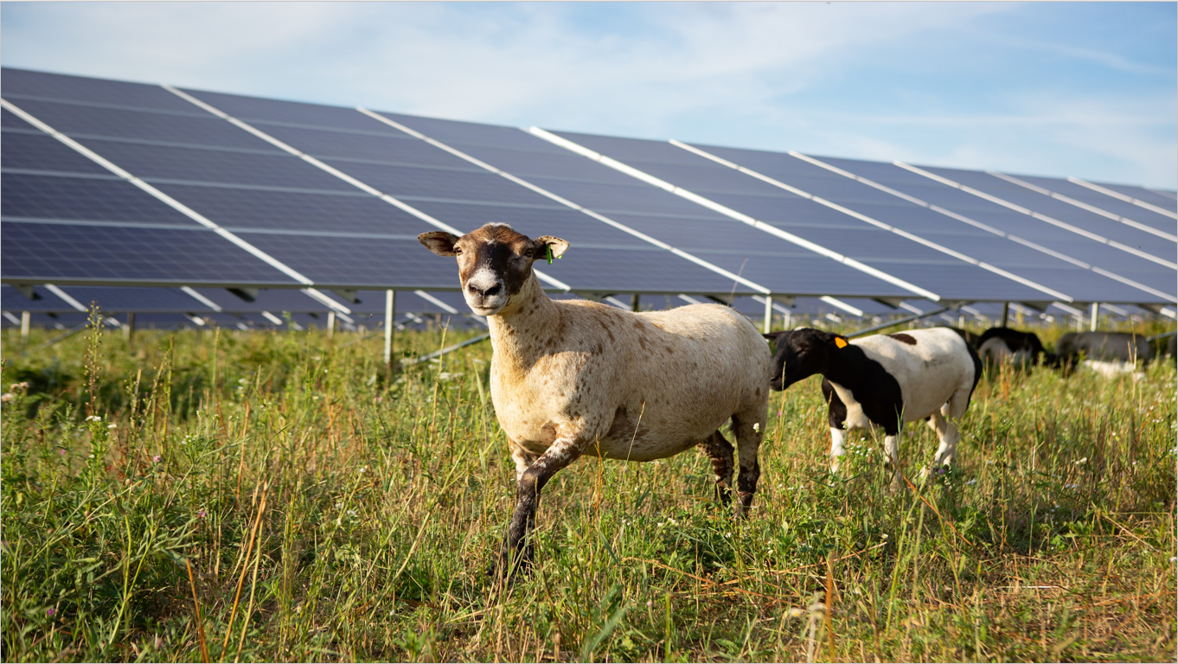
American Solar Grazing Association
800+ Members
45 States
Join or Sponsor ASGA Today!
https://solargrazing.org/join/
We are a community of farmers, solar developers, and innovators who are shaping the future of solar energy and farming. Solar grazing provides a sustainable future for farmers and a cost-effective way to manage vegetation on solar farms. ASGA provides essential resources and education to help support the growth of solar grazing.
Contact: outreach@solargrazing.org

Slide 20
Questions?
Kevin Campbell
Director, Development
Kevin.Campbell@edf-re.com

