Slide 1
Build Your Future in Ontario
Lora Field
December 11, 2023

Slide 2
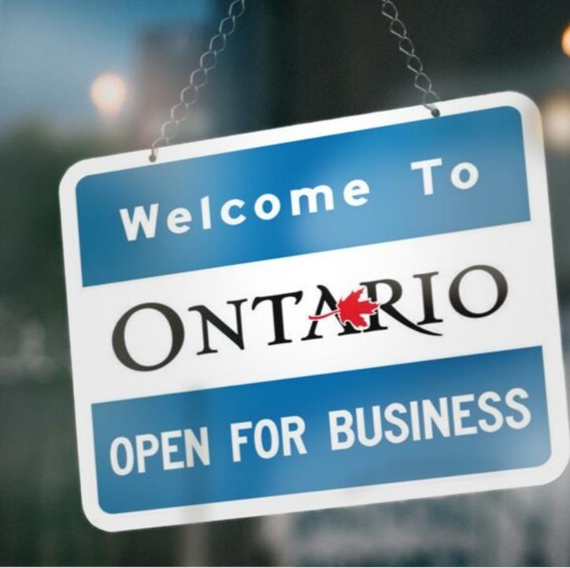
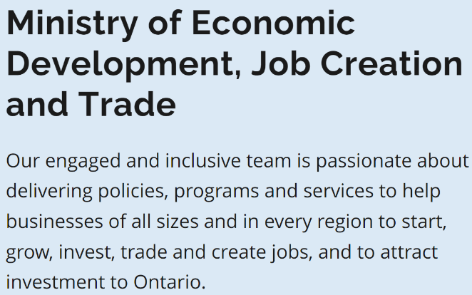

Slide 3
Business Advisory Services
For Ontario’s Small And Medium-sized Businesses
Our Senior Business Advisors provide tailored options, advice, analysis and practical recommendations for unique business challenges.
Senior Business Advisors support small and medium-sized businesses with:
  accessing capital
  assessing organizational strengths and identifying potential opportunities for improvement
  doing business with government
  understanding and navigating government regulations and compliance challenges
  making connections to other provincial ministries, and other levels of government
  networking with other businesses
  making connections with local partners (e.g. to help find skilled staff)
  facilitating discussions and referrals to support business capacity building, such as technology adoption and export readiness programs

Slide 4



ONTARIO
ADVANCED MANUFACTURING
Sault Ste. Marie
Ottawa
Maitland
Manufacturing Clusters
in Ontario
Kingston
Automotive
Chemical and biochemical
Aerospace
Clean Technology
Alliston
Oshawa
Brampton
Waterloo
Toronto
Kitchener
Cambridge
Oakville
Woodstock
Hamilton
St. Catharines
Ingersoll
Niagara Region
London
Sarnia
Windsor

Slide 5
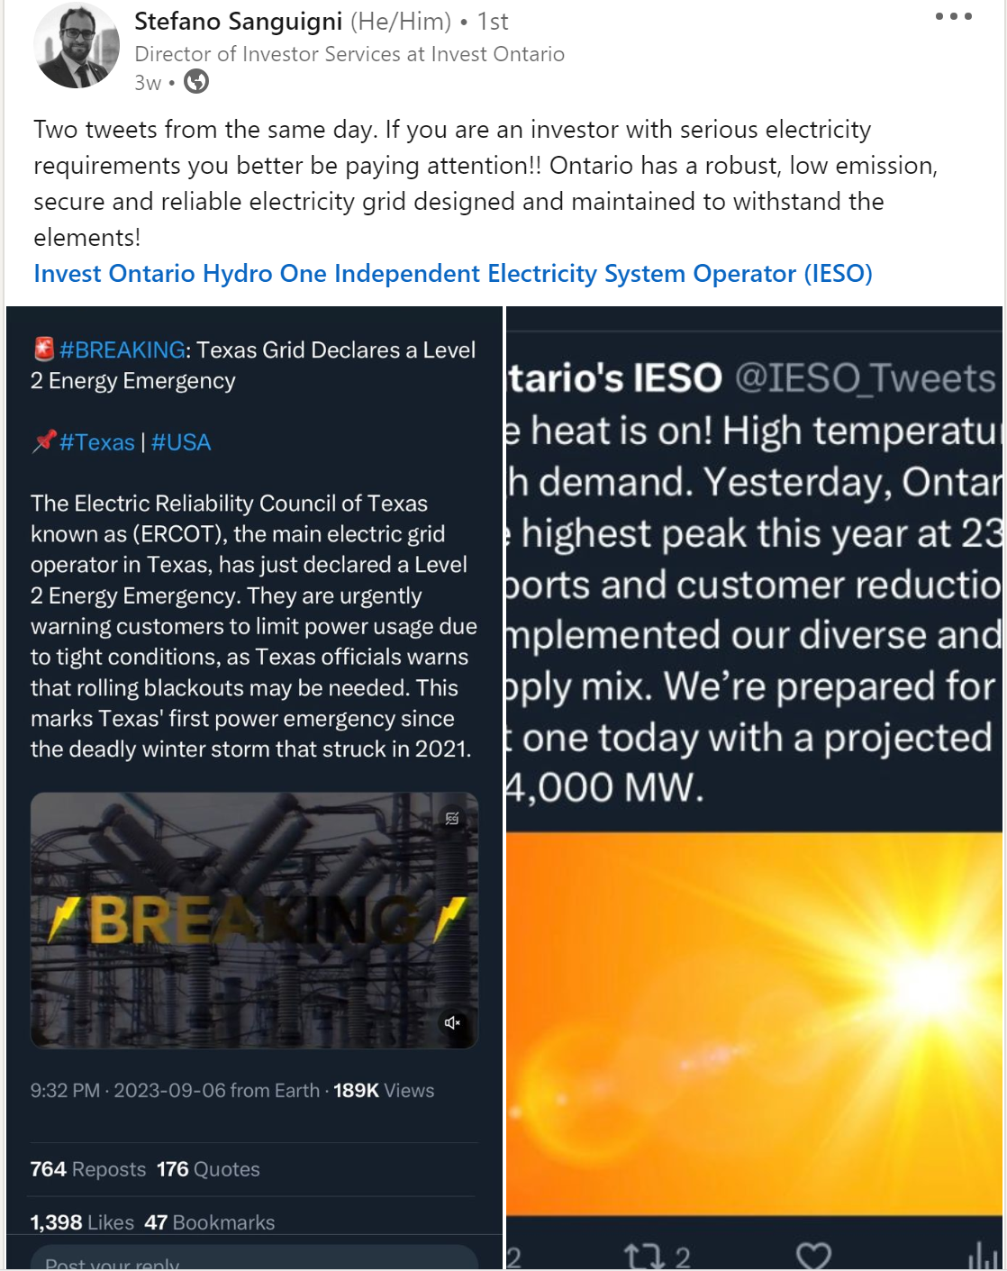
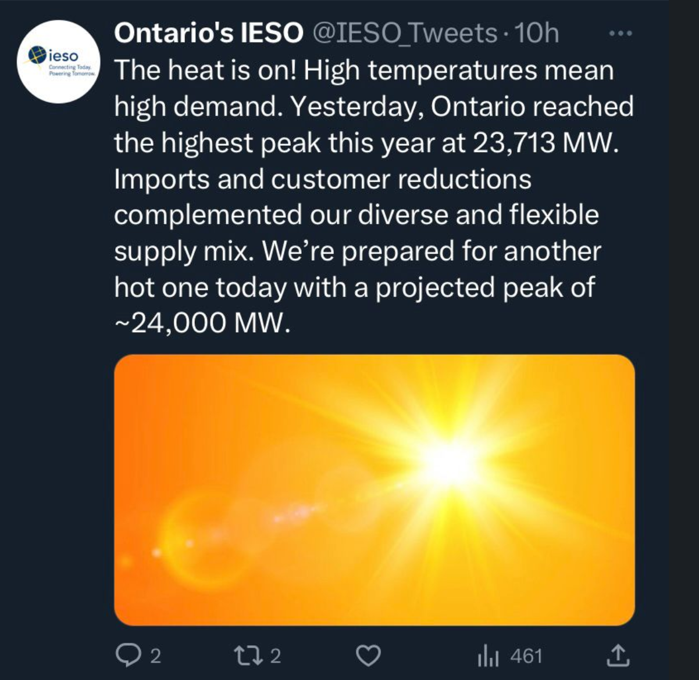
Reliable Electricity Is Critical To Investment Attraction & Retention

Slide 6
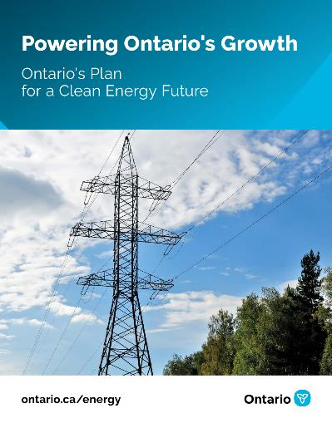
Plan To Meet Increasing Electricity Demand
Powering Ontario’s Growth outlines the actions the province is taking to meet electricity demand over the long-term, including:
Nuclear Energy – Advancing reliable, affordable and clean nuclear power through pre-development work at Bruce Power and three additional small modular reactors at Darlington
Competitive Procurements – Starting to plan for the next long-term competitive procurement of non-emitting electricity resources including wind, solar, hydroelectric, batteries and biogas
New Transmission Infrastructure – Designating and prioritizing three new transmission lines that will power Algoma Steel and job creators in Northern Ontario, and one new transmission line to power growth in the Ottawa region and across Eastern Ontario.
Hydroelectric Power – Asking OPG to optimize hydroelectric generation from current sites and working with IESO to assess two proposed pumped hydroelectric storage projects in Marmora and Meaford to improve grid efficiency
Keeping Costs Down – Starting planning for the future of energy efficiency programming in Ontario to help reduce demand and supporting the deployment of distributed energy resources (DER) such as rooftop solar and the EV batteries
Planning for Future Transmission – Directing IESO to report back to the Minister with transmission options to address system bottlenecks between Toronto and northern Ontario, and into downtown Toronto, to enable growth

Slide 7
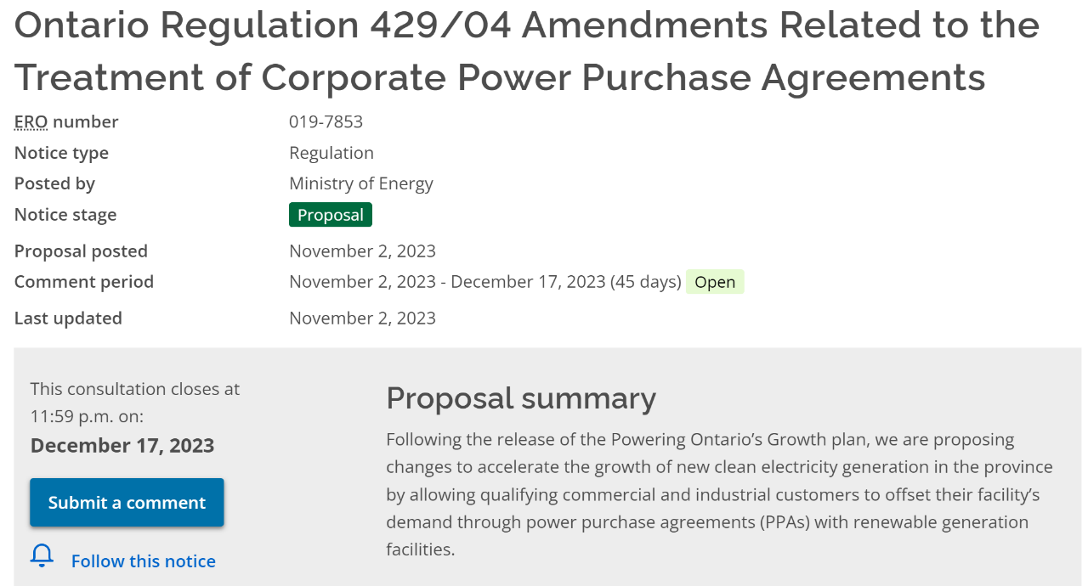

Slide 8
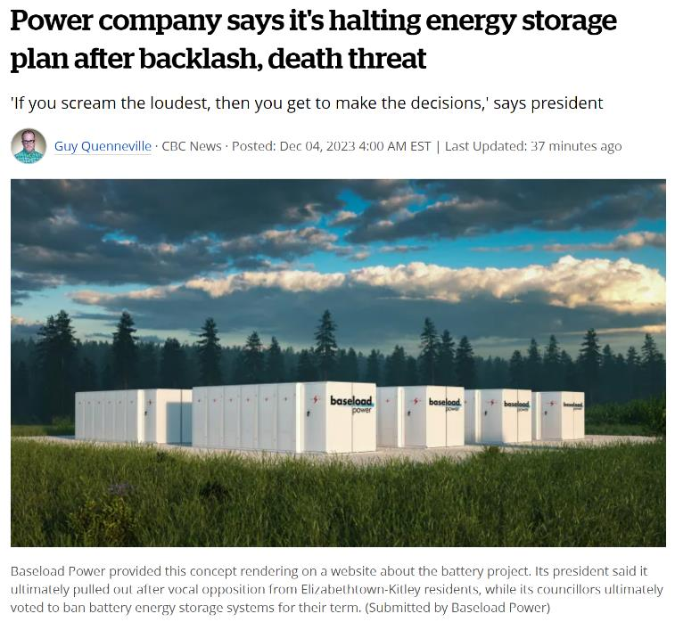
“A Toronto-based power corporation is halting its proposal for an eastern Ontario energy storage facility after facing intense local pushback.”
“The mayor of Elizabethtown-Kitley said the company ultimately failed to gain traction on its project because it did not consult widely or early enough.”
“…Councillors ultimately voted to ban battery energy storage systems for their term.”
Source: CBC News

Slide 9

LEARN MORE
InvestOntario.ca
Lora Field, PhD
Team Leader
Industrial Materials, Clean & Low Carbon Technologies Unit
Advanced Manufacturing Branch
Ministry of Economic Development, Job Creation & Trade
Lora.Field@ontario.ca
(416) 452-6887
FOLLOW US @investontario

