Slide 1


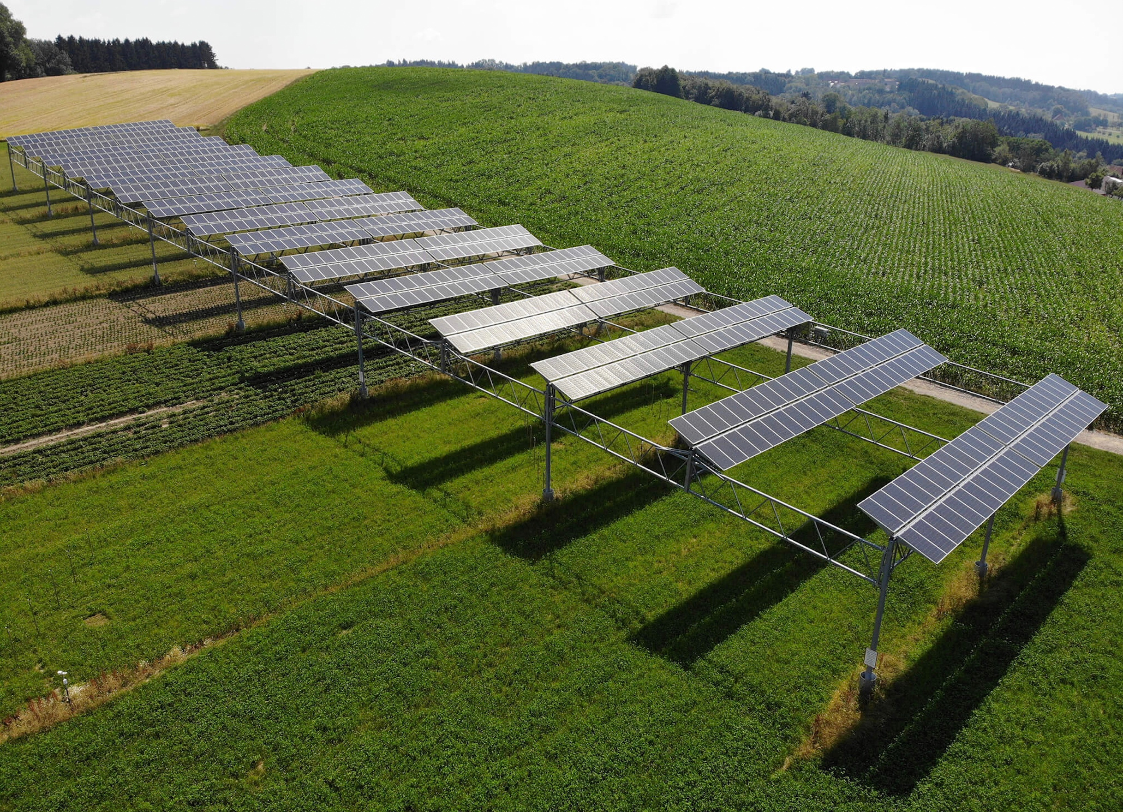
Keeping Agrivoltaics to Technology’s Core
- Sustainability
Claude Mindorff, Director of Development
Dr. Rhonda Millikin, Sustainability Strategist
PACE Canada LP
claude.mindorff@pathfinderce.com

Slide 2


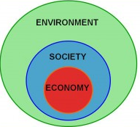
Renewable Energy Projects
Approx. 1.9 GW of solar (and wind) projects of interest
Distribution Projects
Transmission Projects
  Mannix Mine (59 MW)
  Harvest Sky I and II (40 MW)
  Paintearth (330 MW)
  Sheerness III (310 MW)
  Joffre III (300 MW)
  Wind River (up to 700 MW)
  Joffre I and II (47.5 MW)
  Youngstown (6 MW)
  Sheerness I (13 MW)
  Caroline (14.6 MW)
  Viking (9 MW)
  Lougheed (14.8 MW)
  Brooks (26 MW)
  Killam (21.6 MW)
  Wainwright (14 MW)
  Provost (14 MW)
  Bassano (15 MW)
Notes:
Underway and not yet registered with AESO

Slide 3


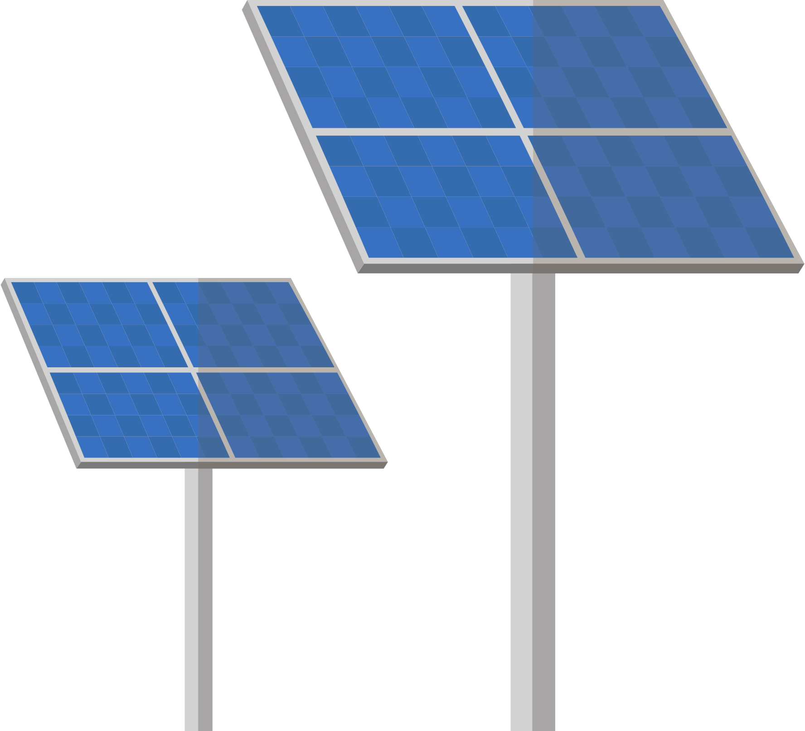










Agrivoltaics - True Synergy
Under an agrivoltaics systems multiple benefits occur across the food-energy-water nexus
Shade from the solar panels reduces evaporation which helps soil retain moisture longer.
Significantly reduces carbon emissions.
Solar panels can be outfitted to collect rainwater and used for irrigation.
Increases crop productivity and land utilization.
Transpiration from plants
cools the panels increasing their efficiency.
Elevated solar panels utilize excess sunlight not needed by plants.
Solar panels create a microclimate which helps protects plants from heat stress, hail, soft frost and wind.
Generates non-traditional farm revenue.
Shaded areas make for better working conditions.
Agrivoltaics results in increased public support for solar energy developments.
Notes:
This slide offers a look at the symbiotic relationship across the food-energy-water nexus.

Slide 4

Soil Analysis *AUC requirements
Soil Quality
Compaction*
Rutting*
Salinity*
Sodicity*
Fertility*
Contamination*
Clubroot*
Hydrology
Topography*
Soil Drainage*
Depth to groundwater*
Soil Quality
Wind erosion*
Water erosion*
Hydrology*
Soil Micronutrients
Iron
Manganese
Boron
Molybdenum
Copper
Zinc
Organism Biomass
Texture
Soil active carbon
Soil microbial respiration
Total bacterial biomass
Total fungal biomass
Organic matter
Soil pH
Bicarbonate
Soil Macronutrients
Nitrogen, Nitrate
Phosphorous, Phosphate
Potassium, Potash
Calcium
Magnesium
Sulfur
Gypsum
AUC requirements are database only. PACE uses actual soil samples in its analysis. As a result, we have moved PDSA from pre-construction to permitting and approval.

Slide 5
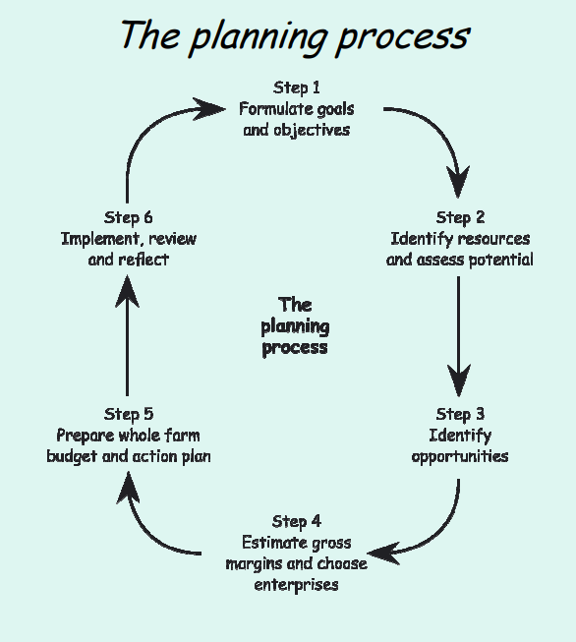
PACE 7-year Farm Plan
Steps to incorporate Agrivoltaics farm plan for PACE
  Recommendations to mitigate concerns (evidence)
  Target outcomes (30% renewable energy, yield/cost)
  GIS pre-dev suitability indices & post challenges
  BACI design (control, fully-replicated) e.g, pre-T attraction & mortality
  Site metrics (land use efficiency (ha/TWh/y))
  Soil health (soil biology, diversity, C sequestration)
  Monitor indicators of efficacy (diversity of farmer income portfolios)
  Microclimate (UV, temp, wind, water; cloud-based probes, GIS+time to link to plant phenology & wildlife behaviour
  Measure growth of 3-4 crops over 4 farms (4x4 sections): a) crops we need to know more about; b) horticulture grouping where we need to go next (high-value, include perennials)
  Year 1-3 rest lands & weed control; aim for 30-50-year surface lease on lands to allow for up to 6-7-year rotations.
  Extra credit for EV machinery, no till, native predator-prey systems

Slide 6
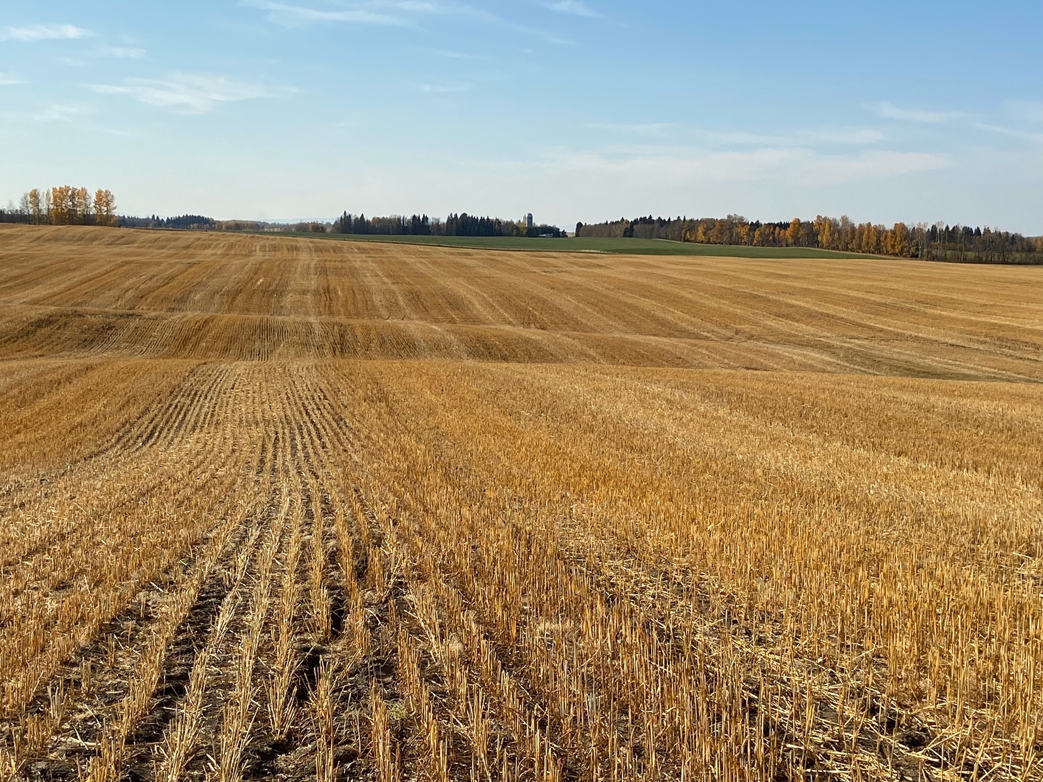
Caroline (14.6 MW)
Bob and Germaine Roper, a fifth-generation farming family, will graze sheep and operate bee hives in harmony with the solar farm development.
Q: how to make grazing system more effective

Slide 7
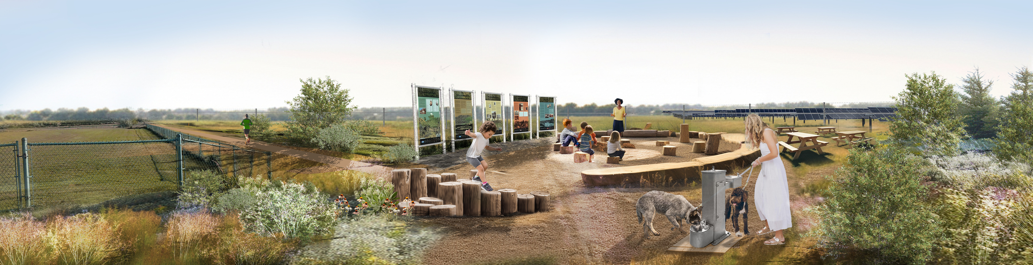
Brooks (Salt Flats) Solar Farm (26 MW)
Testing expanded row spacing, green space, a recreational path and a farm plan.
Candace and Stacey Stein, a 4th-generation farming family, are currently pasturing 6 cow/calf pairs on 160 acres of salt contaminated lands. The land will be cultivated and reseeded with a salt tolerant species to improve soil health in 2024.
HSP proposal to augment SAR habitat with native grasses, pollinator plants, perennial shrubs & trees, and connectivity to wetlands.

Slide 8
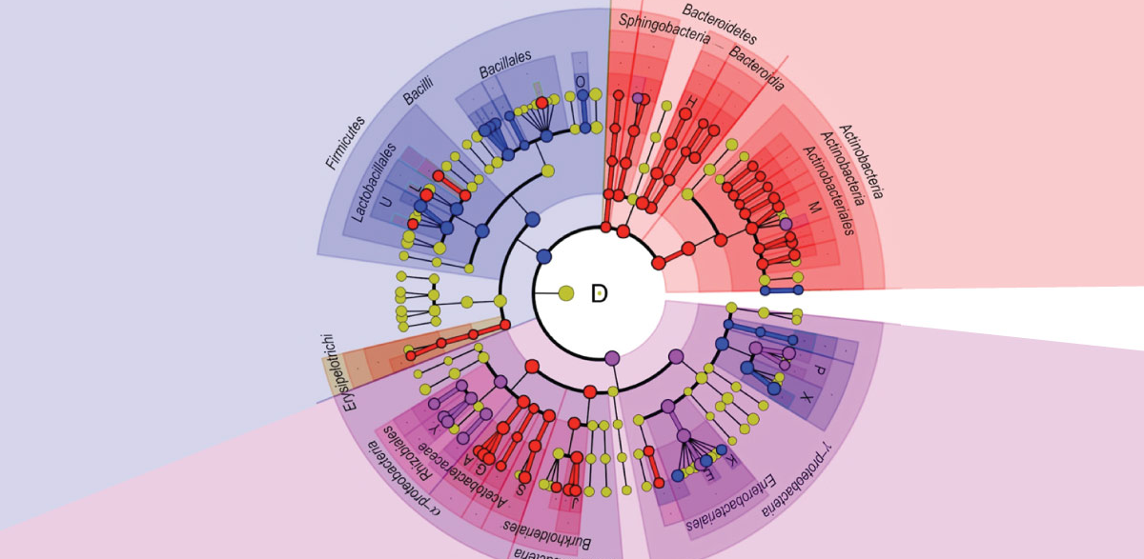
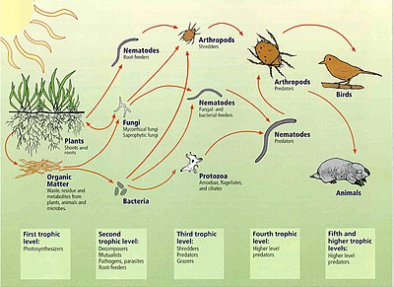
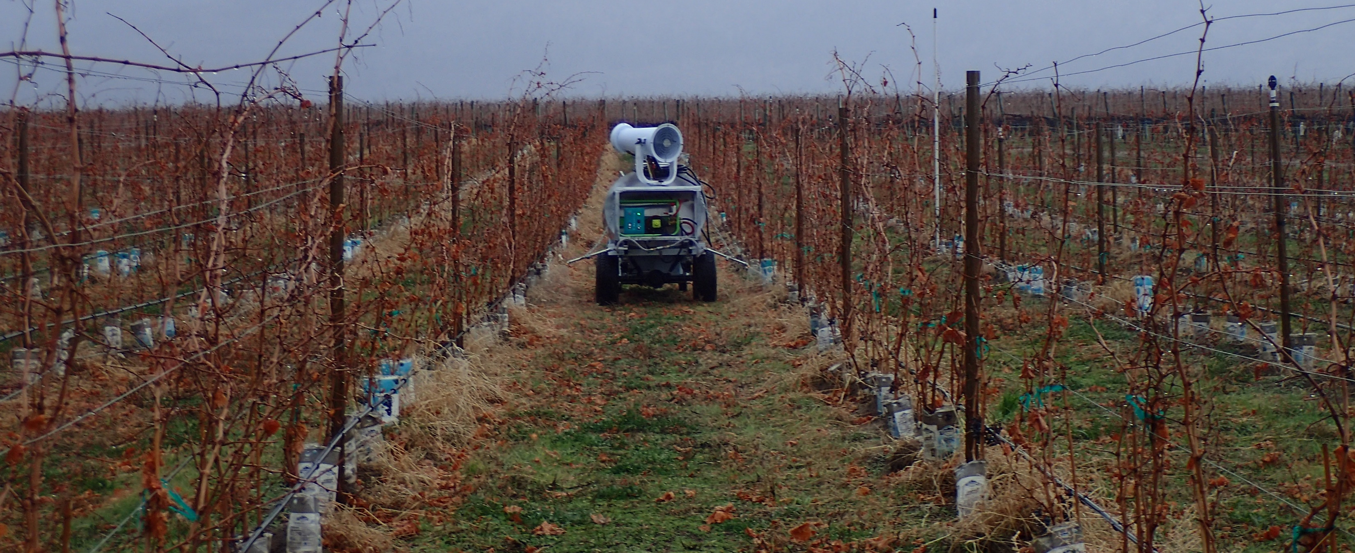

Ecosystem Sustainability for Vineyards
After 2 growing seasons: 96% native plants spreading (27 species), increased SAR bats, CC resilience (OM, water retention, diversity, frost) & flavour profile

Slide 9
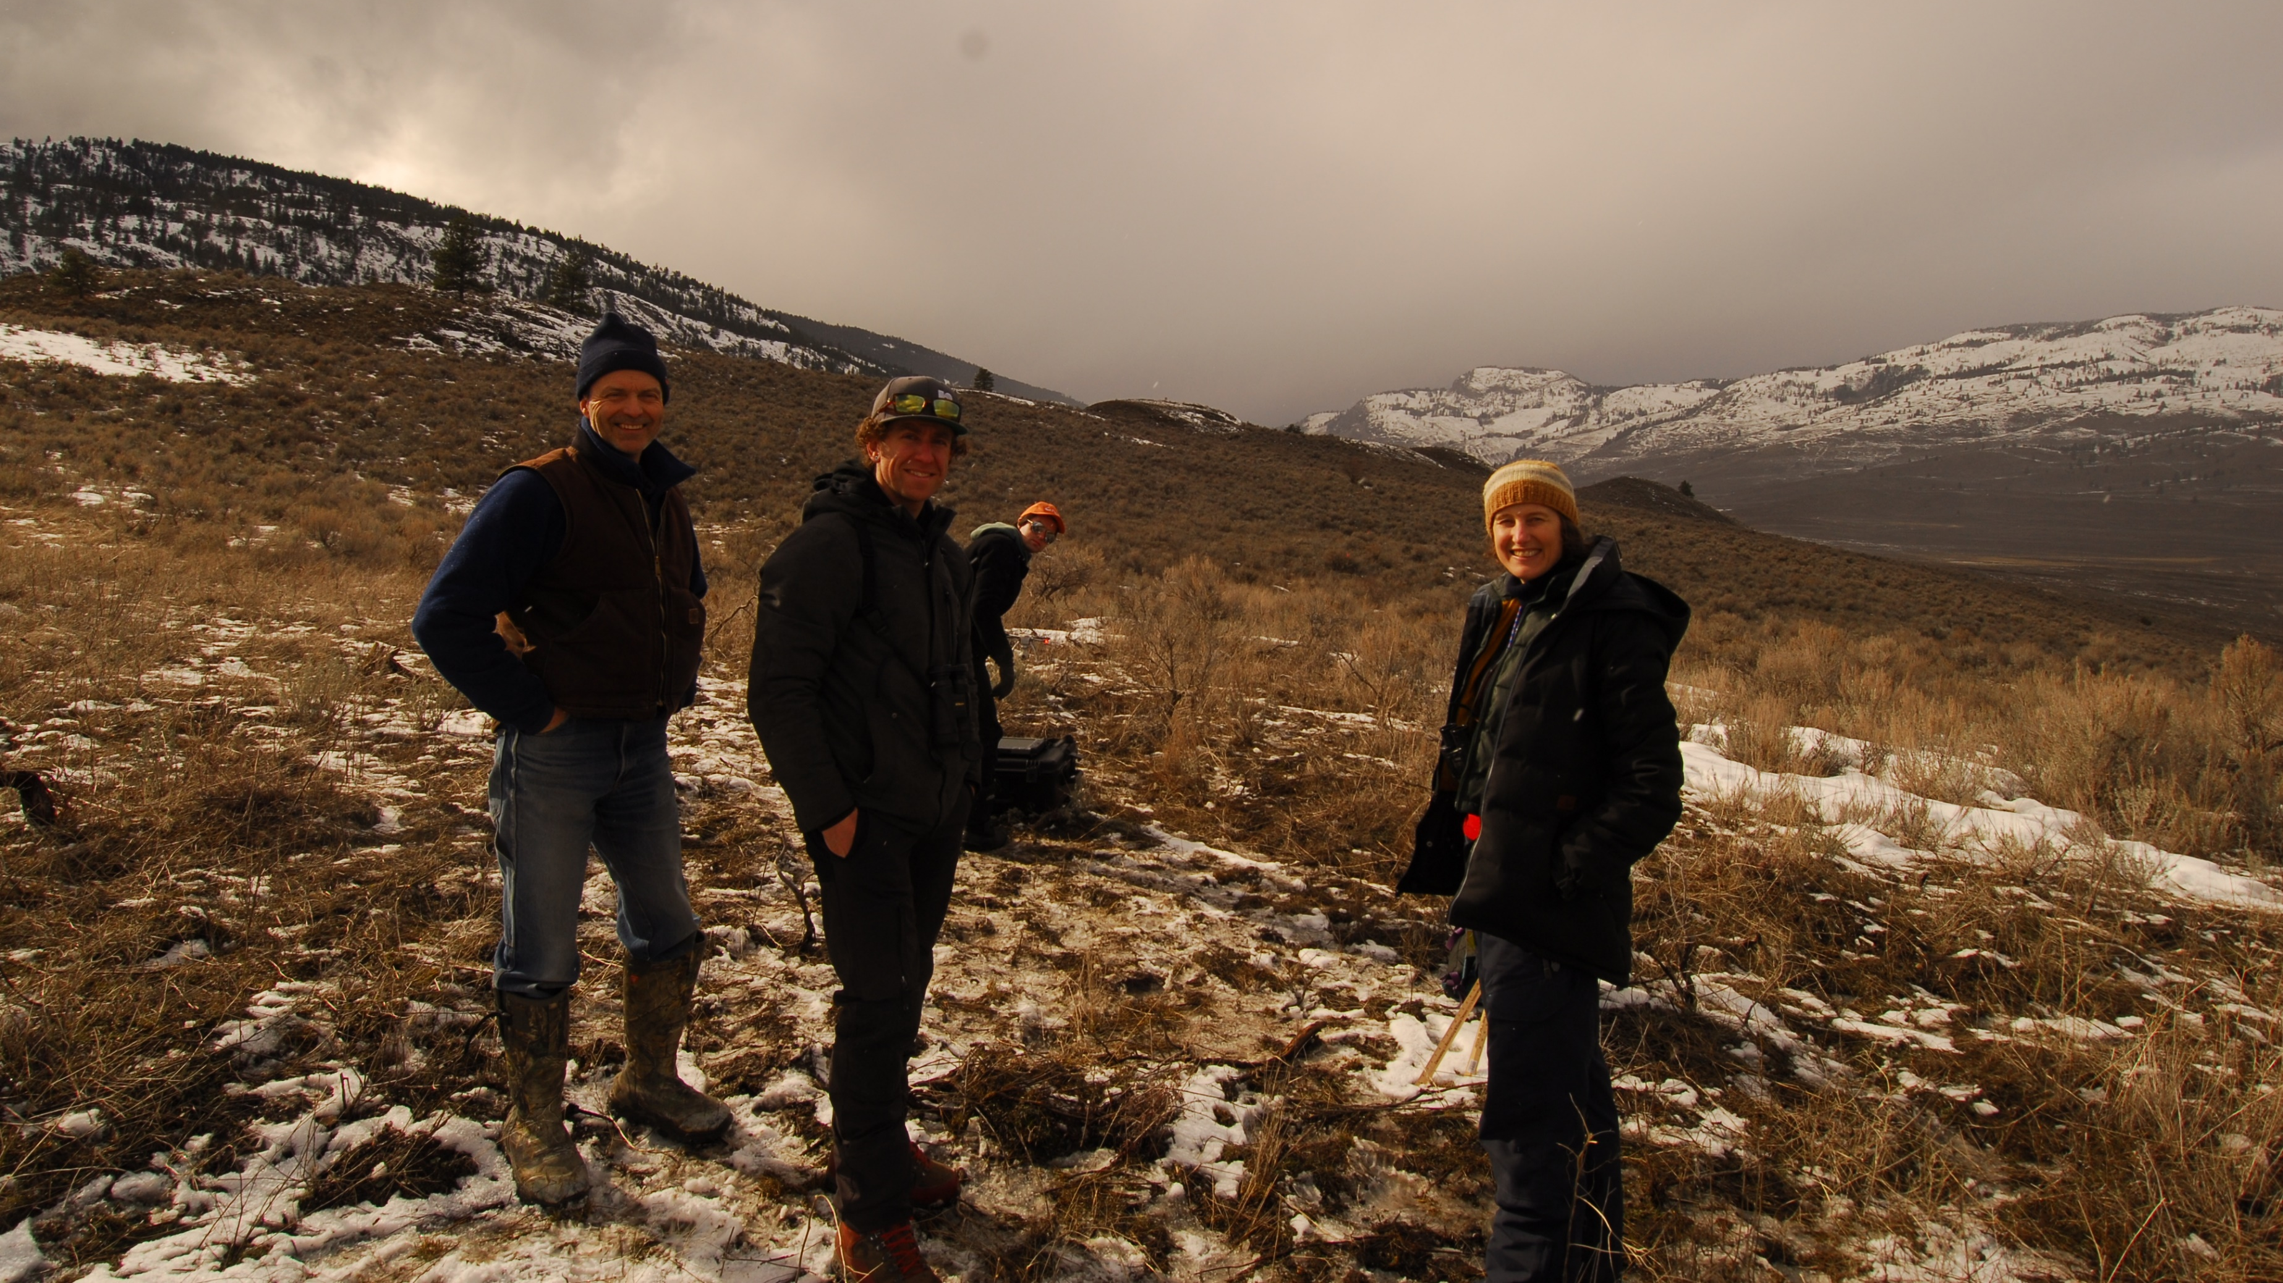
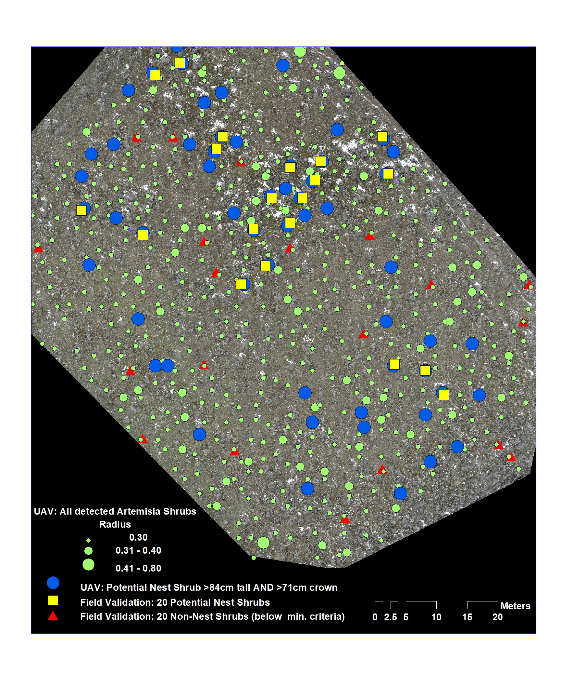
Evaluation of a Drone to assess CH for SATH
Q: more efficiently locate Artemesia shrubs defined as CH without disturbing SAR or cryptogamic layer
Result: a) Drone correctly identified nest bushes 100% of the time & non-nest bushes 65%; b) could estimate shrub canopy cover as a % of assessment area (i.e., suitable habitat); c) could survey in late winter when other conservation work couldn’t be done

