Slide 1

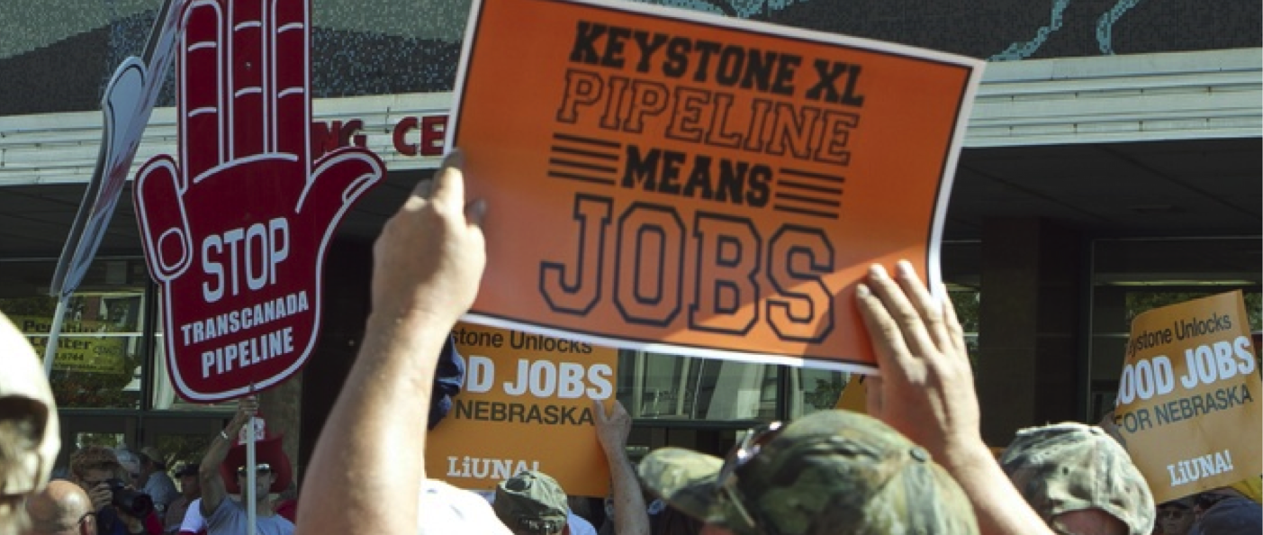
TransCanada’s Keystone XL Pipeline: Learnings and Legacy
Reflections on Keystone XL
Dennis McConaghy

Slide 2
TransCanada
One of North America’s Largest Natural Gas Pipeline Networks
  • 68,000 km (42,000 mi) of pipeline
  • 406 Bcf of storage capacity
  • 14 Bcf/d or 20% of continental demand
Premier Liquids Pipeline System
  • 4,250 km (2,600 mi) of pipeline
    530,000 bbl/d or 18% of Western Canadian Production
Largest Private Sector Power Generator in Canada
  • 19 power plants, 10,900 MW
Market Capitalization, $36 billion, 14th on TSE
Dividend Yield, 4.6%

Slide 3
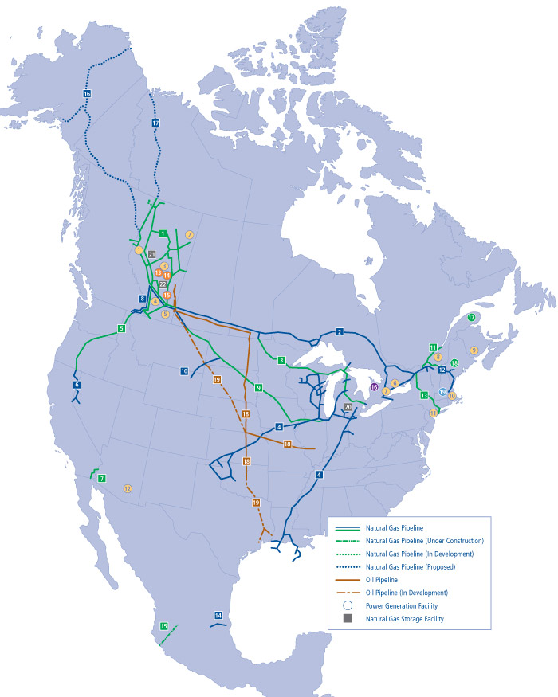
TransCanada Background

Slide 4
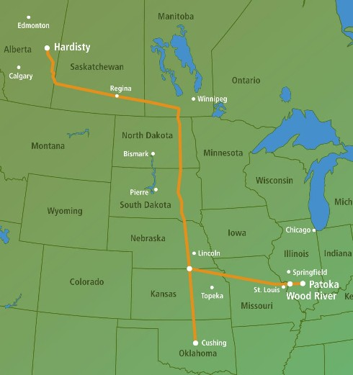
Base Keystone Experience
TransCanada’s Initial Response to Required Oil Sands Transportation Infrastructure
Conversion of Existing Underutilized Gas Pipeline Capacity
Strong Contractual Support
Regulatory Process Unfolded “as expected”

Slide 5
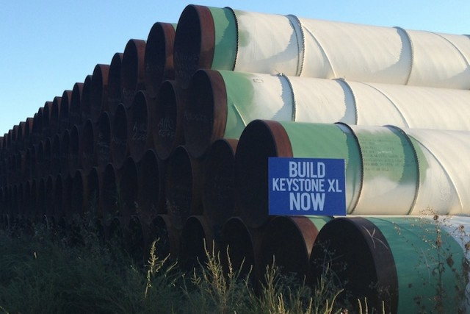
http://drrichswier.com/2015/01/09/veto-threat-president-claims-6-years-isnt-enough-time-study-keystone-pipeline/

Slide 6
Initial Business Case for XL
  XL would represent a direct link from Alberta to the US Gulf Coast for roughly 800 Mbbl/day of Canadian diluted bitumen
  Access to the Gulf Coast would have achieved a maximum netback for Canadian interests
    Removal of mid-Continent price discounts
    Lowest achievable tolls between Alberta and Gulf Coast
    Synergies with Gulf Coast refinery configurations
    Faster transit times
    Better safety fundamentals
    Minimal pipeline impact within Canada compared to alternatives
  Potential to access US Bakken oil volumes

Slide 7
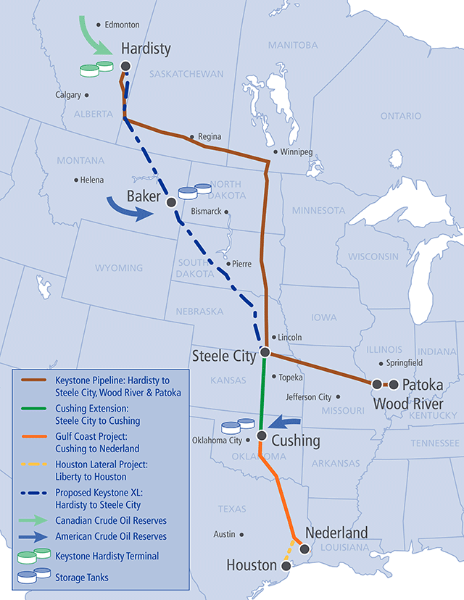
Keystone XL
Route Map

Slide 8
Initial Business Case for XL
Initial expectations were a November 2012 in service date with a toll on the order of $6.00/bbl
Expectations of oil sands growth would require the incremental capacity offered by XL.
  Roughly 2.0 Million bbl/day in 2013 growing to at least 3.2 by 2020
Alternatives to XL not expected to be available until the end of decade
Privately Financed
  TransCanada Balance Sheet, A credit
  Strong Counterparty Credits
  Long term contractual commitments
  Attractive risk adjusted returns to TransCanada

Slide 9
How could a rejection of XL have happened?
Things that were known or believed when project was conceived and committed to, circa 2007-2008
  A Presidential permit was required to cross the border
  Barrack Obama would be the President to make this decision
  Pipeline projects with commercial support had always achieved regulatory sanction
  Oil sands production was fundamentally “in the money” long term, validated by contracts with strong counterparties
  Landowner issues would arise but could dealt with traditional remedies
  Construction and operating challenges related to the project were seen as eminently manageable
  Efforts to deal with climate change would continue as global issue
  Carbon intensity of Canadian oil sands production acknowledged, but not seen as a “showstopper”

Slide 10
How could a rejection of XL have happened?
What was not expected?
  Canadian oil sands evolving as a pariah to the US ENGO movement, “carbon bomb”
  Routing through Nebraska becoming very problematic
  Breakdown of carbon pricing as a policy option in the United States
  Impact of Macondo and Kalamazoo incidents on public’s safety concerns related to oil transport and handling
  Obama to not validate his own bureaucracy in terms of their environmental assessment and national interest determination related to Keystone XL – “no material environmental impact”

Slide 11
Was the US process “fair” to Canada?
Three environmental assessments by the Department of State validated the project as “acceptable” to “no significant environmental” impact
Twice “due process” was disrupted to avoid a decision relative to US election cycle
Standard for approval evolved and never genuinely explicit
  Materiality of related incremental emissions attributable to product carried in XL
  Climate effects vs routing/safety
  Acknowledgement of net economic benefits
No initiative to bilaterally resolve the issue via direct negotiations
  What did Obama want out of Canada on carbon policy to rationalize an approval?

Slide 12



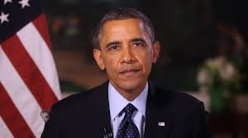
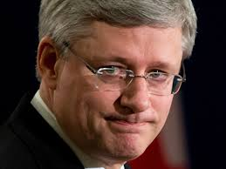
Keystone XL Protagonists

Slide 13
What has the loss of XL cost Canada?
Direct Cash flow lost to Canada
  Loss of improved transportation economics, $2 – 3 billion/yr
  Loss of capacity to move incremental barrels , on the order of $20 billion/yr
  A Tipping Point ?

Slide 14
Is the loss of Keystone XL a tipping point for Canadian hydrocarbon development?
ENGOs have learned that obstruction of hydrocarbon transportation infrastructure can work given existing regulatory/ judicial processes and political sentiments in North America
Admittedly, circumstances of Keystone XL were very fortuitous for the US ENGOs to exploit
But same techniques at work on Gateway, Kinder and Energy East
What is not explicitly constrained at the production level becomes de facto constrained by the lack of transportation infrastructure
A resource the world still demands Canada de facto constrains itself from supplying

Slide 15
Was the basic business opportunity for the Keystone XL pipeline sufficiently attractive to justify TransCanada’s pursuit of it in 2008?
Unequivocally yes
Any probability assessment of the project not achieving regulatory sanction undertaken in 2008/2009 would be been extremely low

Slide 16
Was it reasonable for TransCanada to assume full accountability for delivering the project within a fixed time frame given its lack of control over the regulatory process?
Retrospectively that risk proved to be much greater than it was assessed to be in 2007/2008
Some party had to take the risk achieving regulatory approval within the desired in service date
If TC has assessed the risk differently, closer to what it actually proved out to be, there would have been a different allocation of the risk or the project would not have had requisite contractual support

Slide 17
Should TransCanada have abandoned the project in November 2011 when the Obama Administration deferred the regulatory process?
TC gained real value from completing the section of Keystone XL south of Cushing. That could only have been achieved by persisting with the overall project, at least for some time
Obviously at some point, after that section was constructed, TC might have reached the conclusion that the Obama administration would never provide an approval
In the context of November 2011, however, that determination would likely not have been seen as the “reasonable view”

Slide 18
How could a rejection of XL have been avoided? Were there other tactics that could have been pursued, before or after 2011, to gain a favorable outcome?
Tactics not taken?
  A earlier re-route through Nebraska
  Adjustments to Canadian carbon policy
    Carbon taxes to redeem incremental emissions related to XL

Slide 19
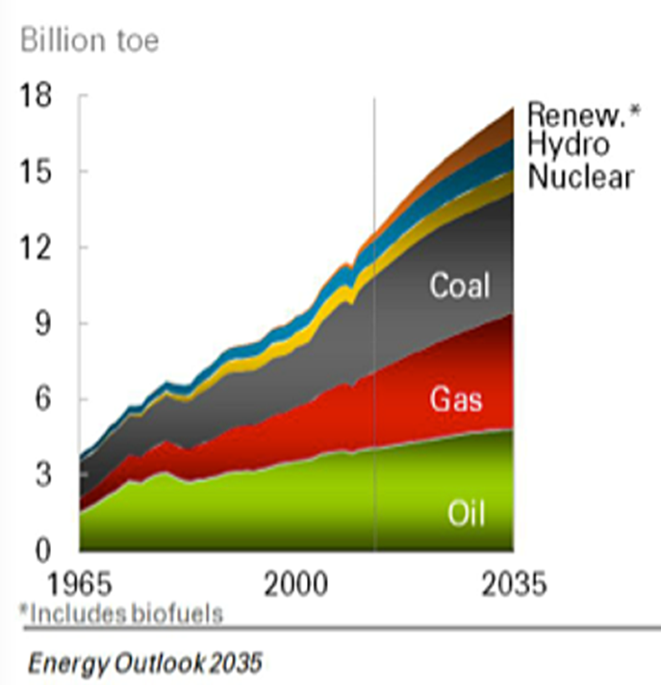
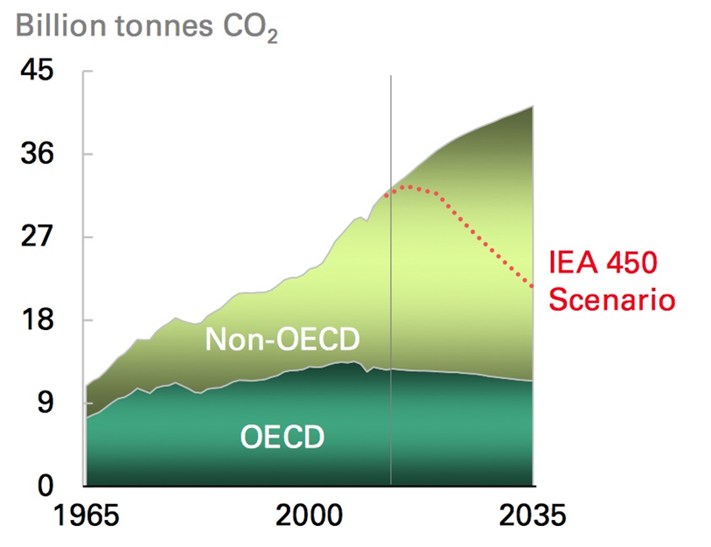
Conundrum – Expected Global Energy Demand/ Resulting Emissions
2015 BP Energy Outlook

Slide 20
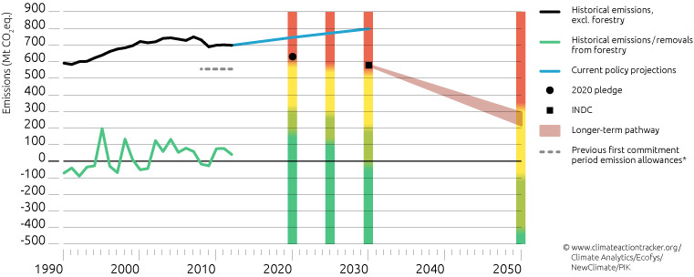
Keystone XL/Canadian Oil Sands /Carbon Emission Targets

Slide 21
Does Canada still identify with exploiting its hydrocarbon potential?
Hydrocarbon potential can be rationalized to credible climate policy via appropriate carbon tax regime.
Global demand for hydrocarbons robust over the short and medium term notwithstanding efforts to deal with the risk of climate change
But the Canadian political process remains fundamentally equivocal about exploiting its hydrocarbon potential .
  Consider the status of Gateway, KinderMorgan, Energy East
  Regulatory sanction versus litigation and lack of enforcement

Slide 22
Public Policy Implications of Keystone XL Rejection
Market Diversification
  The XL experience underscored the vulnerability of Canada as to how the US deals with required transportation infrastructure for Canadian hydrocarbons into the US
  In fact continued election of Democratic Presidents will likely follow the Obama legacy in terms of how the Keystone XL rejection was rationalized
  Regardless of the US being the most economically logically market for Canadian oil sands derived crude oil, incremental transportation access to tidewater is now a national imperative if Canada is to salvage its hydrocarbon potential

Slide 23
Public Policy Implications of Keystone XL Rejection
Carbon Pricing
  Whether the outcome related to Keystone XL vis a vis the Obama administration would have unfolded differently if Canada had embraced a legitimate national carbon pricing regime can be debated
  But it is the only policy option that could have rationalized increased absolute emissions attributable to Canada post Keystone XL and higher incremental emissions attributable to oil sands derived crude oil carried on Keystone XL would have been a national carbon pricing regime
  Without carbon pricing, how does Canada preserve its hydrocarbon potential?

Slide 24
Public Policy Implications of Keystone XL Rejection
Market Access Restored
  If Canada still wants to preserve its hydrocarbon potential, is it prepared to actually realize the necessary transportation infrastructure make that potential real?
  However, the demands of the Canadian environmental movement is to contract even the current exploitation of the oil sands resource regardless of its economic contribution to Canada
  The battleground is how the Canada actually deals with actual pipeline projects for both oil sands crude and LNG
  Even if Canada were to impose on itself a credible national carbon tax, it is prepared to restore the current deficiencies in respect of actually realizing market access via major pipelines?
    Due process respected
    All Canadians subject to Canadian law
    Free trade between provinces a practical reality

