Slide 1
Perspectives on Canada’s Market Access Crisis for Major Hydrocarbon Infrastructure
DJ McConaghy
Visiting Fellow
Ivey Energy Policy and Management Centre
Lawrence National Centre for Policy and Management
February 1, 2016
1:00 pm – 2:00 pm

Slide 2
Gateway Map

Slide 3
Project Status
Gateway
500K bbl/day dilbit via Kitimat
Application in May 2010
Federal permit granted 2014
Continued efforts to meet NEB conditions including greater aboriginal alignment – yet to apply for leave to construct
The federal Liberal government has signaled it intends to formalize a tanker ban on B.C.'s north coast.
BC Supreme Court decision on “equivalency”/inadequate consultation

Slide 4
Trans Mountain Expansion Route

Slide 5
Project Status
Trans Mountain Expansion
Capacity of 890,000 barrels per day
Current capital cost estimate roughly $6.0 billion CDN
Route follows the existing Trans Mountain right of way, Edmonton to Burnaby
Kinder Morgan filed its regulatory application for the Trans Mountain expansion in late 2013
Currently in final argument phase but various litigation efforts to suspend the process
BC government has now formally opposed the project in final argument based on concerns about increased tanker traffic and inadequate mitigation of related risks

Slide 6
Keystone XL Route

Slide 7
Project Status
Keystone XL
November 14th 2015 Obama denies TransCanada permit that would have allowed Keystone XL to cross the US border
In January 2016, TC launches two claims against the Obama administration, one to reverse the Presidential decision, the other for $15 billion in damages
Coming after seven years of protracted regulatory review, denial is rationalized on the damage to Obama’s credibility at the upcoming Paris climate conference
TransCanada now faces a $2.4 – $2.7 billion write down on costs expended on Keystone XL
No tangible support from the Trudeau government upon its election to help salvage the project or assist TC’s litigation

Slide 8
Energy East Route Map

Slide 9
Project Status
Energy East
Alberta to New Brunswick pipeline , relying on the conversion of 3,000 kilometers of existing gas pipelines capacity to oil service​
New build from Ontario/Quebec border to New Brunswick​
Originally filed with the NEB in late 2014, the project filing has been amended to remove an oil terminal in Québec from the scope of the project. ​
Expectations are that the NEB will deem a complete application for Energy East later this quarter​
Current capital cost estimate approach $16 billion, CDN​
Similar litigation and opposition encountered by EE as is facing Trans Mountain ​
At present neither Quebec or Ontario has formally opposed the project​

Slide 11
Recent Developments – Litany of Dysfunction​
North BC Coast Moratorium on Crude Oil Tanker Traffic​
Prime Minister Justin Trudeau has called for a moratorium on crude oil tanker traffic for B.C.'s North Coast.​
Trudeau outlined the directive in a mandate letter to Canada's transport minister, Marc Garneau​
No rationalization referenced in the mandate letter to justify the ban​
Only rationale is to ensure the demise of Gateway​

Slide 13
Recent Developments – Litany of Dysfunction​
Clark Government Formal Opposition to Kinder Morgan Trans Mountain Expansion ​
After close to six years of development and three years since the filing of the NEB application , the government of Christy Clark comes out in its final written submission to the NEB process against the Kinder Morgan ​
Rationale “not offering sufficient details of its spill-response plans”​
Notwithstanding Kinder Morgan complying with 150 draft NEB conditions ​
Rejecting also referenced inadequate aboriginal support and deficiencies of BC’s “fair share”

Slide 14
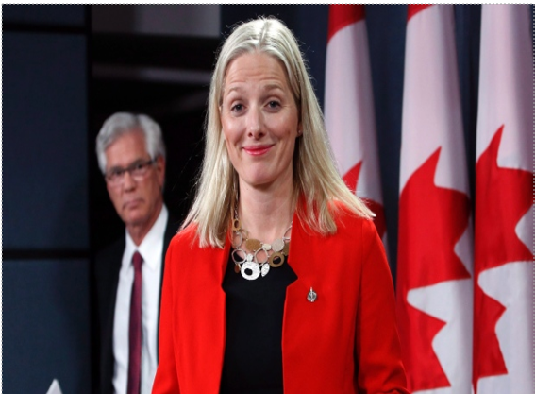

Slide 15
Recent Developments – Litany of Dysfunction
Carr Mandate Letter – changes to Canadian regulatory processes for major hydrocarbon projects​
“Immediately review Canada’s environmental assessment processes to regain public trust”​
Restore robust oversight and thorough environmental assessments of areas under federal jurisdiction​
Ensure that decisions are based on science, facts, and evidence, and serve the public’s interest​
“Modernize the National Energy Board”​
Sufficient expertise in fields such as environmental science, community development, and Indigenous traditional knowledge​
January 27, Carr/McKenna confirm “new process”​
Includes extension of existing statutory timelines for both EE and TMP​

Slide 16
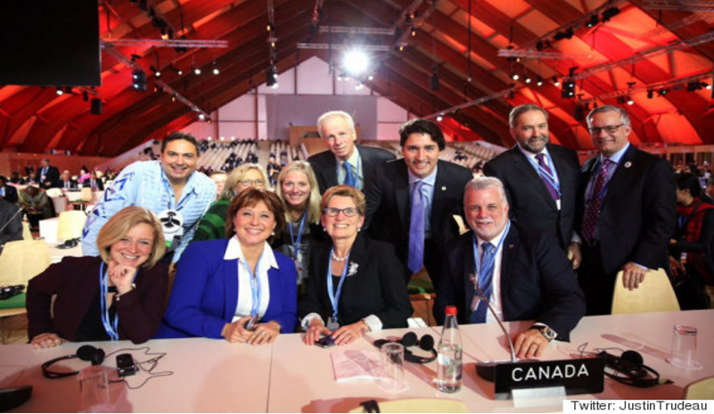

Slide 17
Recent Developments – Litany of Dysfunction
Trudeau musings on more stringent Canadian emission reduction targets and Canadian hydrocarbon development​
“Canadians expect their government to be responsible around climate change”​
“Canada is going to be a strong and positive actor on the world stage”​
Canada is back…we're here to help.“​
“Set a date to meet with provincial and territorial leaders to develop a pan-Canadian framework for addressing climate change”​
“In partnership with provinces and territories, establish national emissions-reduction targets... recognizing the economic cost and catastrophic impact that a greater-than-two-degree increase in average global temperatures would represent”​
“We are all in this together” via Tweet​
“…wanted world leaders to know Canada more for its "resourcefulness" than its resources”​

Slide 19
Recent Developments – Litany of Dysfunction
Montreal Areas Mayors Opposition to Energy East​
82 Montreal-area municipalities with 3.9-million inhabitants​
Codere :​
“Environmental risks outweigh the meagre economic benefits the pipeline would bring to Quebec”​
“The era in which “the Queen can do no wrong,” is over in Canada”​
No municipal environmental review apparently conducted to come to this determination , however, Codere observed:​
Financial benefits of $2 million a year according to Transport Canada estimates and internal analyses​
The cost of a major spill in the greater Montreal region could run between $1 billion and $10 billion​

Slide 20
Recent Developments – Litany of Dysfunction
BC Supreme Court Decision on “equivalency”​
A finding that the BC government entering into an equivalency agreement the federal government , ( in which British Columbia gave the National Energy Board the power to carry out the environment review of Northern Gateway), "breached the honour of the Crown" by failing to consult with the Gitga'at and Coastal First Nations”​
The consequence:​
The equivalency agreement is invalid and the province must make its own decision on Northern Gateway — after consulting with and accommodating First Nations along the route.​
Notwithstanding, Northern Gateway has had a federal permit in hand — with 209 conditions attached — since mid-2014.

Slide 21
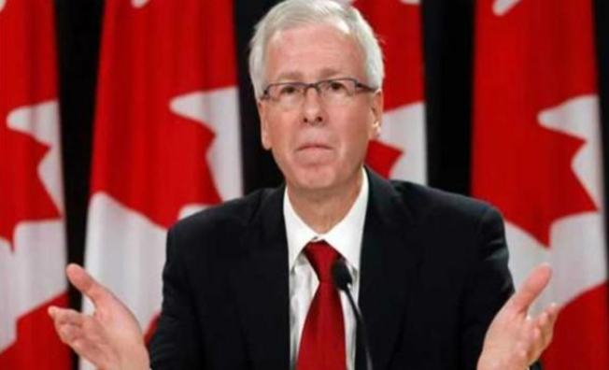

Slide 22
Recent Developments – Litany of Dysfunction
Trudeau Government “MIA” in respect of Keystone XL​
No intervention with the Obama administration to salvage the project , post election​
Indifference to the Obama rejection​
“No comment” , no support for TransCanada’s litigation against the Obama administration re its rejection of Keystone XL

Slide 23
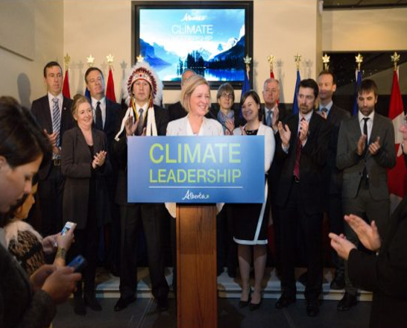

Slide 24
Recent Developments – Litany of Dysfunction
Alberta Carbon Policy – “no quid pro quo”​
Notley administration’s carbon policy lack of any tangible “quid pro quo” on market access​
No conditionality on a breakthrough on market access​
No evidence of any “stand down” on environmental resistance to major Canadian pipeline infrastructure​
No tangible assurance from Trudeau administration of approval for any actual major hydrocarbon pipeline proposal

Slide 25
Private Sector Realities
Development Dollars at risk​
Likely on the order of half billion per project​
All equity dollars at risk​
Prudence of persisting with regulatory process ​
Collapsing Commodity Prices​
Strained cash flow​
Capacity to persist with the regulatory process​
Higher taxation ​
Alberta carbon and corporate taxes​
Federal tax increases ​
Alberta royalty review – a bullet dodged​
Fundamental Uncertainty of the Regulatory/Legal/Political Process impacting Approvals of Major Hydrocarbon Infrastructure​
“Yes” must be fundamentally highly probable ​
Otherwise risk becomes untenable ​
Capital will react

Slide 26
Realities of the Canadian Economy
25% of the value of the Canadian exports comes from the energy sector​
10% of Canadian GDP attributed to Canadian energy sector​
Energy investment close to 50% of capital investment in Canada for 2014​
“Energy superpower” to what?​
Competitive advantage realities​
Lack of scale​
Capacity to invest in alternatives?

Slide 27
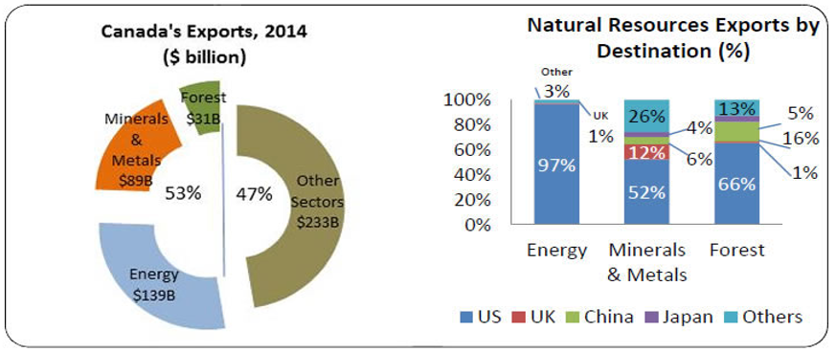
What Hydrocarbons Mean to Canadian Economy
http://www.nrcan.gc.ca/publications/key-facts/16013#a3​

Slide 28
Implausibility of Canada’s Current INDC Commitment​
Existing Canadian GHG emissions , roughly 700 megatons/year​
Existing Canadian INDC requirement , roughly 250 megatons/year by 2030​
Emissions attributed to Canadian upstream sector, roughly 250 megaton/year​
Potential from eliminating coal in Alberta , approx. 50 megatons​
Allowance for growth in Canadian economy vs Carbon taxes at Alberta level as a national standard​
Any viable path to achieve even current reductions?​
No growth in hydrocarbons , or hydrocarbon infrastructure​
Mandated contractions in hydrocarbon output​
Economic contraction from long term price collapse in hydrocarbons?

Slide 29
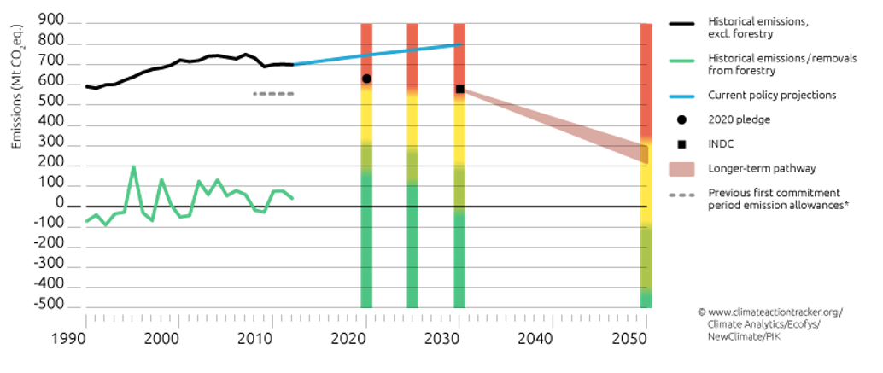
Canada’s INDC in Context

Slide 30
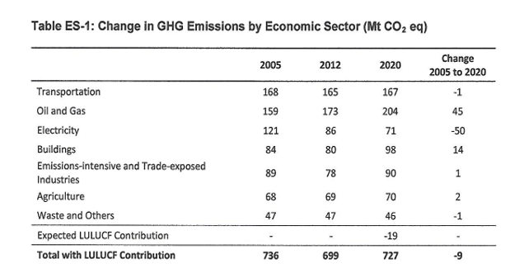
Current NRCAN Emissions Projection
http://ec.gc.ca/ges-ghg/E0533893-A985-4640-B3A2-008D8083D17D/ETR_E%202014.pdf

Slide 31
Alberta’s Contribution as per Notley Climate Plan
Our policy architecture is expected to reduce​ emissions from current trends by approximately 20 Mt by 2020, and approximately 50 Mt by 2030. This​ would roughly stabilize emissions, by 2030, just above current levels at approximately 270 Mt.
http://www.alberta.ca/documents/climate/climate-leadership-report-to-minister.pdf

Slide 32
What the Paris Commitment Really Is
Article 2 of the Agreement reaffirms the goal of limiting the global average temperature increase above the pre-industrial level to 2 degrees C, and adds 1.5 degrees C as something even more aspirational. In my opinion, these aspirational goals – which come not from science (although endorsed by most scientists) nor economics, and may not even be feasible – are much less important than the critical components of the agreement: the scope of participation through the INDC structure, and the mechanisms for implementation (see below).​
http://www.robertstavinsblog.org/2015/12/12/paris-agreement-a-good-foundation-for-meaningful-progress/

Slide 33
Real Policy Options to Salvage the Canadian Hydrocarbon Industry – Going Forward
Canada on Climate Policy ​
Embracing carbon pricing via carbon taxes as the pre-eminent policy instrument​
Paying the tax is a license to emit​
Canada will meet the explicit or implicit price the US is actually prepared impose on its own economy​
Targets are aspirational not binding obligations ​
A growing Canadian hydrocarbon industry may not be inconsistent with a lower carbon intensive future​
Can it afford the tax?​
Re-invent Canadian Regulatory Process for Major Hydrocarbon Infrastructure ​
Existing process , let alone making it more obstruction-friendly, is untenable going forward to attract capital to undertake the risk of obtaining approval​
An initial , efficient process to achieve a determination of public interest​
“Show-stoppers”, if any, identified early​
Regulators/governments must deal with them ​
Within fixed time limits​
Limited judicial review​
Second phase to fix conditions​
But within the context of having already made a finding of public interest​
Required Federal Clarifications​
Primacy of Federal Determination of Public Interest​
All Canadian land owners subject to certain remedies available to infrastructure developers​
“Transit taxes”, explicit or implicit, are not available for one province versus another​
A federal permit is “social license”

Slide 34
Real Policy Options to Salvage the Canadian Hydrocarbon Industry – Near Term
Few easy options available for Trudeau government ​
Walk back federal positions ​
Regulatory reform ​
Carbon review​
Tanker moratorium​
More stringent carbon targets​
Discover carbon taxes more authentically​
Provide sufficient assurance to ensure the Kinder and TC persist with existing regulatory process​
“Yes” not just more process​
Energy East is not simply Keystone XL redux​
For Alberta​
Notley, per se, has no real “bullets” left​
Reliant on Federal Government ​
Four years until other options are available

