Slide 1
Wholesale market design
Richard Green
16 October 2023

Slide 2
Context – short-term and long-term issues

Slide 3
Gas spot prices
€/MWh
€/MMBtu
Sources: Refinitiv and EIA
Notes:
The three European markets are highly correlated, despite different proportions of gas coming from Russia. Spot LNG in Asia also has a very similar pattern (contracted sales would be different). US prices remain far lower, with the exception of the Texas winter crisis of 2021.
All series are to the same scale; the right-hand axis shows that 100 mmBTu (the units used in the US and some other markets) are equal to 341 MWh (the units used in European markets). Dollar prices for Asia and Henry Hub converted to Euros at the daily exchange rates given by Refinitiv.

Slide 4
Gas spot prices
€/MWh
€/MMBtu
Sources: Refinitiv and EIA
Notes:
The three European markets are highly correlated, despite different proportions of gas coming from Russia. Spot LNG in Asia also has a very similar pattern (contracted sales would be different). US prices remain far lower, with the exception of the Texas winter crisis of 2021.
All series are to the same scale; the right-hand axis shows that 100 mmBTu (the units used in the US and some other markets) are equal to 341 MWh (the units used in European markets). Dollar prices for Asia and Henry Hub converted to Euros at the daily exchange rates given by Refinitiv.

Slide 5
Gas spot prices
€/MWh
€/MMBtu
Sources: Refinitiv and EIA
Notes:
The three European markets are highly correlated, despite different proportions of gas coming from Russia. Spot LNG in Asia also has a very similar pattern (contracted sales would be different). US prices remain far lower, with the exception of the Texas winter crisis of 2021.
All series are to the same scale; the right-hand axis shows that 100 mmBTu (the units used in the US and some other markets) are equal to 341 MWh (the units used in European markets). Dollar prices for Asia and Henry Hub converted to Euros at the daily exchange rates given by Refinitiv.

Slide 6
Gas spot prices
€/MWh
€/MMBtu
Sources: Refinitiv and EIA
Notes:
The three European markets are highly correlated, despite different proportions of gas coming from Russia. Spot LNG in Asia also has a very similar pattern (contracted sales would be different). US prices remain far lower, with the exception of the Texas winter crisis of 2021.
All series are to the same scale; the right-hand axis shows that 100 mmBTu (the units used in the US and some other markets) are equal to 341 MWh (the units used in European markets). Dollar prices for Asia and Henry Hub converted to Euros at the daily exchange rates given by Refinitiv.

Slide 7
Gas spot prices
€/MWh
€/MMBtu
Sources: Refinitiv and EIA
Notes:
The three European markets are highly correlated, despite different proportions of gas coming from Russia. Spot LNG in Asia also has a very similar pattern (contracted sales would be different). US prices remain far lower, with the exception of the Texas winter crisis of 2021.
All series are to the same scale; the right-hand axis shows that 100 mmBTu (the units used in the US and some other markets) are equal to 341 MWh (the units used in European markets). Dollar prices for Asia and Henry Hub converted to Euros at the daily exchange rates given by Refinitiv.

Slide 8
Gas and Electricity Prices
Day-ahead prices (monthly averages)
Electricity (lhs)
Gas (rhs)
Source: Ofgem, Wholesale Market Indicators
https://www.ofgem.gov.uk/energy-data-and-research/data-portal/wholesale-market-indicators
Notes:
Right-hand axis is scaled by the amount of gas required to generate 1 MWh of electricity in a typical CCGT. These slides show part of the context for discussions around electricity markets in Europe recently – the short-term need to cap electricity prices to business and household consumers, at the expense of the government or the industry

Slide 9
Electricity in Great Britain
TWh
Source: Electric Insights

Slide 10
Electricity in Great Britain
TWh
Source: Electric Insights
Notes:
This shows the scale of decarbonisation in Great Britain (England, Scotland and Wales); Northern Ireland has a separate system integrated with the Republic of Ireland. Future plans rely on very large amounts of offshore wind and an increase in solar PV.
This sets the other part of the context – the need for markets to work in a decarbonised system which will look very different from the traditional ones that wholesale markets were designed for

Slide 11
EU generation by source
TWh
Source: Eurostat
Notes:
The EU is moving in a similar direction, but on average more slowly…

Slide 12
Response
short-term capping prices
Taxpayer or industry pays?
long-term market design
wholesale market rules
renewable support

Slide 13
Generator Variable Costs
(approximate)
£/MWh
400
300
Low-carbon
Low fuel cost
High-carbon
High fuel cost
200
100
0
0 10 20 30 40 50 60 70
GW
Nuclear
Wind
Solar PV
Gas
Coal
Offshore
Onshore
Source: Drax Electric Insights, Q2 2022
Notes:
This is a very approximate variable cost curve for generators in Great Britain – note that the full capacity of renewable generators is shown, rather than the available capacity in a particular half-hour, which would be (often much) lower.

Slide 14
Generator Revenues
Great Britain, Jan-Jun 2022
£/MWh
400
300
High-carbon
High fuel cost
Market Price
200
100
0
0 10 20 30 40 50 60 70
GW
Nuclear
Wind
Solar PV
Gas
Coal
Offshore
Onshore
Source: Drax Electric Insights, Q2 2022
Estimates are not adjusted for timing of output or old renewables no longer receiving ROCs
https://reports.electricinsights.co.uk/wp-content/uploads/2022/09/Drax_Electric_Insights_Report_2022_Q2.pdf
Notes:
This shows how electricity prices based on the marginal cost of fossil fuels have given a windfall to nuclear power stations. Politicians have responded to the high energy prices with price caps, sometimes paid for by governments, sometimes by electricity companies, directly or via windfall taxes or limits on the prices they can receive. There have been suggestions that low-cost nuclear and renewable power should receive a lower price, perhaps selling in a separate market. Similar “pay them their own bid” proposals have disintegrated at least twice before…

Slide 15
After showing nuclear revenue, comment on suggestions it shouldn’t get the market price; at least the third attempt at price discrimination that RG remembers

Slide 16
Market design issues
Transmission pricing: nodal vs zonal
Ancillary services
Reserve / Response
Reactive power
Inertia
???
Renewable support
Notes:
In the longer term, we need to think about market design, and the UK government is in the middle (?) of a Review of Electricity Market Arrangements. I understand that the main “active” issues are the following. More granular wholesale prices by location send better signals and reduce operating costs but increase risks and the cost of capital. Ancillary services will become more important as the types of generator on the system change. Renewable support schemes can interact with the wholesale market, too…

Slide 17
Generator Revenues
Great Britain, Jan-Jun 2022
Contract for Differences
Feed-in Tariffs
£/MWh
400
Tradable Certificates
300
High-carbon
High fuel cost
Market Price
200
100
0
0 10 20 30 40 50 60 70
GW
Nuclear
Wind
Solar PV
Gas
Coal
Offshore
Onshore
Source: Drax Electric Insights, Q2 2022
Estimates are not adjusted for timing of output or old renewables no longer receiving ROCs
https://reports.electricinsights.co.uk/wp-content/uploads/2022/09/Drax_Electric_Insights_Report_2022_Q2.pdf
Notes:
This shows how electricity prices based on the marginal cost of fossil fuels have given a windfall to nuclear power stations and to the wind and solar generators in the Renewables Obligation scheme, which get tradable Renewable Obligation Certificates on top of whatever price they can sell their output for. Small wind and solar get feed-in tariffs at rates depending on when they were commissioned. Recent offshore wind stations receive effectively fixed prices under a Contract for Differences. The chart assumes all stations are receiving the time-weighted day-ahead wholesale price, ignoring any correlation between prices and a generator’s output, and ignoring the effect of advance sales under bilateral contracts

Slide 18
Renewable Support: still needed?
Renewables are currently “cheap”
Costs dominated by capital cost / cost of capital
Project finance is typical, not corporate finance
Market revenues highly uncertain year-to-year
Constraint on amount of debt raises cost of capital
CfDs allow more debt and reduce this cost
Competition for the market via auctions
Efficient operation incentivised by smart contract design
Allow all customers to benefit?

Slide 19
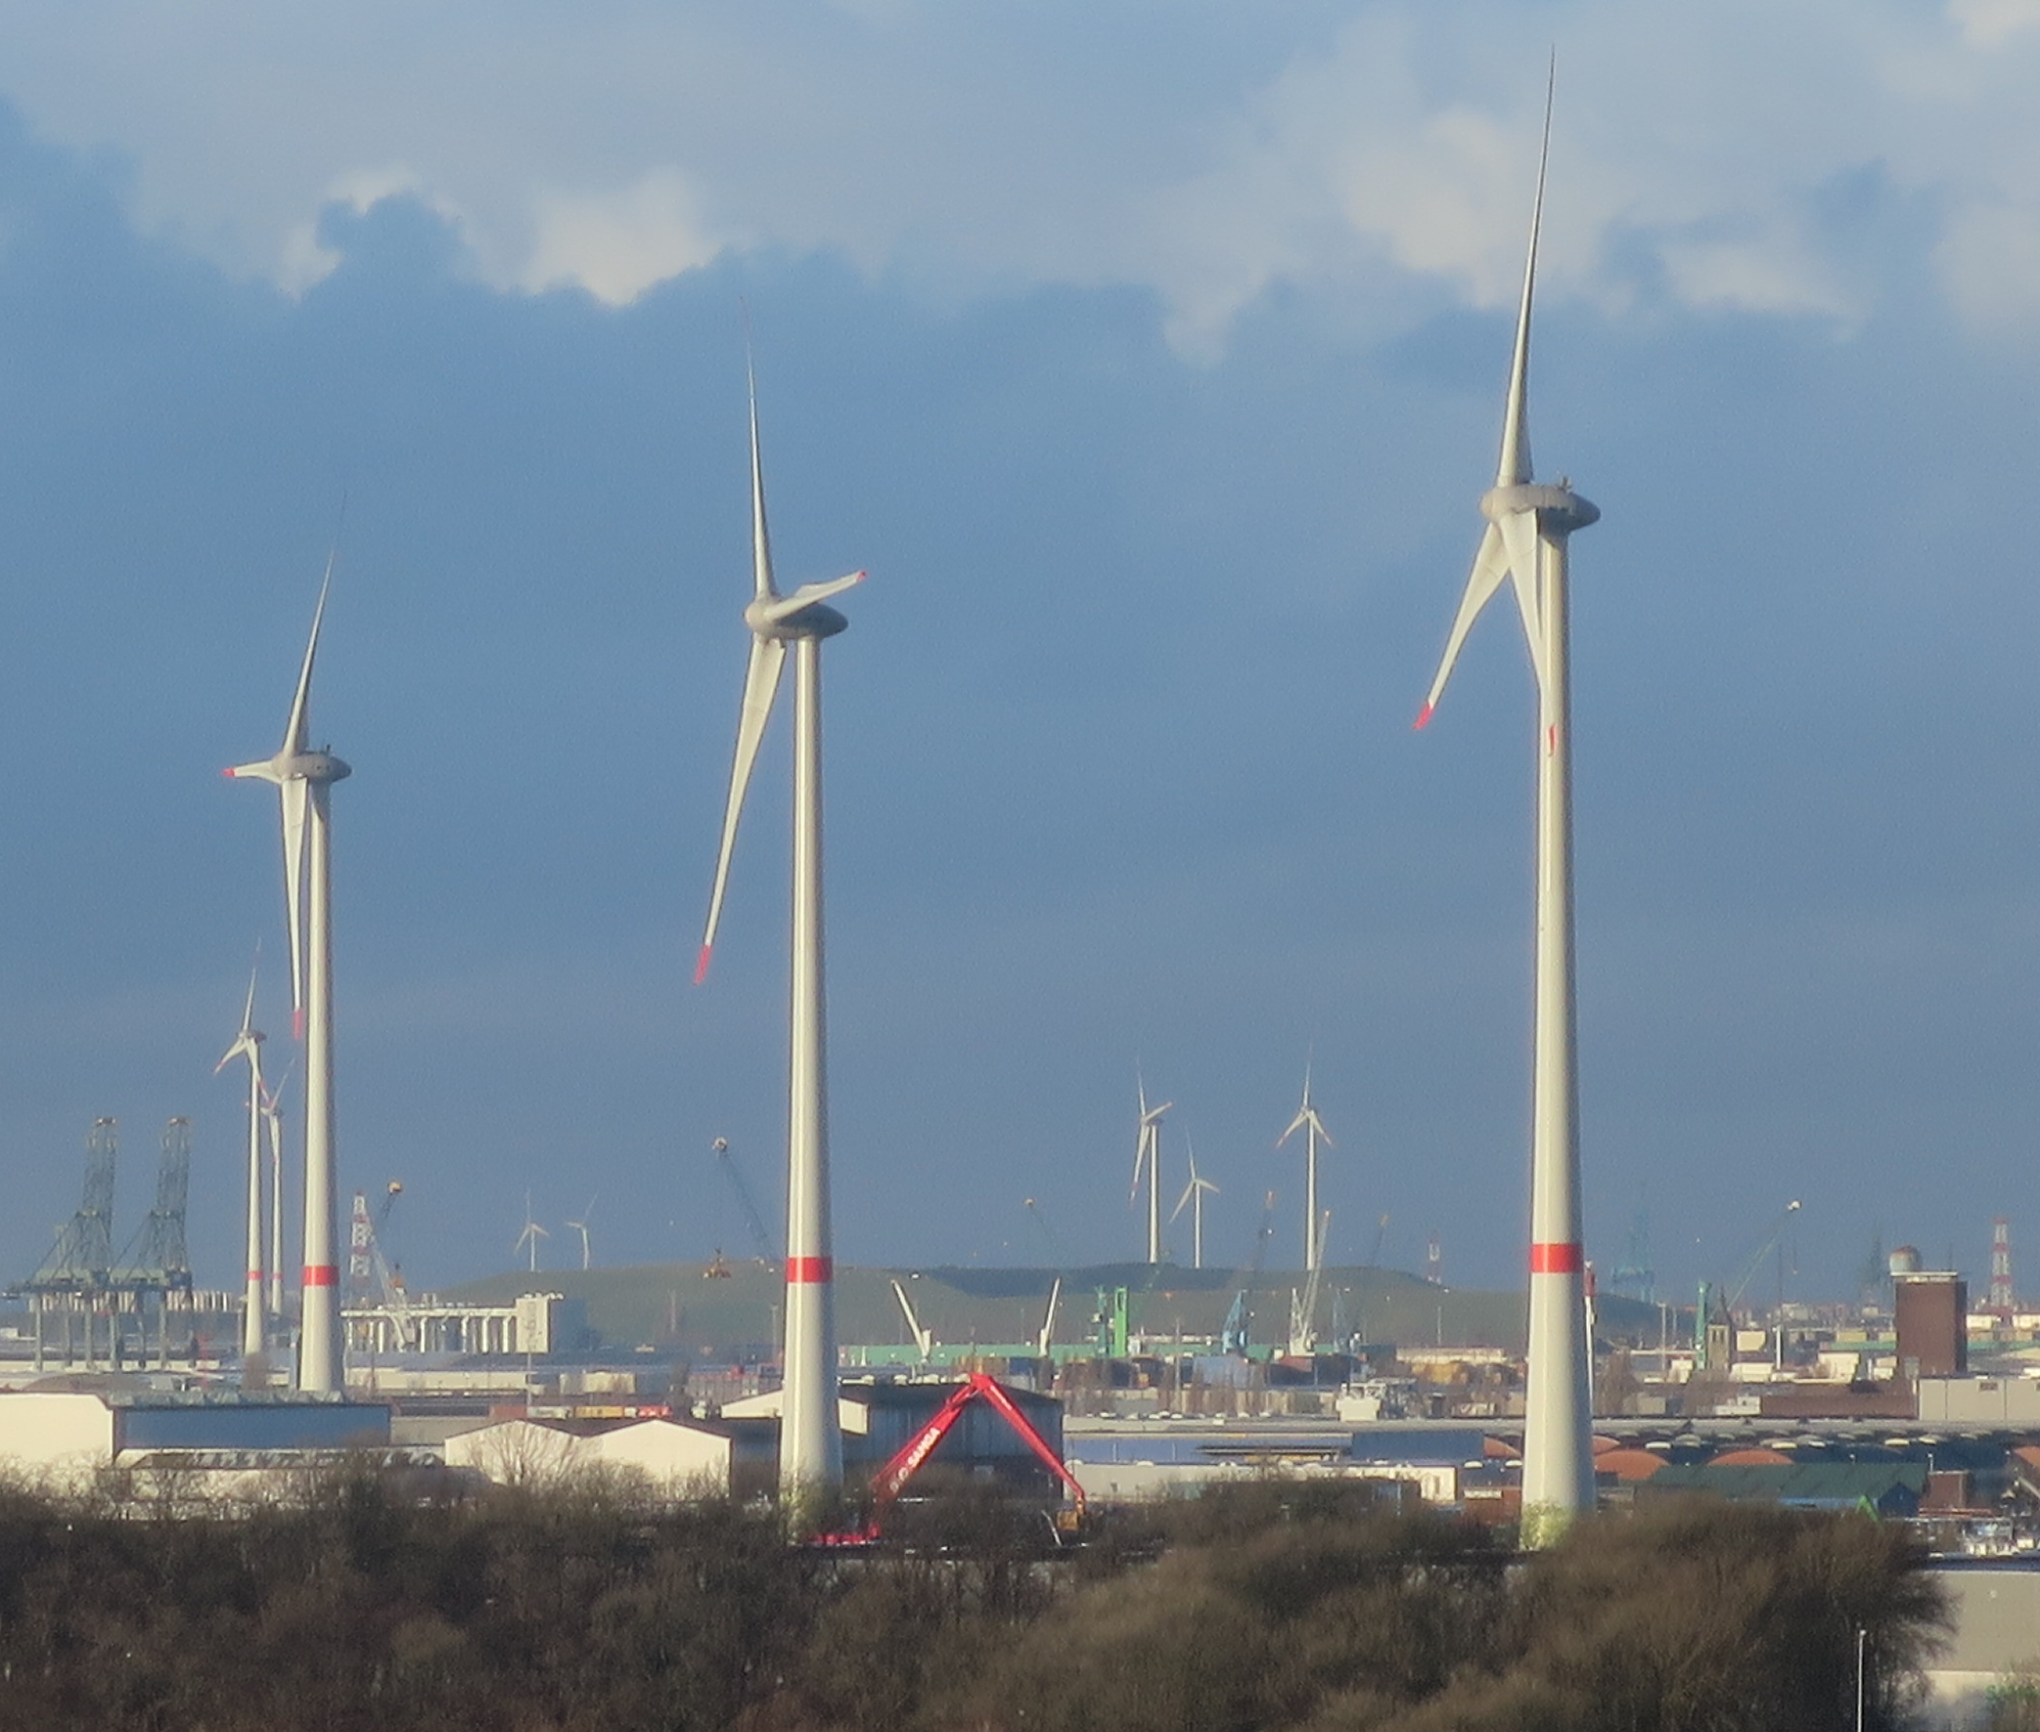
Renewable Support: still wanted!
Photo: R Green

Slide 20
Spare slides

Slide 21
Renewable Support Paradigms
 | “Regulated” | “Market”
Price fixed | Feed-in Tariff | Contract for Differences
Price supplement | Production Tax Credit / Premium FiT | Tradable Green Certificates
Quantity fixed | Renewable Portfolio Standard | Tradable Green Certificates

Slide 22
Renewable Support Paradigms
 | “Regulated” | “Market”
Price fixed | Feed-in Tariff | Contract for Differences
Price supplement | Production Tax Credit / Premium FiT | Tradable Green Certificates
Quantity fixed | Renewable Portfolio Standard | Tradable Green Certificates

Slide 23
Variable Generators (x2)
Coal, Gas and Oil, versus Wind and Solar
GW
GW
Source: Electric Insights (data are for GB)

Slide 24
Variable Generators (x2)
Wind and Solar versus Coal, Gas and Oil
GW
GW
Availability-led
Demand-led
Source: Electric Insights (data are for GB)

