Slide 1
Ontario Sheep Farmers Grazing Project

Slide 2
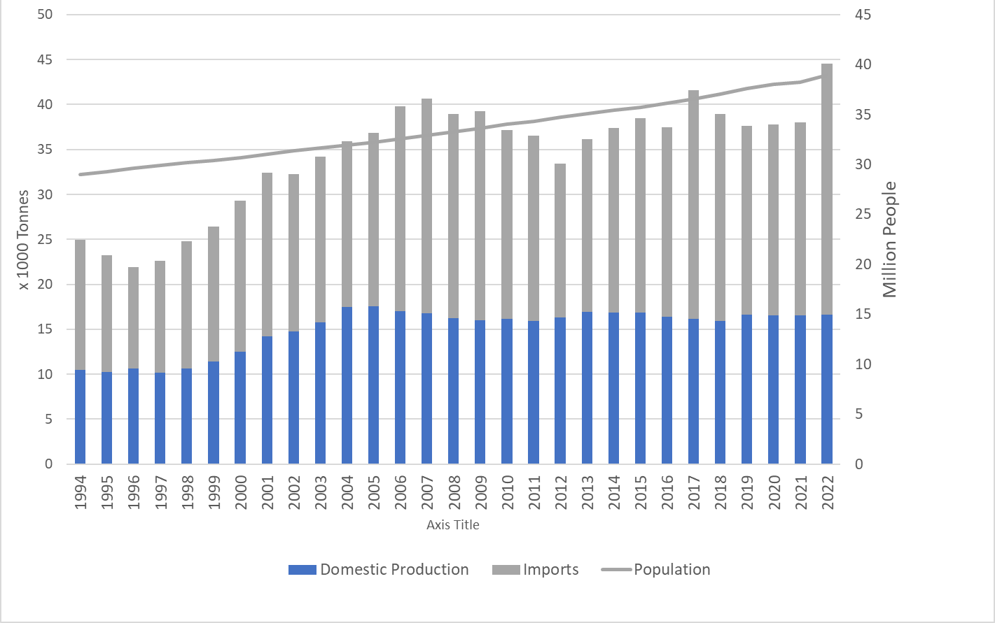
Supply of lamb & mutton in Canada
Notes:
Estimated production has been relatively the same since 2004 and supply variation comes from imported product
This means that Cdns eat more lamb when more lamb is imported
In 2022 Domestic production of 16.63 and imports of 27.92 thousand tonnes.
Imports account for 63.5% of total domestic disappearance.
Although 2022 saw a large increase in imports, preliminary data for 2023 indicates imports fell back to similar volumes as 2021
Year to date (November) Lamb imports are down 14.7% over 2022 to 18.9 thousand Tonnes and mutton is down 14.7% to 3.73 thousand tonnes

Slide 3
New Grazing Course in Development
Online, self-directed
Modules to cover:
Management elements – fencing, watering, transportation/labour, feed/pasture
Marketing & Relationship building
Contracts
Liability & Insurance
Predation
Biosecurity
Economics & budgeting
Mentorship for success

