Slide 1
IVEY
FOUNDATIONS
OF EQUITY PRACTICE
TOOL v.2.0
Ladan Mowlid,
Senior EDI Program Associate
Dr. Erin Huner
Director, Culture & Inclusion

Slide 2
ACKNOWLEDGEMENTS
We want to thank the Ivey community for participating in the design process for the creation of this EDI tool. We learned so much from each member of the community that has taken the time to use this tool; tell us about their experiences with the tool; and how we could continue to refine the design for the community.
A Note on Version 2.0:
In this version of the Foundations of Equity Practice Learning Tool, we have worked to increase the accessibility of the tool, by integrating best practices for accessible design. We know this work is never complete. So, you will see new versions of this tool emerge as we continue our practice of learning and unlearning as we design EDI tools with the Ivey community.

Slide 3
Land Acknowledgement
The Ivey Business School is located on the traditional territory of the Anishinaabek (Ah-nish-in-a-bek), Haudenosaunee (Ho-den-no-show-nee), Lūnaapéewak (Len-ahpay-wuk) and Chonnonton (Chun-ongk-ton) Nations.
As visitors to this land, we acknowledge the responsibilities given to us through the Dish With One Spoon Covenant Wampum. The bowl that centres the teaching of this Wampum, holds a series of responsibilities for how to live in a good way. We recognize that we are asked to live in reciprocity with the birds, the plants, animals, waters, rocks and one another, as the ethics and values by which we all live within this bowl. We also recognize that as visitors, we collectively eat with one spoon, and therefore we must only take what we need from the bowl, and that maintaining the balance of the bowl is a responsibility we all hold and must maintain.

Slide 4
Who We Are
Ladan (Luh-than) Mowlid (Mow-Leed)
My pronouns are (she/her) and I identify as a Black Muslim woman born to East African parents who immigrated to Canada. I am the first in my immediate family to pursue post-secondary studies. My lived experiences navigating healthcare, government and educational systems stem from growing up translating for my parents, community members and mentoring other first-generation youth. Although there were and often are, many challenges that come with embodying these identities, those are ultimately the lived experiences that have shaped my path as an EDI and Student Affairs practitioner.
Erin (Air-In) Huner (Hugh-ner)
My pronouns are (she/her) and I identify as a white, first-generation settler to Canada. I am a social geographer who works at the intersections of health, ethics and the environment. I am also the mother of, and co-advocate with, my neurodivergent son. I support my son as he navigates the systemic inequalities and inaccessibilities of the educational, governmental and healthcare systems in Canada. These are the lived experiences that have shaped my path as an EDI inclusion researcher and practitioner.

Slide 5
AGENDA
Learning Outcomes
Learning Guidelines
Introducing the journey of Learning and Unlearning
Areas of focus
Positionality
Privilege & Oppression
Equality/Equity/Justice
Bias
Allyship
Anti-Racism
Addressing Harmful Comments
How to get called in, and call others in
Building an Equity Practice
We will offer 10 practice prompts for you to consider as part of your equity practice

Slide 6
Learning Outcomes
IDENTIFY:
Perspective about Positionality
DEVELOP:
Communication
Strategies
CREATE:
Cultural knowledge & Self-Awareness

Slide 7
Learning Guidelines
Here are some basic guidelines to create an optimal learning experience:
Commit to learning and unlearning.
Be willing to learn through both theoretical and practical lenses.
Take some time to reflect on the activities and concepts you will be learning.
Commit to taking part in the conversation about Equity & Inclusion in our community.

Slide 8
This is a Practice of becoming a constant Learner

Slide 9
Areas of focus
Positionality
Privilege & Oppression
Equality/Equity/ Justice
Bias
Allyship
Anti-racism
Foundations of equity & Inclusion Practice

Slide 10
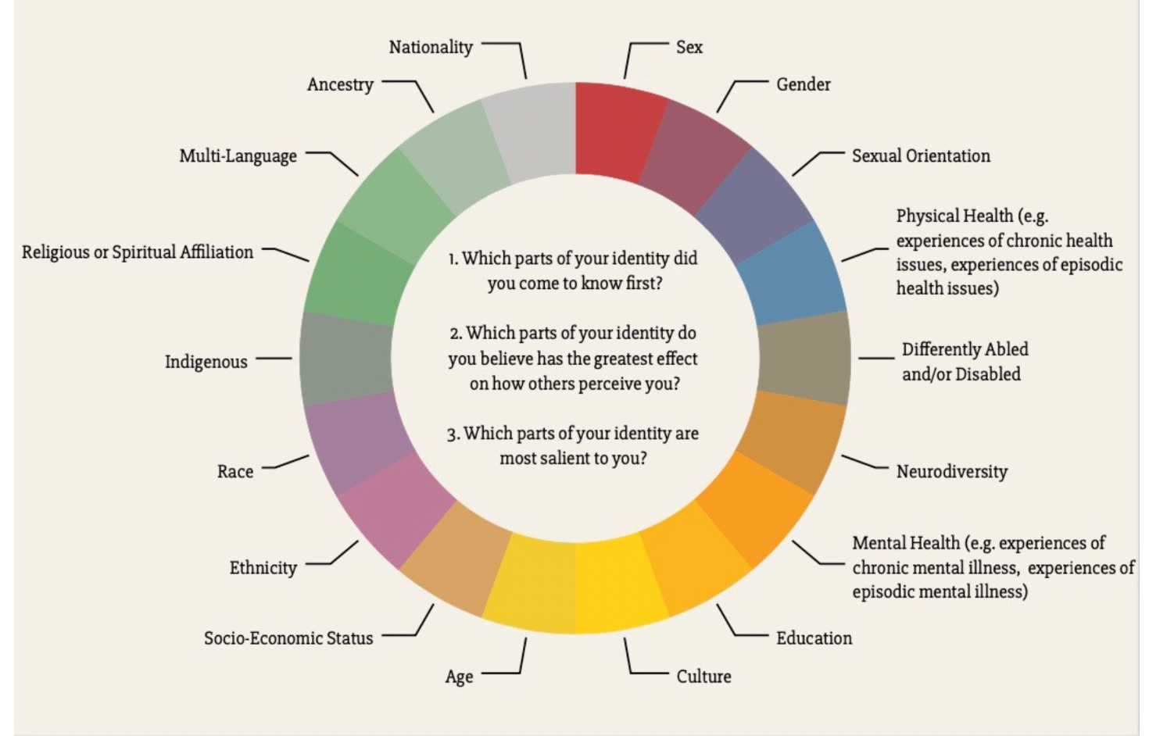
Positionality: Cultivating Self-Awareness
Practice Prompt no.1:
Can we commit to deepening our understanding about the place from which we speak, in order to hear others?

Slide 11
Key Theoretical Concepts
Privilege
Oppression
Equity
Justice

Slide 12
Privilege & Oppression
Privilege
Advantages or resources granted to some social groups that are unavailable to other groups.
Oppression
A system that maintains disadvantages on either an individual, institutional, and/or cultural level.
Practice Prompt no. 2:
Can we commit to deepening our understanding about where and how both privilege and oppression operate in our lives?

Slide 13
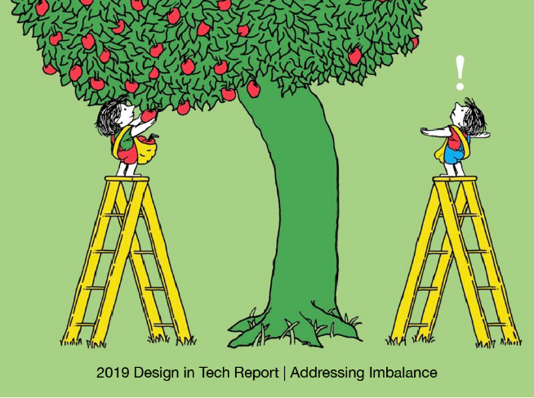
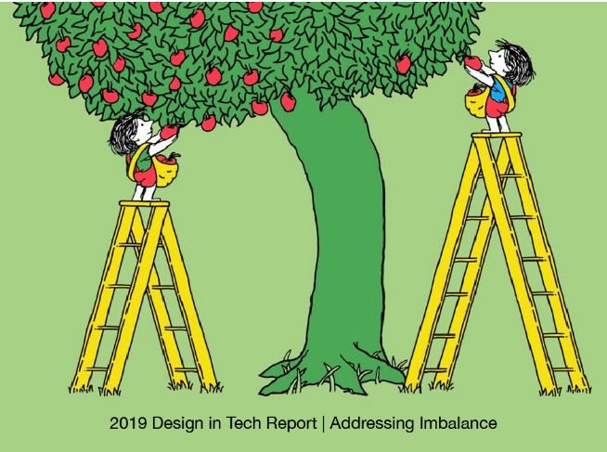
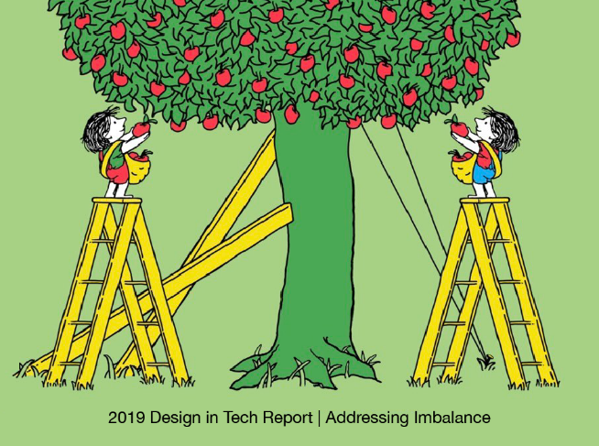
Equality/Equity/Justice
Equity. A promotion of fairness and justice for each individual, by providing everyone with tailored necessary resources to overcome individual barriers that are a result of systemic forms of oppression.
Equality. Means each individual or group of people are given the same resources or opportunities to succeed.
Justice. A collective responsibility to create a free and just society, to ensure that civil and human rights are preserved and protected for each individual.

Slide 14
How positionality impacts privilege
Language Privilege
Religious Privilege
Socioeconomic Privilege
Practice Prompt no. 3:
Can we commit to using our privilege(s) to intervene in systems or scenarios where inequity has or is occurring?
Body Size Privilege
Citizenship privilege
Gender Privilege
Ability Privilege
Cis-Het Privileges
White Privilege
Age Privilege
Light-skinned Privilege

Slide 15
Bias
Unconscious bias are social stereotypes of people that have unknowingly formed through our socialization and are further reinforced through everyday behaviours related to how we view the world.
Conscious bias is prejudice against a person or group of people in comparison to another person or group of people that results in the unfair treatment of people. It important to note that bias is not only limited to racial or ethnic prejudice and can extend to gender, religion, age, and ability.
Practice Prompt no. 4:
Can we commit to ensuring we interrogate our biases, making them conscious and recognizable?

Slide 16
Bias
Micro-aggressions are very specific yet difficult to put a name to. They are the kinds of remarks, questions, or actions that are painful because they have to do with a person’s membership in a group that’s discriminated against or subject to stereotypes. What makes microaggressions so disconcerting is that they happen in everyday, often casual situations; they occur very frequently; and often, the person who has enacted the microaggression may not recognize this behaviour in themselves.
Practice Prompt no. 5:
Can we commit to reflecting on how our actions, body language, tone and attention to others might be connected to unconscious biases?

Slide 17
Allyship a verb.

Slide 18
Allyship is…
A lifetime commitment to unlearning, self-education, receiving constructive criticism, learning from mistakes, doing research, and having difficult conversations.
Practice Prompt no. 6:
Can we commit to asking
Who claims me as an ally? Instead of claiming to be an ally?
Understanding the power and privileges you hold and learning to use your voice and actions to extend the benefits of your privilege to those around you.

Slide 19
Antiracism continuum
Acknowledgement
Action
Self awareness
Self-Interrogation
Neutrality
Education
Practice Prompt no. 6:
Can we commit to the practice of becoming constant learners and unlearners of ourselves, and the systems we live and work within, so that we can action what we learn and unlearn?
Racist
Non Racist
Anti-Racist
Racist.
The belief that one or more races or superior to others. Racist beliefs incline one to feel discrimination or prejudice against people of other races.
Not Racist.
The acknowledgement that all humans have an equal right to respect and tolerance without engaging in dismantling systems of oppression.
Anti-Racist.
The active process of redistributing power equitably by identifying and eliminating organizational, structural and individual forms of racism.

Slide 20
Practice Prompt No. 7: Starting points
Difficult conversations
Normalize talking to your colleagues, community, and loved ones about anti-Black, anti-Indigenous, anti-Asian, misogynistic, ableist, and other equity related issues.
Learn & Unlearn
Read articles, watch videos, listen to podcasts.
Learning can also include the development of your identities and the deconstruction of normalized biases.
Self-inventory check
Assess your thought processes and behaviours when engaging with others.
Ask yourself why you do or think about things in a certain way? You can also ask yourself, are you in an echo chamber?
Learn to listen to hear & empathize
Be prepared to get called in.
Learn how to call others in.

Slide 21
Practice Prompt No. 8: Addressing Harmful comments
Share your journey
Separate Intent from Impact
Challenge the
Stereotype
Hey, I noticed you said ____. I used to say stuff like that too but recently I’ve learned that can be hurtful. Instead, now I say, ____.
When you said ____, I know you didn’t mean for it to be offensive, but it made me think/feel ____. Next time you should use/say ______ instead.
1. “Actually, in my experience ______”
2. “I think that’s a stereotype. I’ve learned recently that _____.”
3. “Really I’ve read something that would suggest otherwise:____”

Slide 22
Getting Called In & Out
Accept
Process
Educate
Thank you for informing me about this. I will take the time to educate myself on this topic some more. Do you have any recommendations for educational resources or individuals I could speak with this about?
I didn’t realize what I said/did was problematic. Thank you for letting me know. I will take this away and reflect on what I can do better for future instances.
Thank you for taking the time to let me know. I know it may have not been easy to call me in. I appreciate you doing so kindly.

Slide 23
Practice Prompt no. 2:
Can we commit to deepening our understanding about where and how both privilege and oppression operate in our lives?
Practice Prompt no.1:
Can we commit to deepening our understanding about the place from which we speak, in order to hear others?
Practice Prompt no. 3:
Can we commit to using our privilege(s) to intervene in systems or scenarios where inequity has or is occurring?
Practice Prompt no. 10:
Can we commit to developing a personal equity practice? Using our positionality and awareness of our privilege(s), can we create sustainable equity-centred changes in the classroom, on our teams and in our community?
Practice Prompt no.9:
Can we commit to deepening our understanding about the place from which we speak, in order to hear others?
Practice Prompt no. 4:
Can we commit to ensuring we interrogate our biases, making them conscious and recognizable?
Practice Prompt no.8:
Can we commit to learning ways to address harmful comments?
Practice Prompt no. 5:
Can we commit to reflecting on how our actions, body language, tone and attention to others might be connected to unconscious biases?
Practice Prompt no.7:
Can we commit to:
Difficult conversations.
Learning & Unlearning
Self-Inventory Check..
Learn to listen to hear and empathize.
Be prepared to get called in. Learn to call others in.
Practice Prompt no. 6:
Can we commit to the practice of becoming constant learners and unlearners of ourselves, and the systems we live and work within?

Slide 24
Thank you
Thank you for taking the time to learn and unlearn with us today!
We are always delighted to hear from community members who have used this tool, so that we can learn with you and from your experiences!
If you have any questions or concerns, please feel free to reach out!
And if you’d like to participate in Ivey’s assessment and evaluation of this tool, please click the link below to participate.
https://forms.office.com/r/nCfin0xMGg
Ladan Mowlid, Senior EDI Associate
lmowlid@ivey.ca
Erin Huner, Director, Culture & Inclusion
ehuner@ivey.ca

