Slide 1

Decarbonization Policies and Innovations in Utility Rate Design
Ivey Energy Policy and Management Centre
Mark Olsheski
Vice President, Energy
October 16, 2023

Slide 2

Presentation Overview
Systemic trends, coupled with utility sector and economy-wide decarbonization objectives, are necessitating a closer look at rate design efficiencies and effectiveness. The declining price of technologies, policy direction, consumer empowerment, economic competitiveness imperatives, and political realities all conspire to challenge the status quo.
Fundamentally, decarbonization-minded rate designs should drive residential, commercial, and industrial behaviour in a way that compliments the composition of a low-emissions supply mix, maintains the central grid as the supplier of choice, and conforms acceptably to a customer’s innate demand requirements.
Today’s discussion will be centered around the following items:
  The Art and Science of Rate Design
  Politics of Electricity Rates and Energy Transition
  General Observations
2

Slide 3


Art and Science of Rate Design
Rates should be understandable and provide stability, simplicity and consumer choice.
Rates should address energy poverty, economic competitiveness realities, and mitigate commodity price volatility.
Governments, utilities and regulators should build consumer understanding and acceptance of new rates through clear communication explaining the ‘how much’ and ‘why’ which underpins a solid value proposition.
Rates should be based on cost-causation principles.
Rates should encourage reduction of both coincident and non-coincident peak demand.
Rates should encourage shift in consumer behaviour without inducing defection from the central grid.
Rates should fully recover the cost of the system.
3

Slide 4
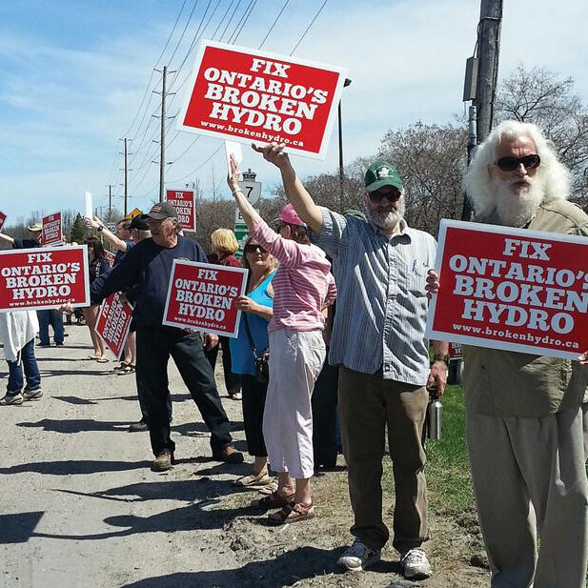
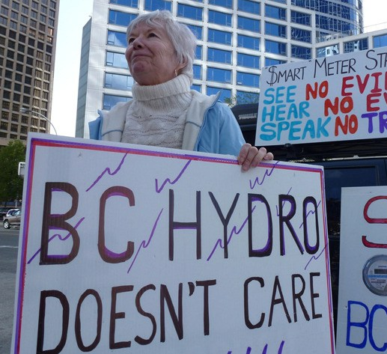





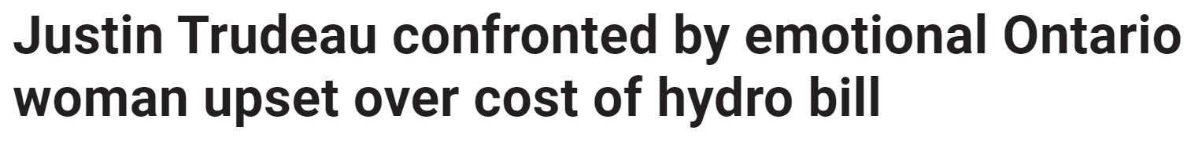
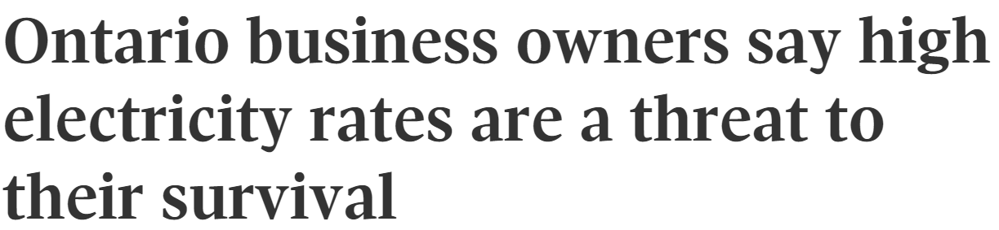

Politics of Electricity Rates and Energy Transition
4

Slide 5
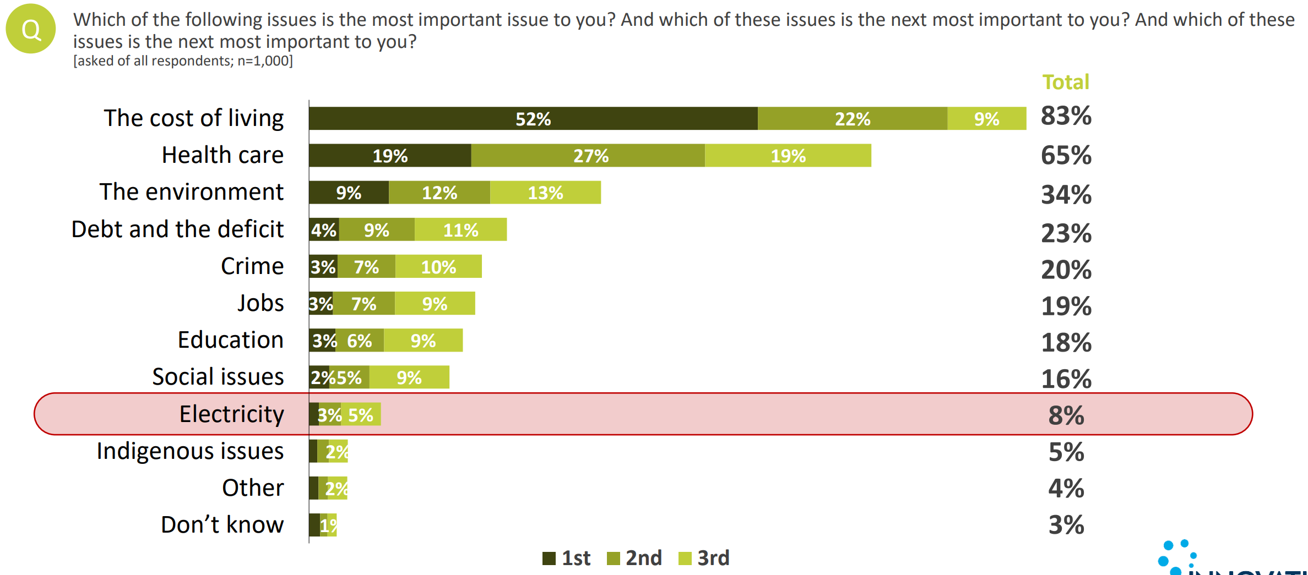

Cost of Living is Canadians’ Top Concern
5

Slide 6
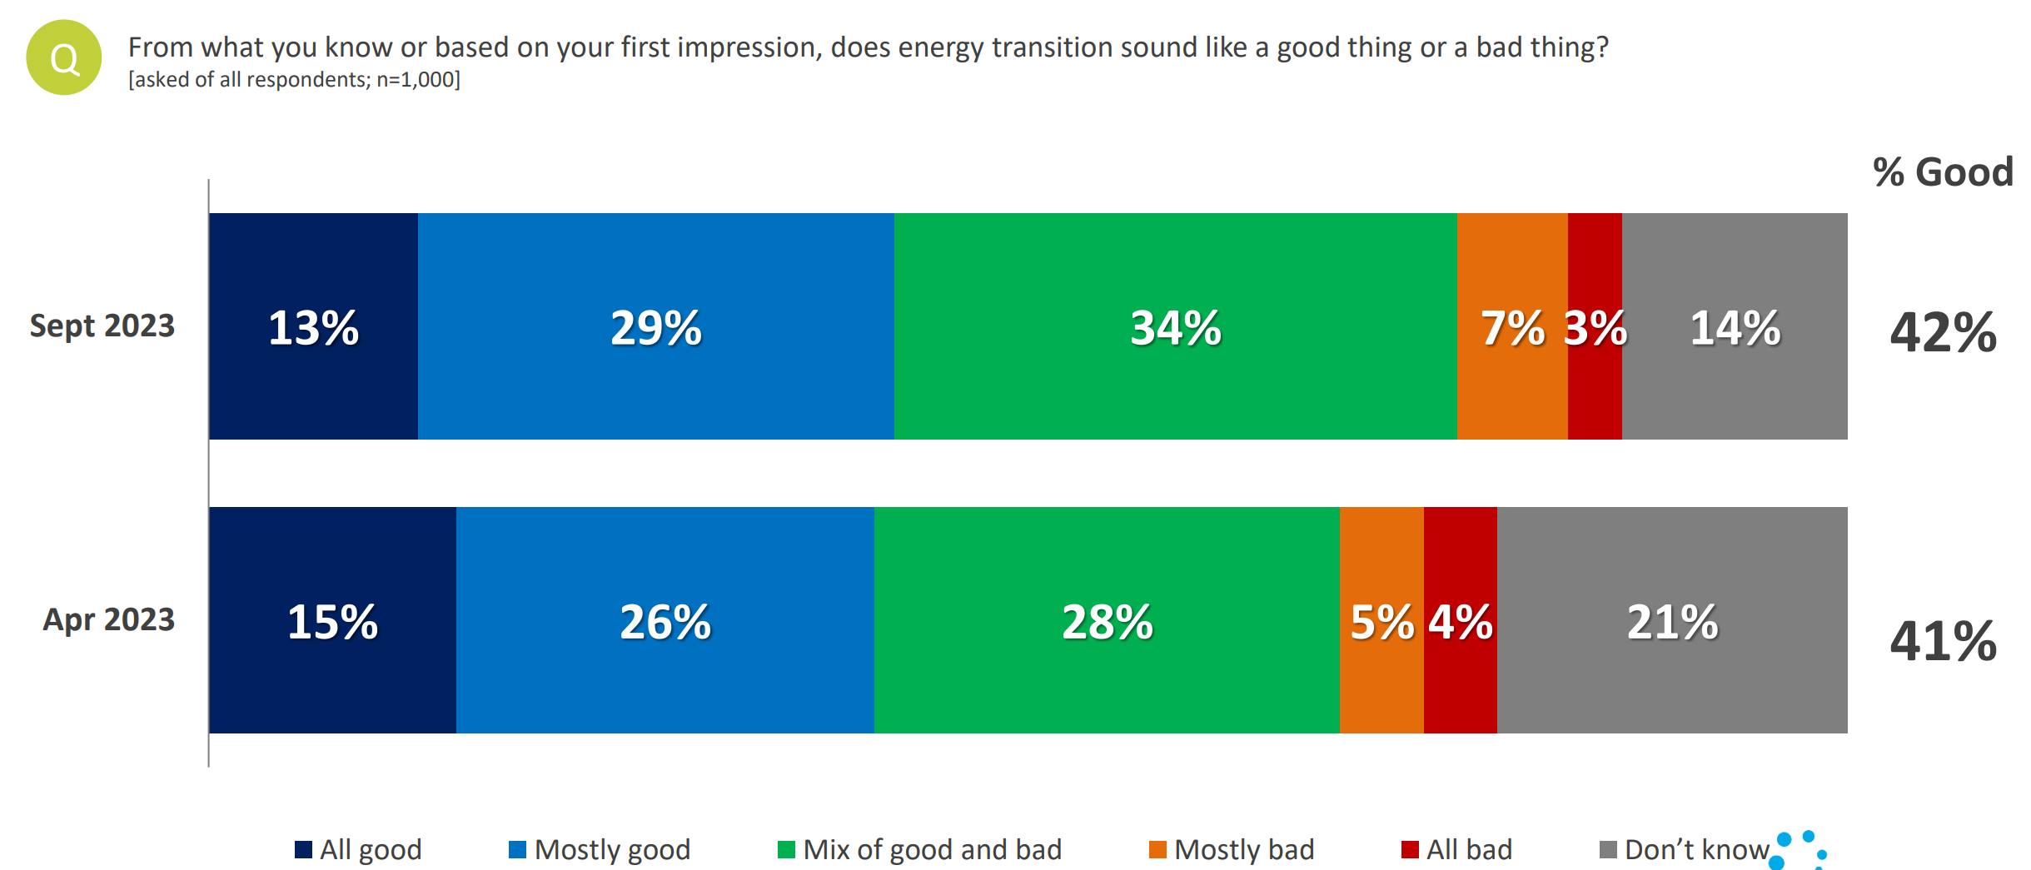
Attitudes Toward the Energy Transition
6

Slide 7
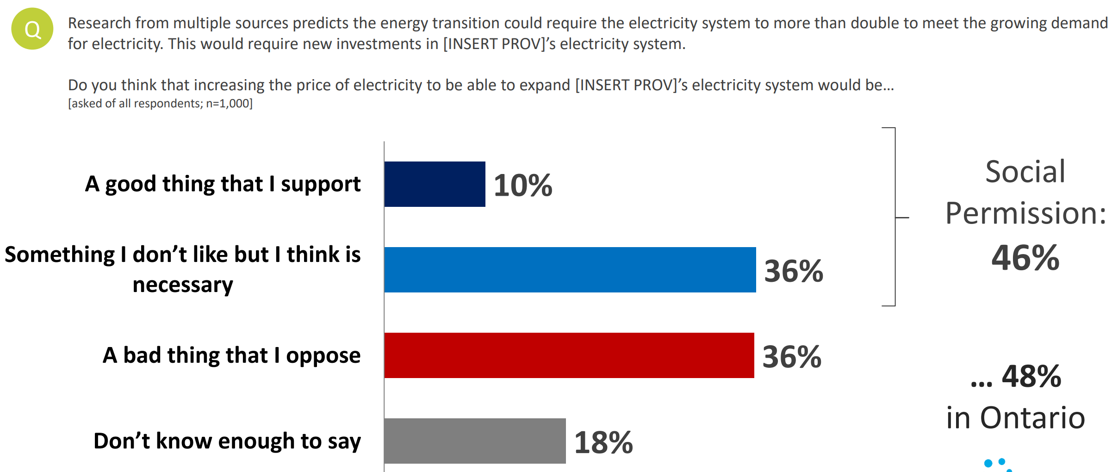
Energy Transition Necessary, Not Beloved
7

Slide 8
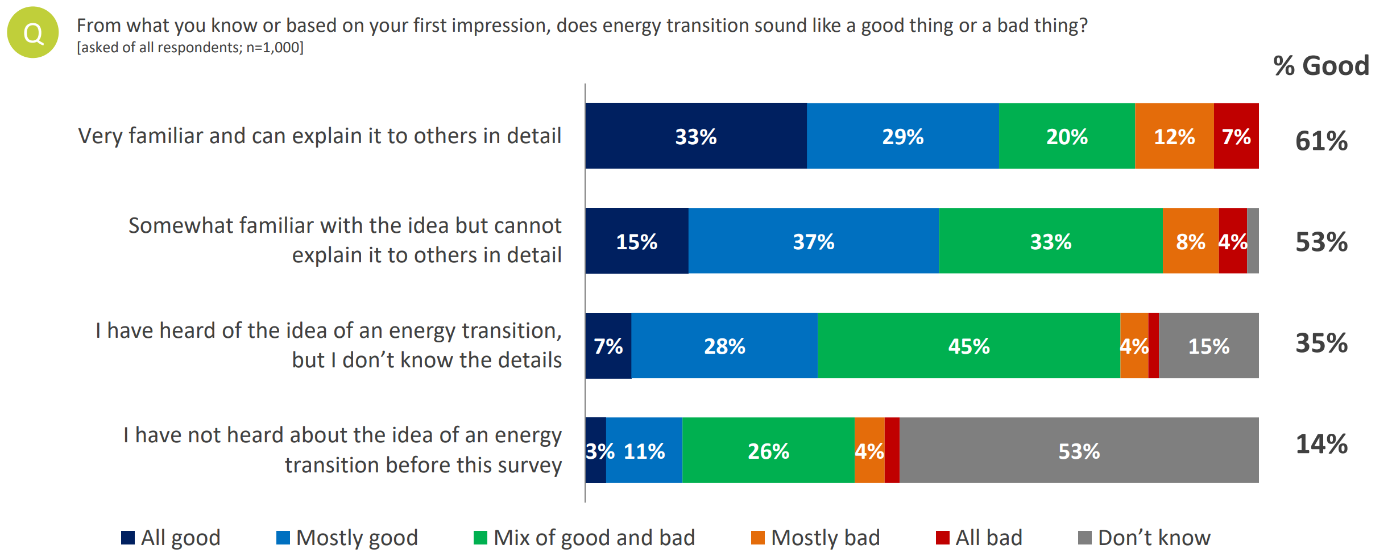
Strong Correlation Between Familiarity and Acceptance
8

Slide 9
General Observations
Energy and cost of living are closely linked - Waning concern with electricity affordability in recent years could be reversed if the energy transition is poorly managed and/or inadequate social permission is achieved.
Communication is essential – It is incumbent upon policymakers and the energy sector to define the value proposition the energy transition presents, and a realistic plan to facilitate it, otherwise it will be defined by those who wish to delay it and growing skepticism will continue to build.
Learn from the lessons of the past – Electricity is a necessity of life, and one which most Canadians view as squarely the accountability of governments to ensure is a harmonious combination of reliable, affordable, and sustainable. An acute period of concern around cost of living threatens any policy perceived as a ‘stick’ vs. ‘carrot’ and more so if it restricts freedom of choice or presents as social engineering.
Perfection cannot be the enemy of the good – Decarbonization is an important objectives that Canadians understand as necessary, but they do not accept the need to shoulder the entire burden of climate action themselves.
9

Slide 10



