Slide 1
Smart & Sustainable Agriculture:
Is Artificial Intelligence the Answer?
Soodeh Nikan
Assistant Professor
Department of Electrical and Computer Engineering Western University

Slide 2
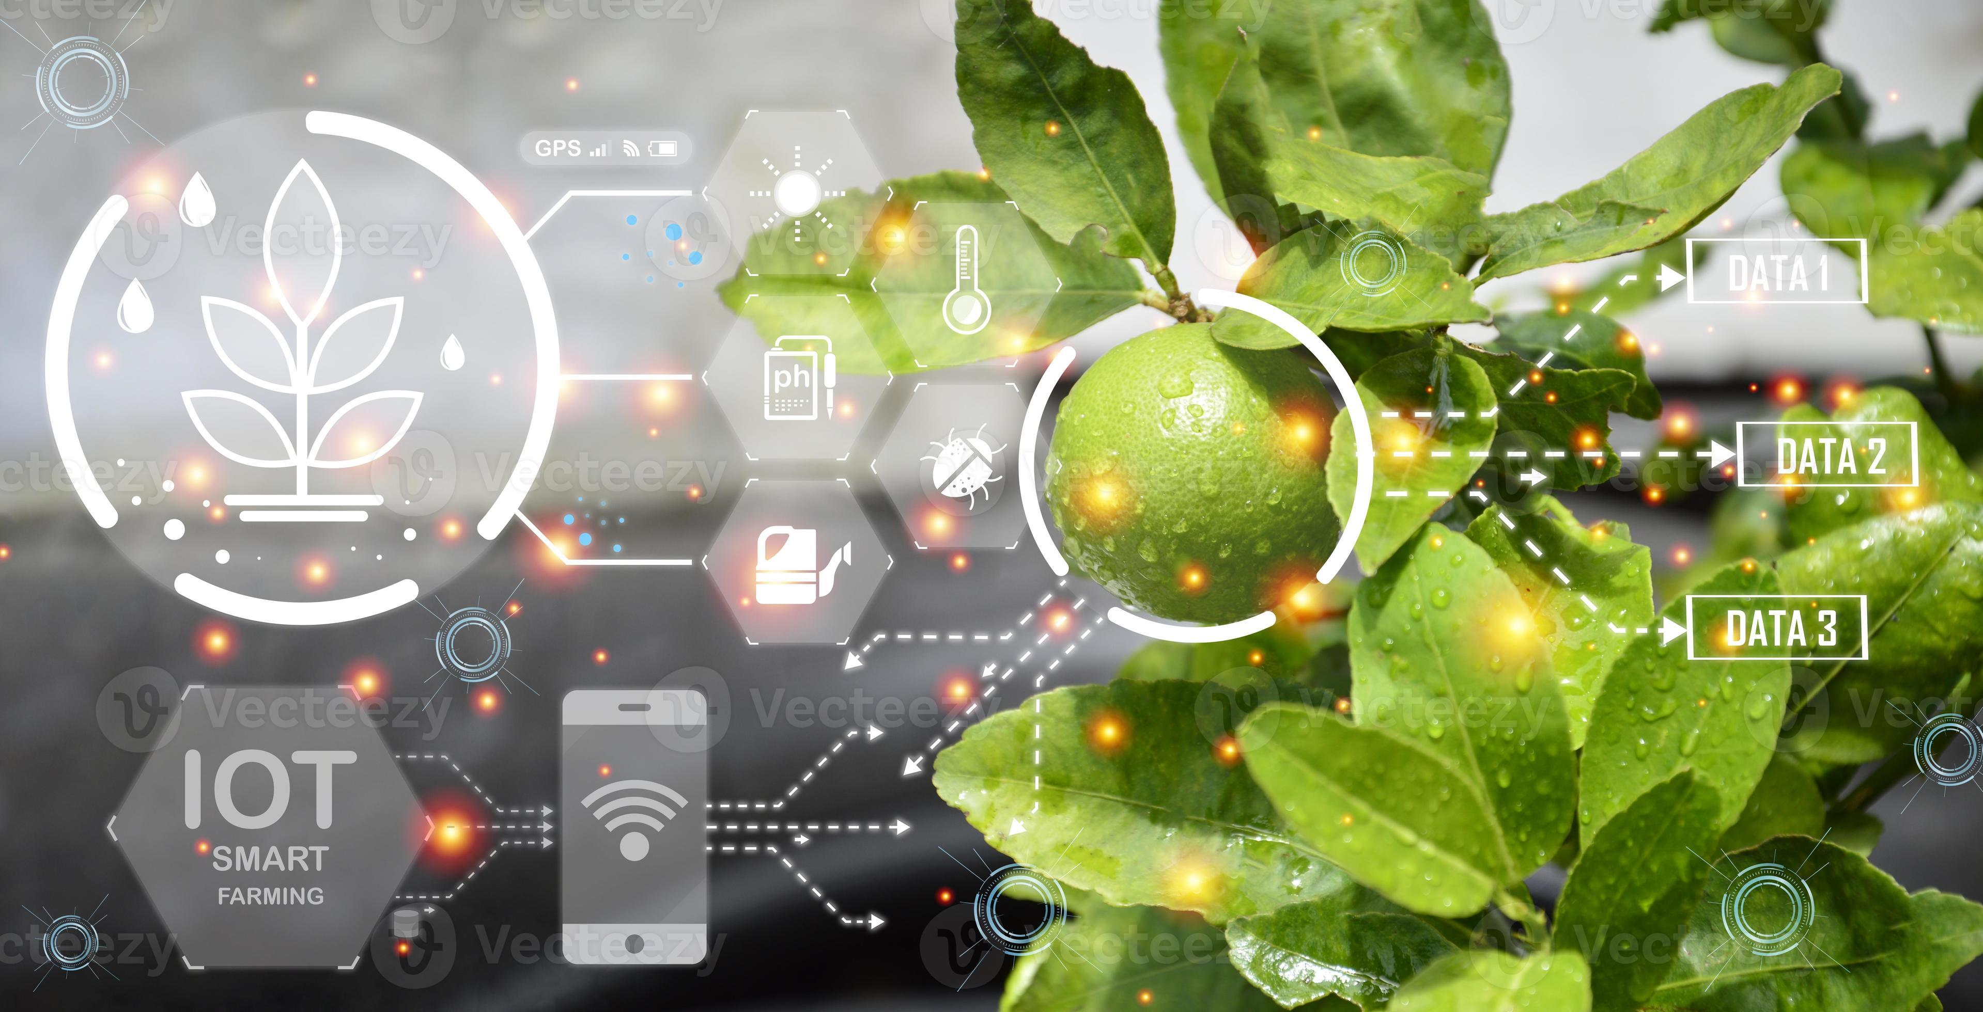
Motivation
Agriculture needs to meet the global food system demand
Will be doubled by 2050 !
Challenges:
water level, land shrinking, greenhouse gas emissions, etc.
Smart Farming & Sustainable Agriculture
Year
[United Nations Second Committee in 2009]

Slide 3
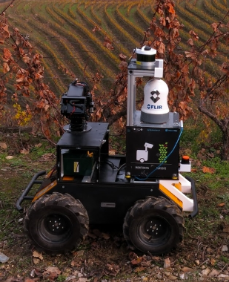
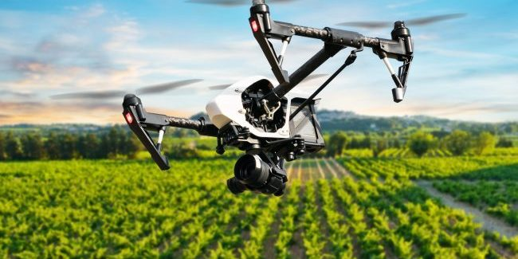
Objective
Using Artificial Intelligence (AI) and Computer Vision to revolutionize agriculture (precision farming)
Using AI technologies, advanced sensors and IOT (internet of things) devices
Drone
Unmanned Ground Vehicle

Slide 4
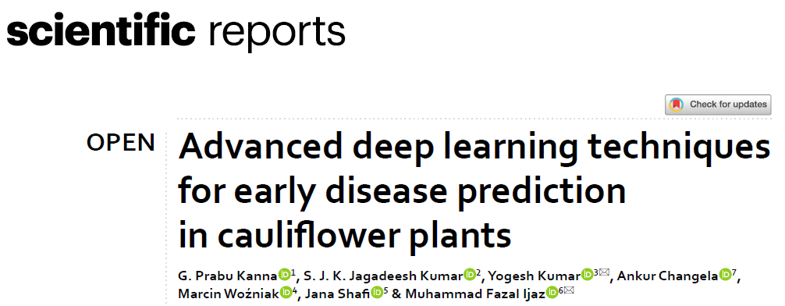
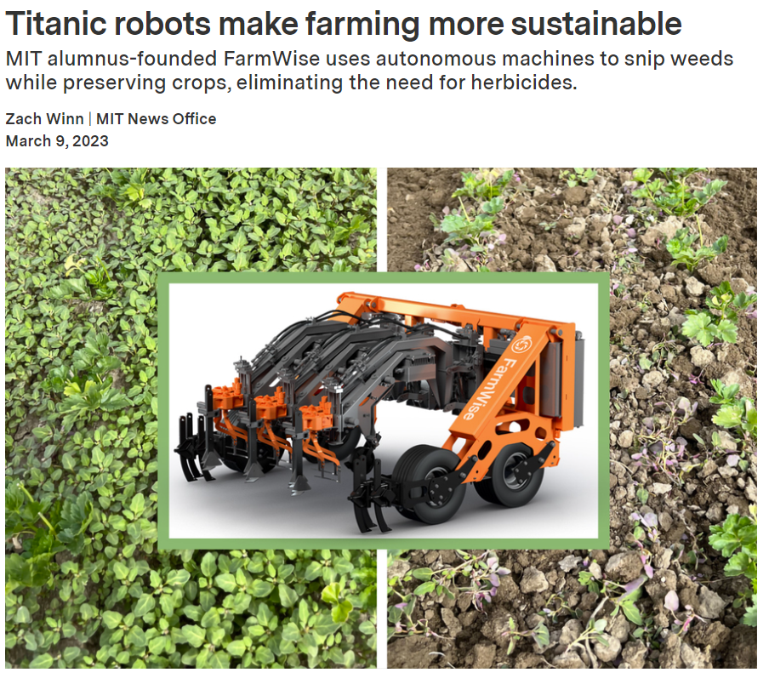
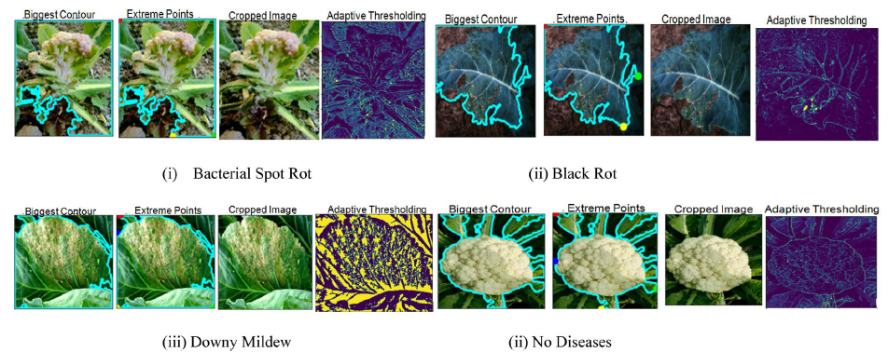
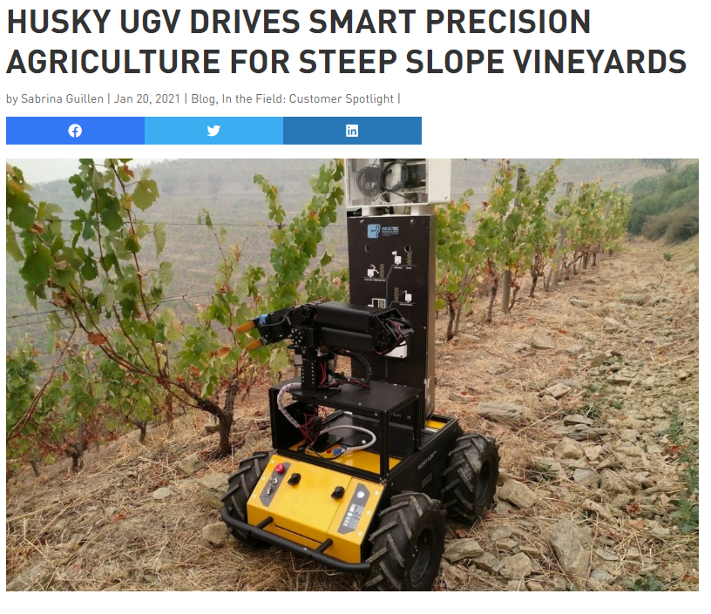
Precision Farming in Recent Years
2023
2019
2021

Slide 5
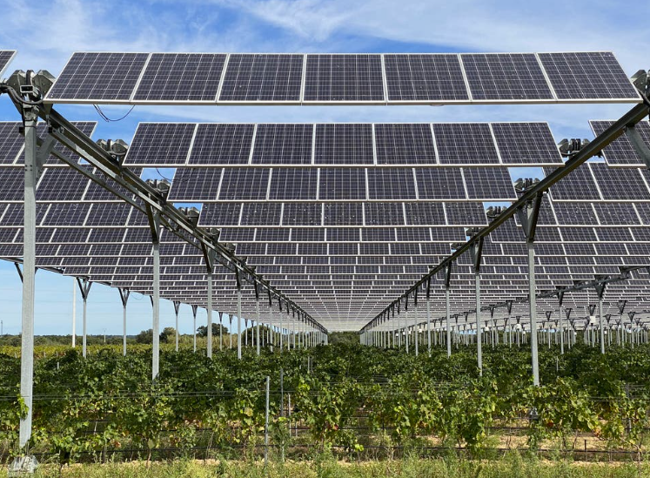
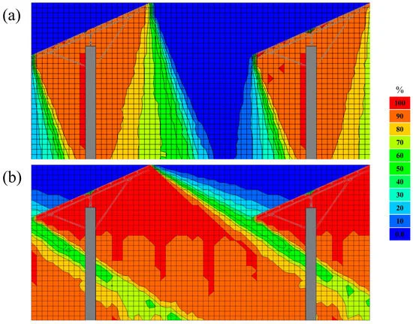
AI in Agrivoltaics Deployment
Control the tilt of the solar panels to protect the crops (considering factors such as crop growth phases, soil quality, weather etc.)
Images of average daily shading rate
Summer
Winter
[Zhang et al. 2023]

Slide 6
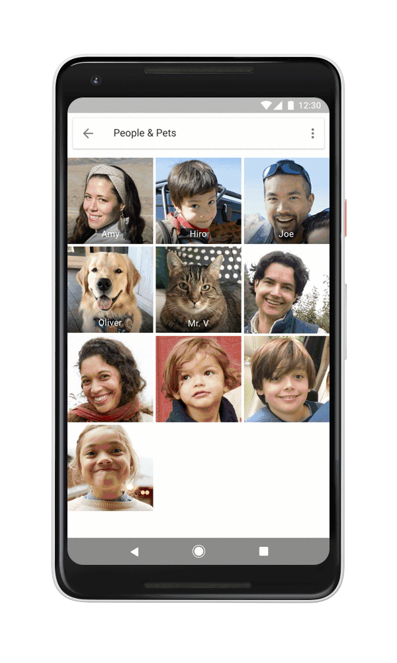
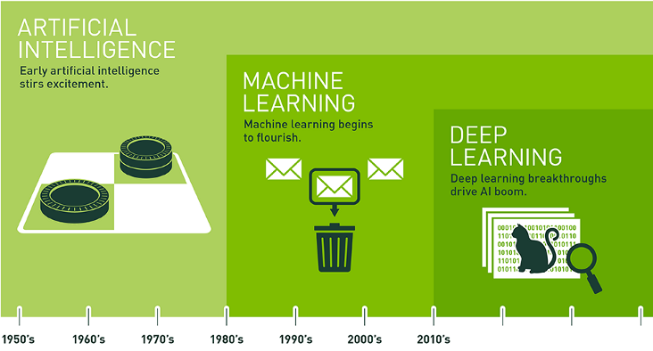
What is AI?

Slide 7
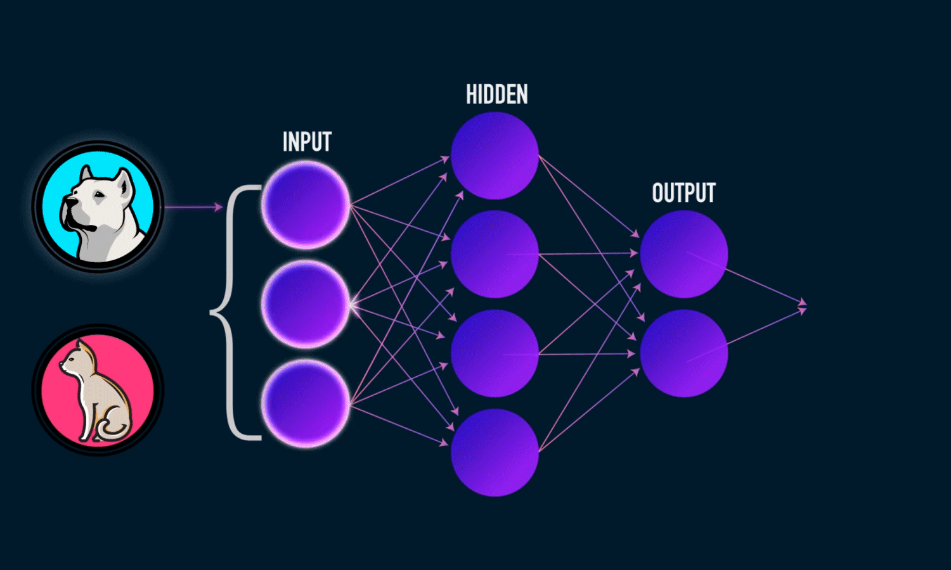
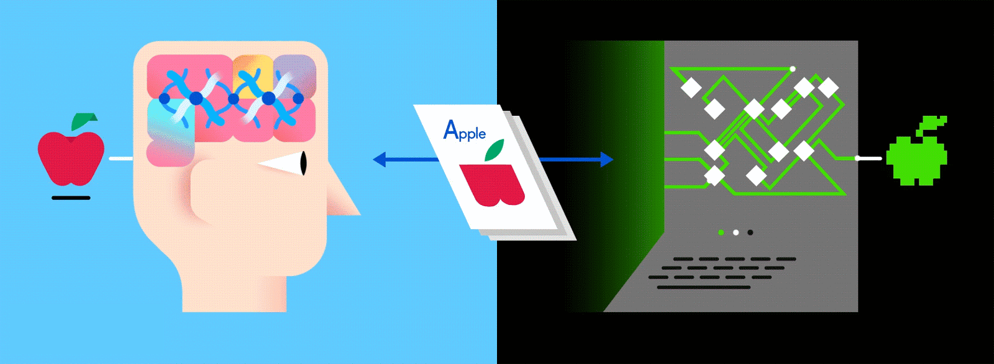
Deep Learning
Inspired by biological neural networks in human brain
Learning from examples

Slide 8
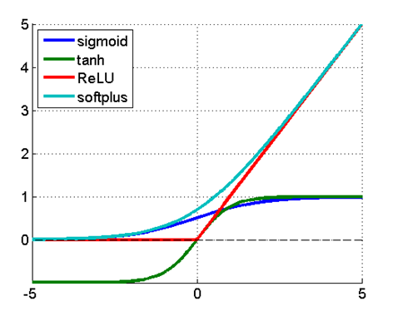
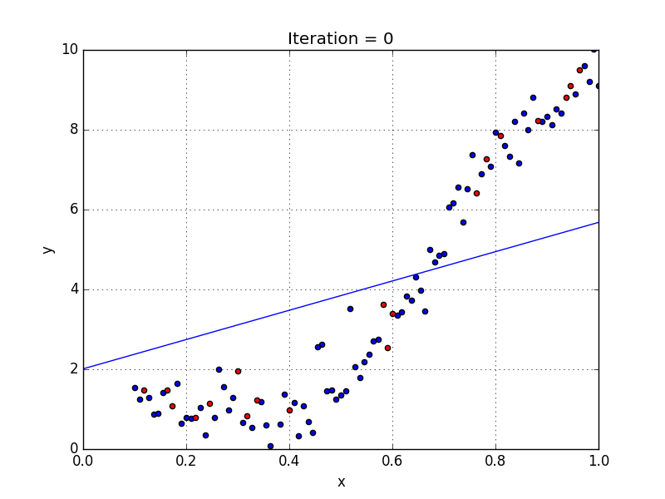
Design Process
Design deep learning network – Python scripting
Neural Network architecture
Neuron activation function
Number of training iterations

Slide 9
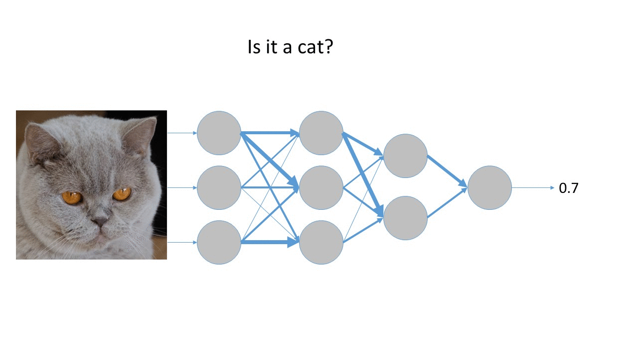
Training Deep Learning Model
Small scale
Training in progress …
Large scale
Is it a strawberry?
High Performance Computing (HPC)
Graphics processing unit (GPU)
Computational Resources
Hours/Days of training time for each network

Slide 10
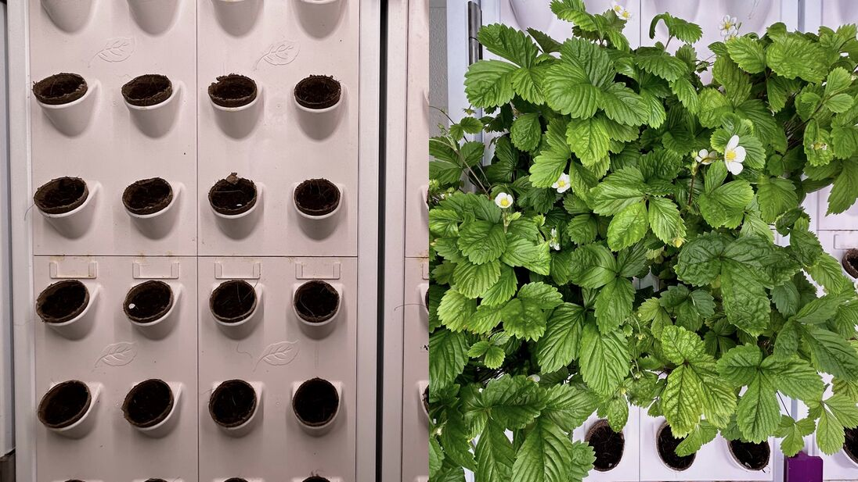
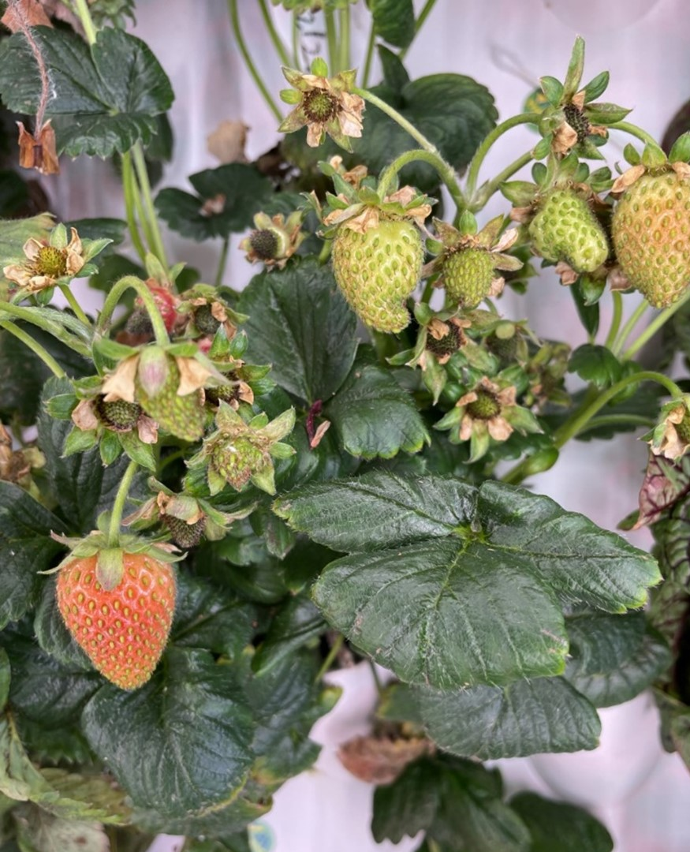
Application – Our Research at Western
The wall facilitates plant growth in a controlled environment with less water.
Digital camera captures images of Alpine Strawberries every day in different positions.
Vertical Grow Wall

Slide 11
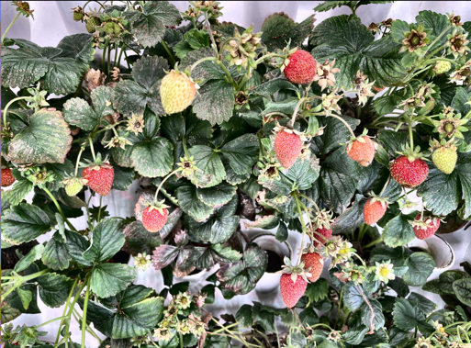
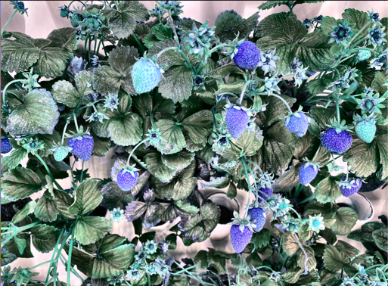
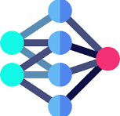
Methodology
The goal is growth monitoring (ripe/unripe) and disease classification.
Full images will be preprocessed and resized to smaller, manageable segments.
Train an AI model using strawberry images to detect strawberries.
Detection Model
Preprocessing (Computer Vision)

Slide 12
Methodology
Data set is labeled and augmented (to improve model training).
Angular Leafspot Anthracnose Fruit Rot Blossom Blight Ripe
Gray Mold Leaf Spot Powdery Mildew Fruit Unripe
Different labels within dataset

Slide 13
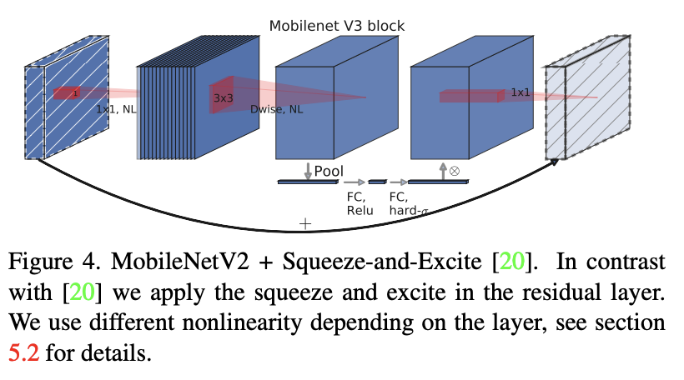
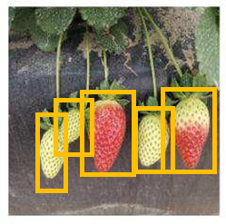
Results
Trained Deep Learning model using 4720 labelled images.
Tested the model on 945 unseen images (not used in training).
Accuracy: 96%
Angular Leafspot
Anthracnose Fruit Rot
Blossom Blight
Unripe
Gray Mold
Leaf Spot
Powdery Mildew Fruit
Ripe
Deep Learning Model
Detection Model

Slide 14
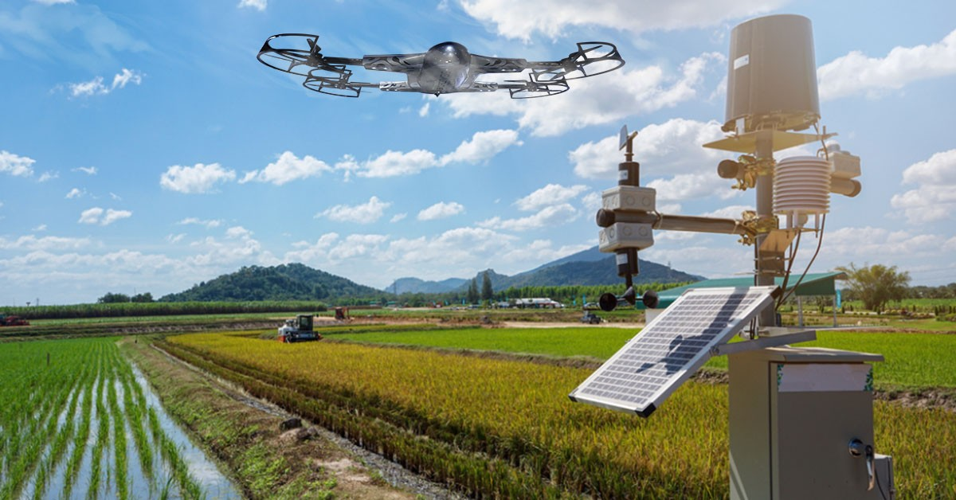
Thank you!
Any Questions?

