Slide 1
AGRIVOLTAICS AROUND THE WORLD - THE LAST YEAR, TYPES OF AGRIVOLTAICS TECHNOLOGIES & IMPLEMENTATION STRATEGIES
UZAIR JAMIL
Graduate Research Assistant – FAST Lab
Mechanical & Materials Engineering
Western University
11TH DECEMBER 2023

Slide 2
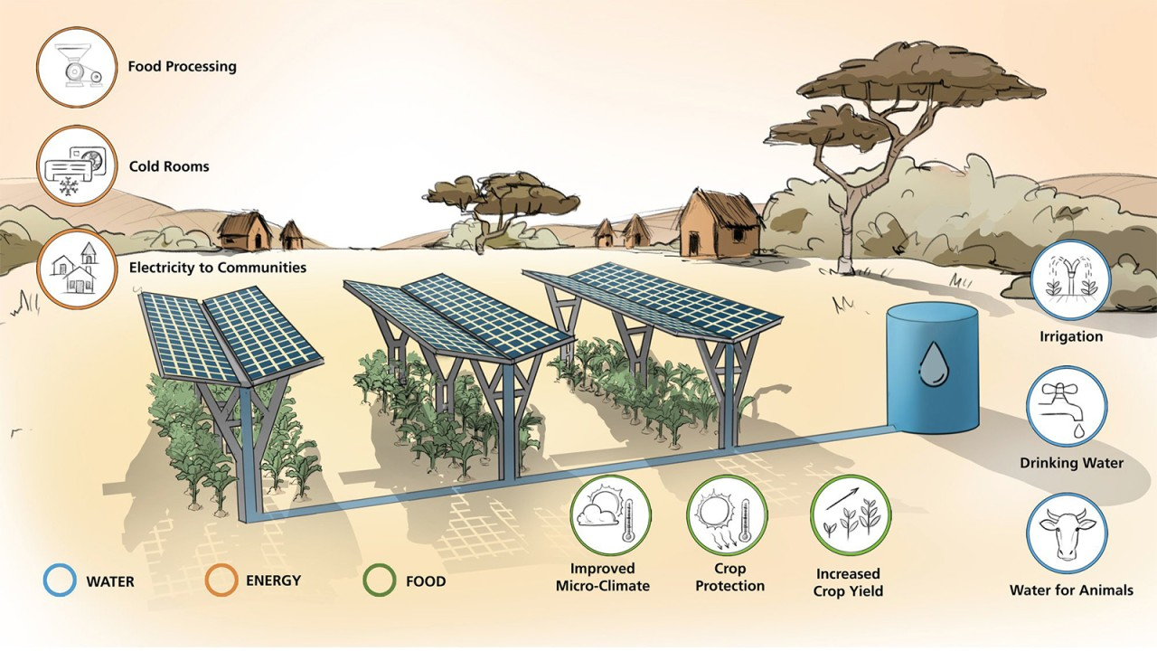
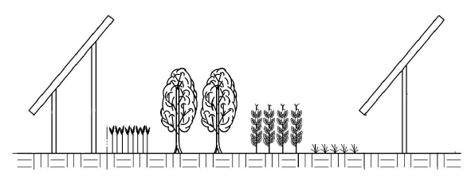
WHAT IS AGRIVOLTAICS? 1
Agrivoltaics (AV) – dual use of land for PV and agriculture OR colocation of PV with farmland
Colocation of Photovoltaics (PV) and Agriculture/Farming/Animal Grazing
Agrivoltaics & Benefits
Source: https://www.linkedin.com/pulse/agrivoltaics-how-solar-panels-changing-agriculture/

Slide 3
BEST CROP YIELDS FROM THE PAST 2
CROP | YIELD INCREASE | LOCATION
Corn | 5.6% | Ichihara City, Japan
Celeriac | 12% | Heggelbach, Germany
Grapes | 25% | Piolenc, France
Potato | 11% | Heggelbach, Germany
Tomato | 90% | Arizona, USA
Chiltepin Pepper | 150% | Arizona, USA
Apple | No impact | Mallemort, France
Jalapeno | No impact | Arizona, USA
Bell Pepper | 40% | Massachusetts, USA
Grapes | No impact | Korea and India
Fava Bean | No impact | Spain
Wheat | 3% | Heggelbach, Germany
Links: https://www.appropedia.org/Dual_use_of_land_for_PV_farms_and_agriculture_literature_review; https://www.sciencedirect.com/science/article/pii/B9780323898669000122

Slide 4
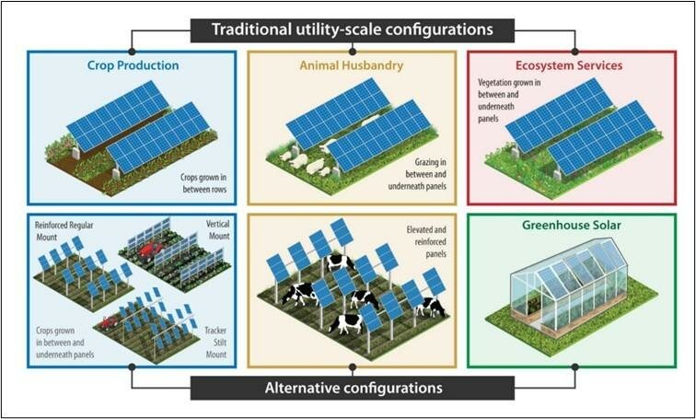
APPLICATION OF AGRIVOLTAICS 3
Six main applications/types of Agrivoltaics
Source Fig.: https://www.researchgate.net/figure/Three-basic-forms-of-agrivoltaics-8_fig1_371043340

Slide 5
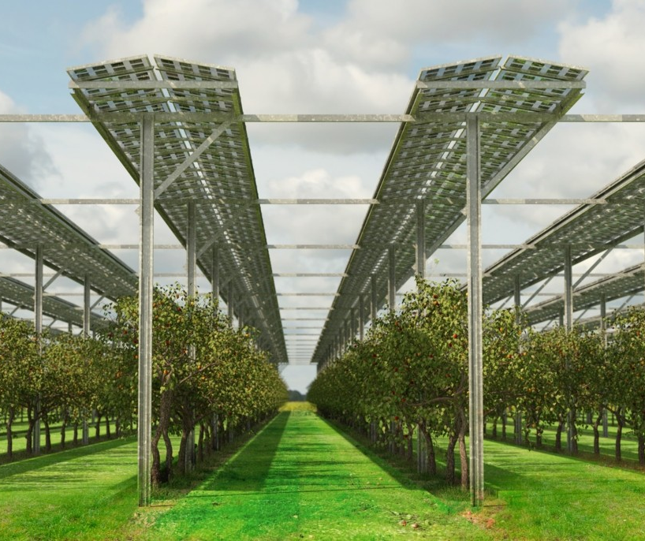
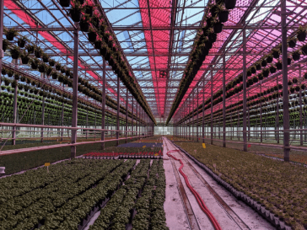
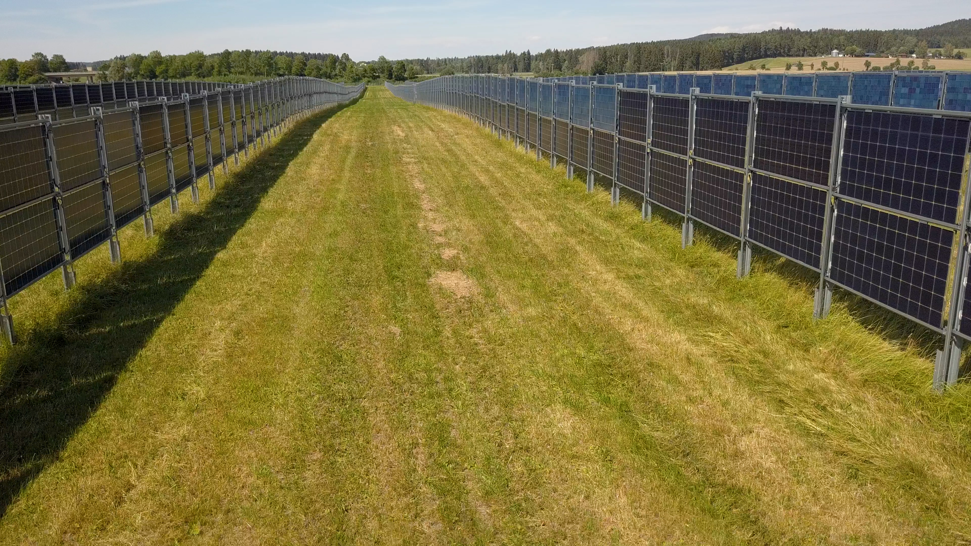
IMPLEMENTATION STRATEGIES FOR AGRIVOLTAICS 4
There are three main system designs for Agrivoltaics
Between the Rows Agrivoltaics
Agrivoltaic Greenhouse
Stilt Mounted Agrivoltaics
Source: https://www.voestalpine.com/sadef/en/Markets/Solar/AgriVoltaics
Source: https://www.crtsgroup.com/en/engineering_talks/photovoltaic-greenhouses-smart-use-of-the-land/

Slide 6
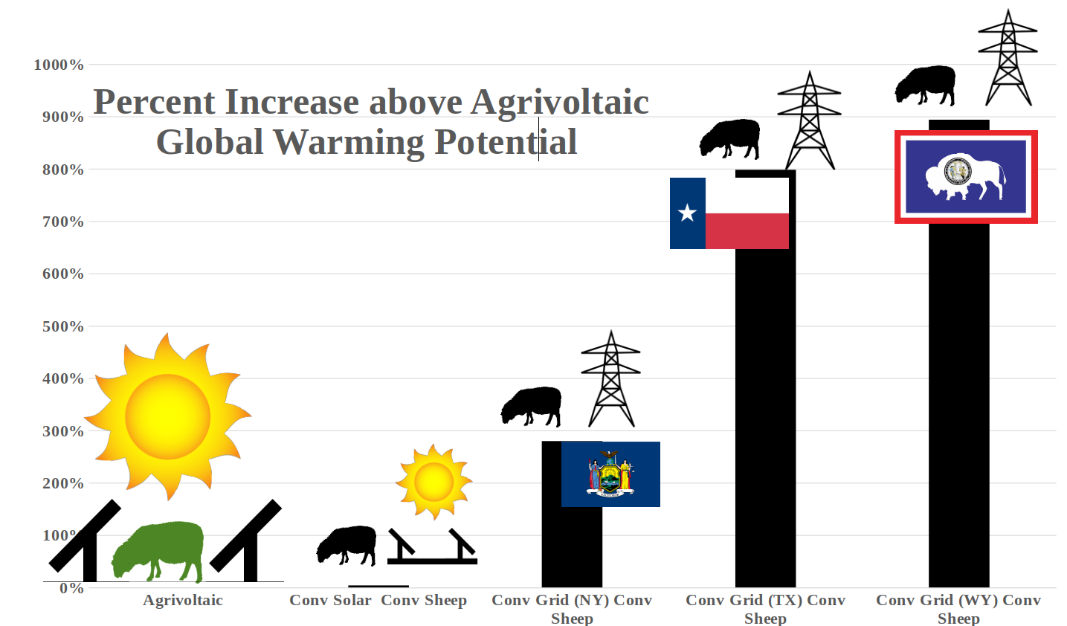
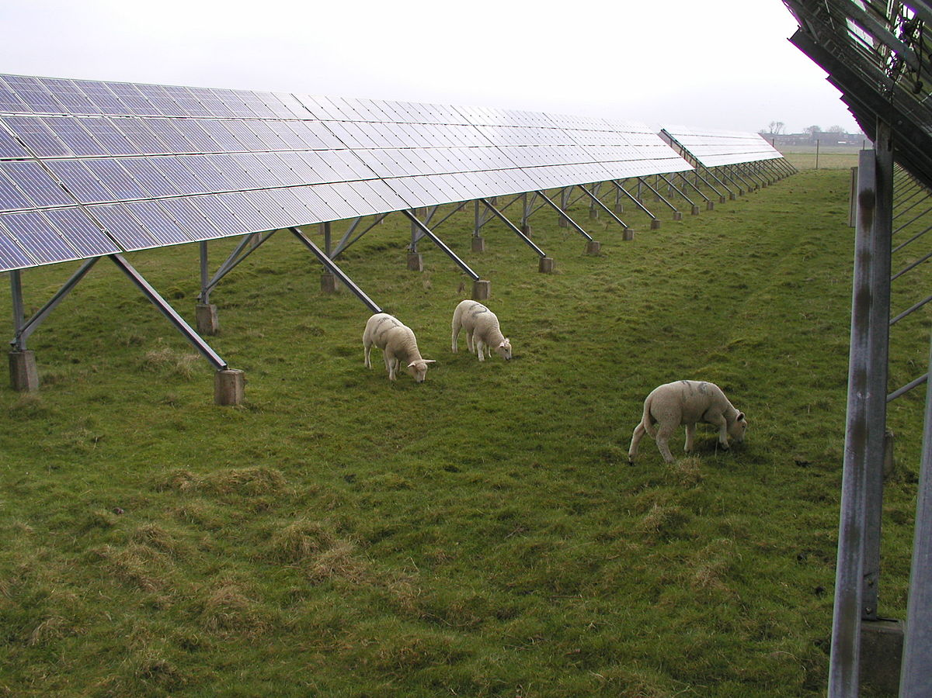
LIFE CYCLE ANALYSIS – SHEEP AGRIOVLTAICS IN USA 5
Handler, R., & Pearce, J. M. (2022). Greener sheep: Life cycle analysis of integrated sheep agrivoltaic systems. Cleaner Energy Systems, 3, 100036. https://doi.org/10.1016/j.cles.2022.100036
CO₂ emissions and ecotoxicity quantified for sheep-based agrivoltaic system
Integrated production results in 3.9% less emissions and 0.5% less energy demand
Comparison of different strategies
Sheep grazing

Slide 7
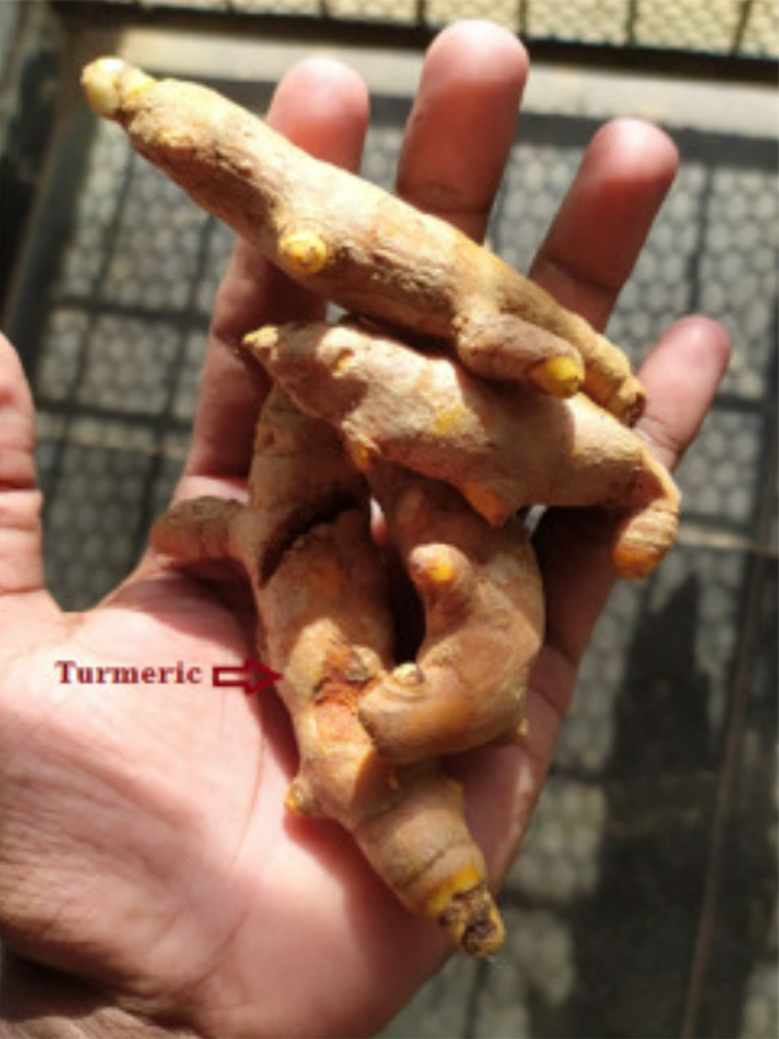
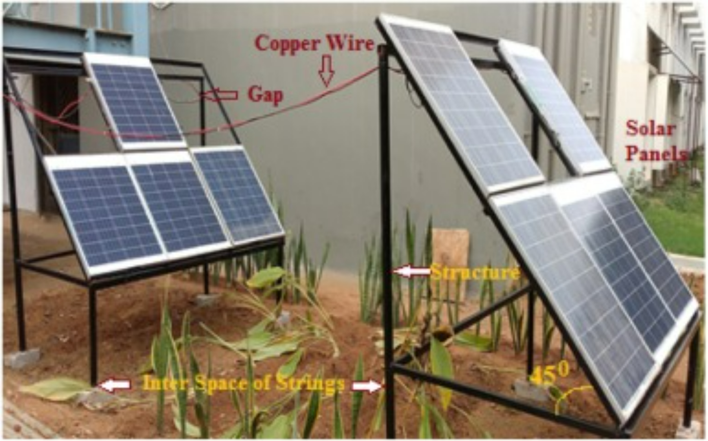
AGRIVOLTAICS IN INDIA – TURMERIC GROWTH 6
Giri, N. C., & Mohanty, R. C. (2022). Agrivoltaic system: Experimental analysis for enhancing land productivity and revenue of farmers. Energy for Sustainable Development, 70, 54–61. https://doi.org/10.1016/j.esd.2022.07.003
0.675 kWp AVS at CUTM, Odisha – Land Equivalent Ratio and Pay Back Period are obtained as 1.73 and 9.49 years
The temperature level is decreased by 1-1.5°C
Control production: 18.5 kg; AV production: 16 kg
Experimental Set-up
Turmeric

Slide 8
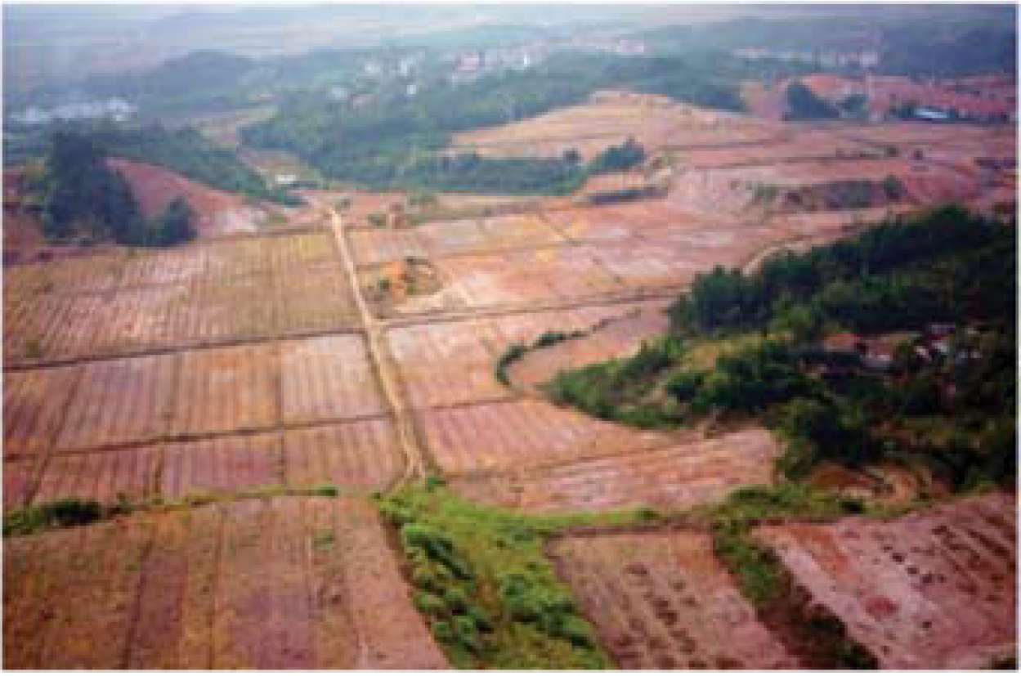
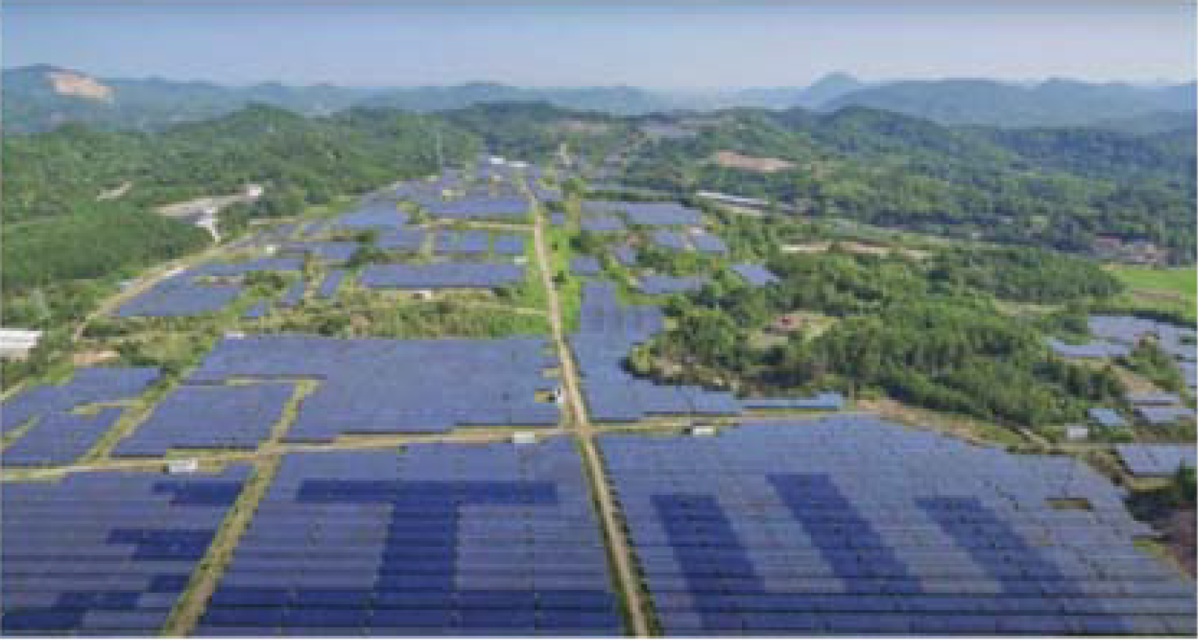
TRANSFORMING BARREN LAND THROUGH AGRIVOLTAICS IN CHINA 7
Xiao, Y., Zhang, H., Pan, S., Wang, Q., He, J., & Jia, X. (2022). An agrivoltaic park enhancing ecological, economic and social benefits on degraded land in Jiangshan, China. AIP Conference Proceedings, 2635(1), 020002. https://doi.org/10.1063/5.0106454
Vegetation cover over 90% from 1%, thus mitigating soil erosion and increasing soil fertility
Saving of 1.63 million tonnes (MT) of coal, an emission reduction of 4.53 MT of CO₂, 140,000 T of SO₂ and 70,000 T of N_{x}O_{y}, a reduction of 1.25 MT of carbon dust emissions and a water saving of 9.12 MT
120 to 150 job opportunities, 1,000 farmers increase their income
Before AV
After AV

Slide 9
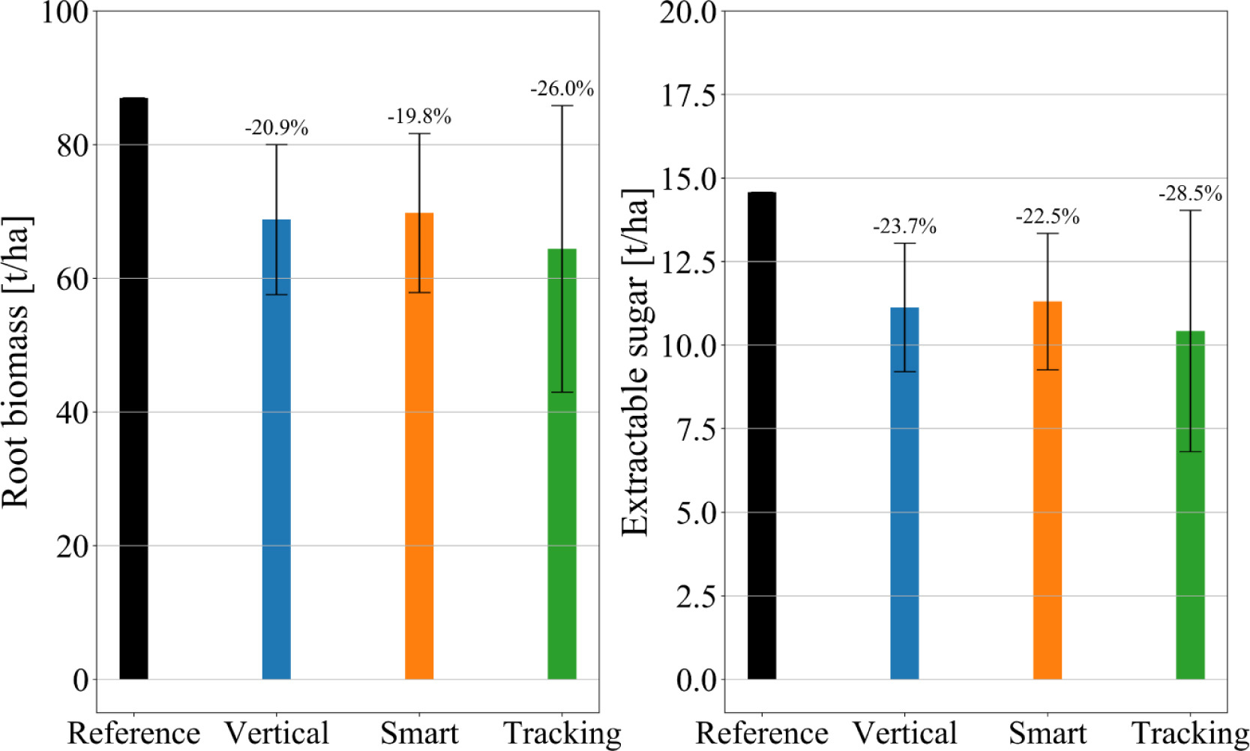
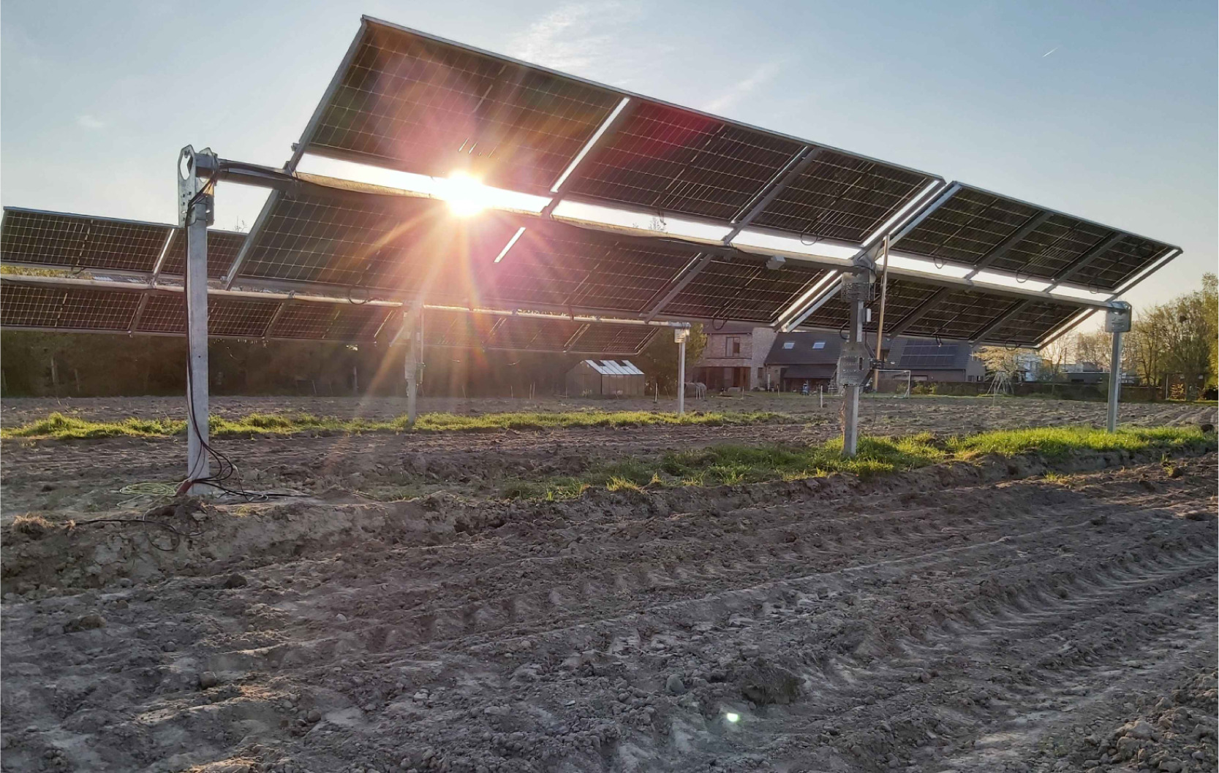
AGRIVOLTAICS IN BELGIUM – SUGAR BEETS EXPERIMENT 8
Willockx, B., Lavaert, C., & Cappelle, J. (2023). Performance evaluation of vertical bifacial and single-axis tracked agrivoltaic systems on arable land. Renewable Energy, 217, 119181. https://doi.org/10.1016/j.renene.2023.119181
Reduction of 26% for full solar tracking, 20% for the vertical setup, and 15% for the smart tracking configuration
The total biomass reduction was observed to be 17% in the vertical setup and 12% in the smart tracking setup
Agrivoltaic Site
Comparative Analysis

Slide 10
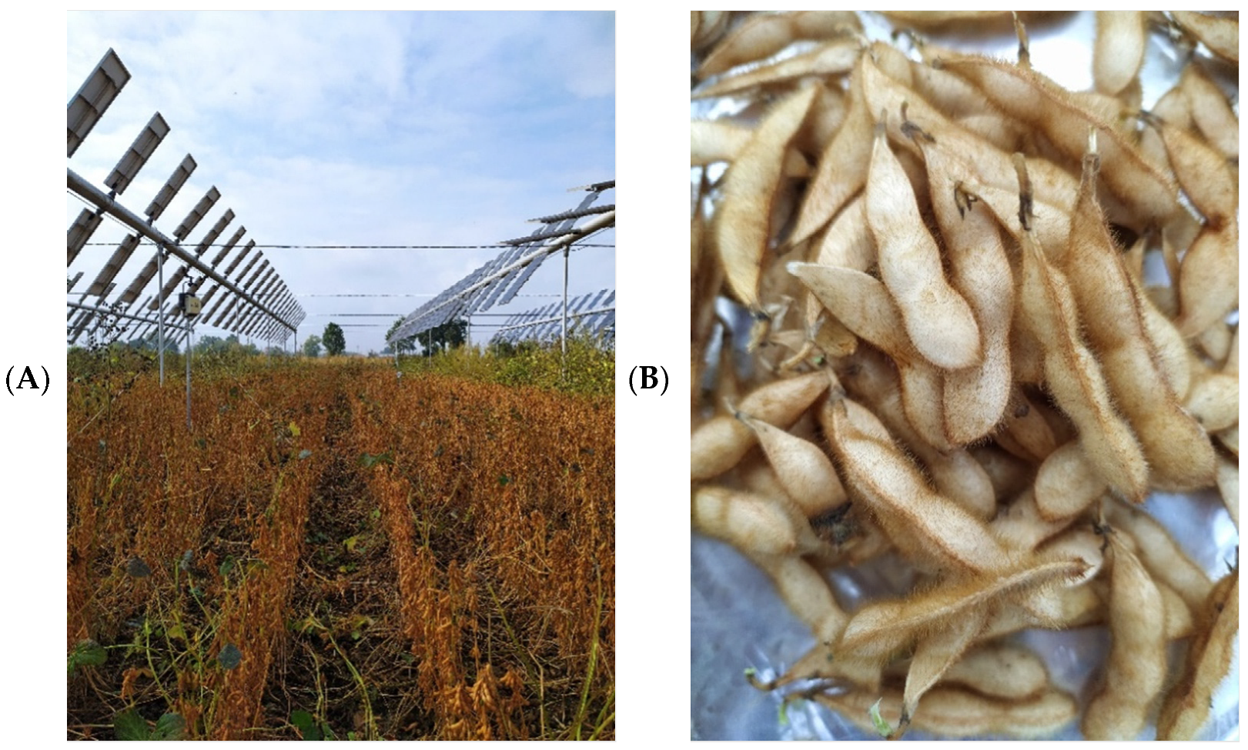
SOYBEAN AGRIVOLTAICS IN ITALY 9
Potenza, E., Croci, M., Colauzzi, M., & Amaducci, S. (2022). Agrivoltaic System and Modelling Simulation: A Case Study of Soybean (Glycine max L.) in Italy. Horticulturae, 8(12), Article 12. https://doi.org/10.3390/horticulturae8121160
Four different shade treatments (27%, 16%, 9%, and 18%) – crop: Soybean
No. of pods – 13% reduction on average
Grain yield – Reduction: 8.6%, 4.6% and 11.8% for AV1, AV3 and AV4; Increment: 4.4% for AV2
Graphical presentation of crop yield
Agrivoltaic Site and Soybean

Slide 11
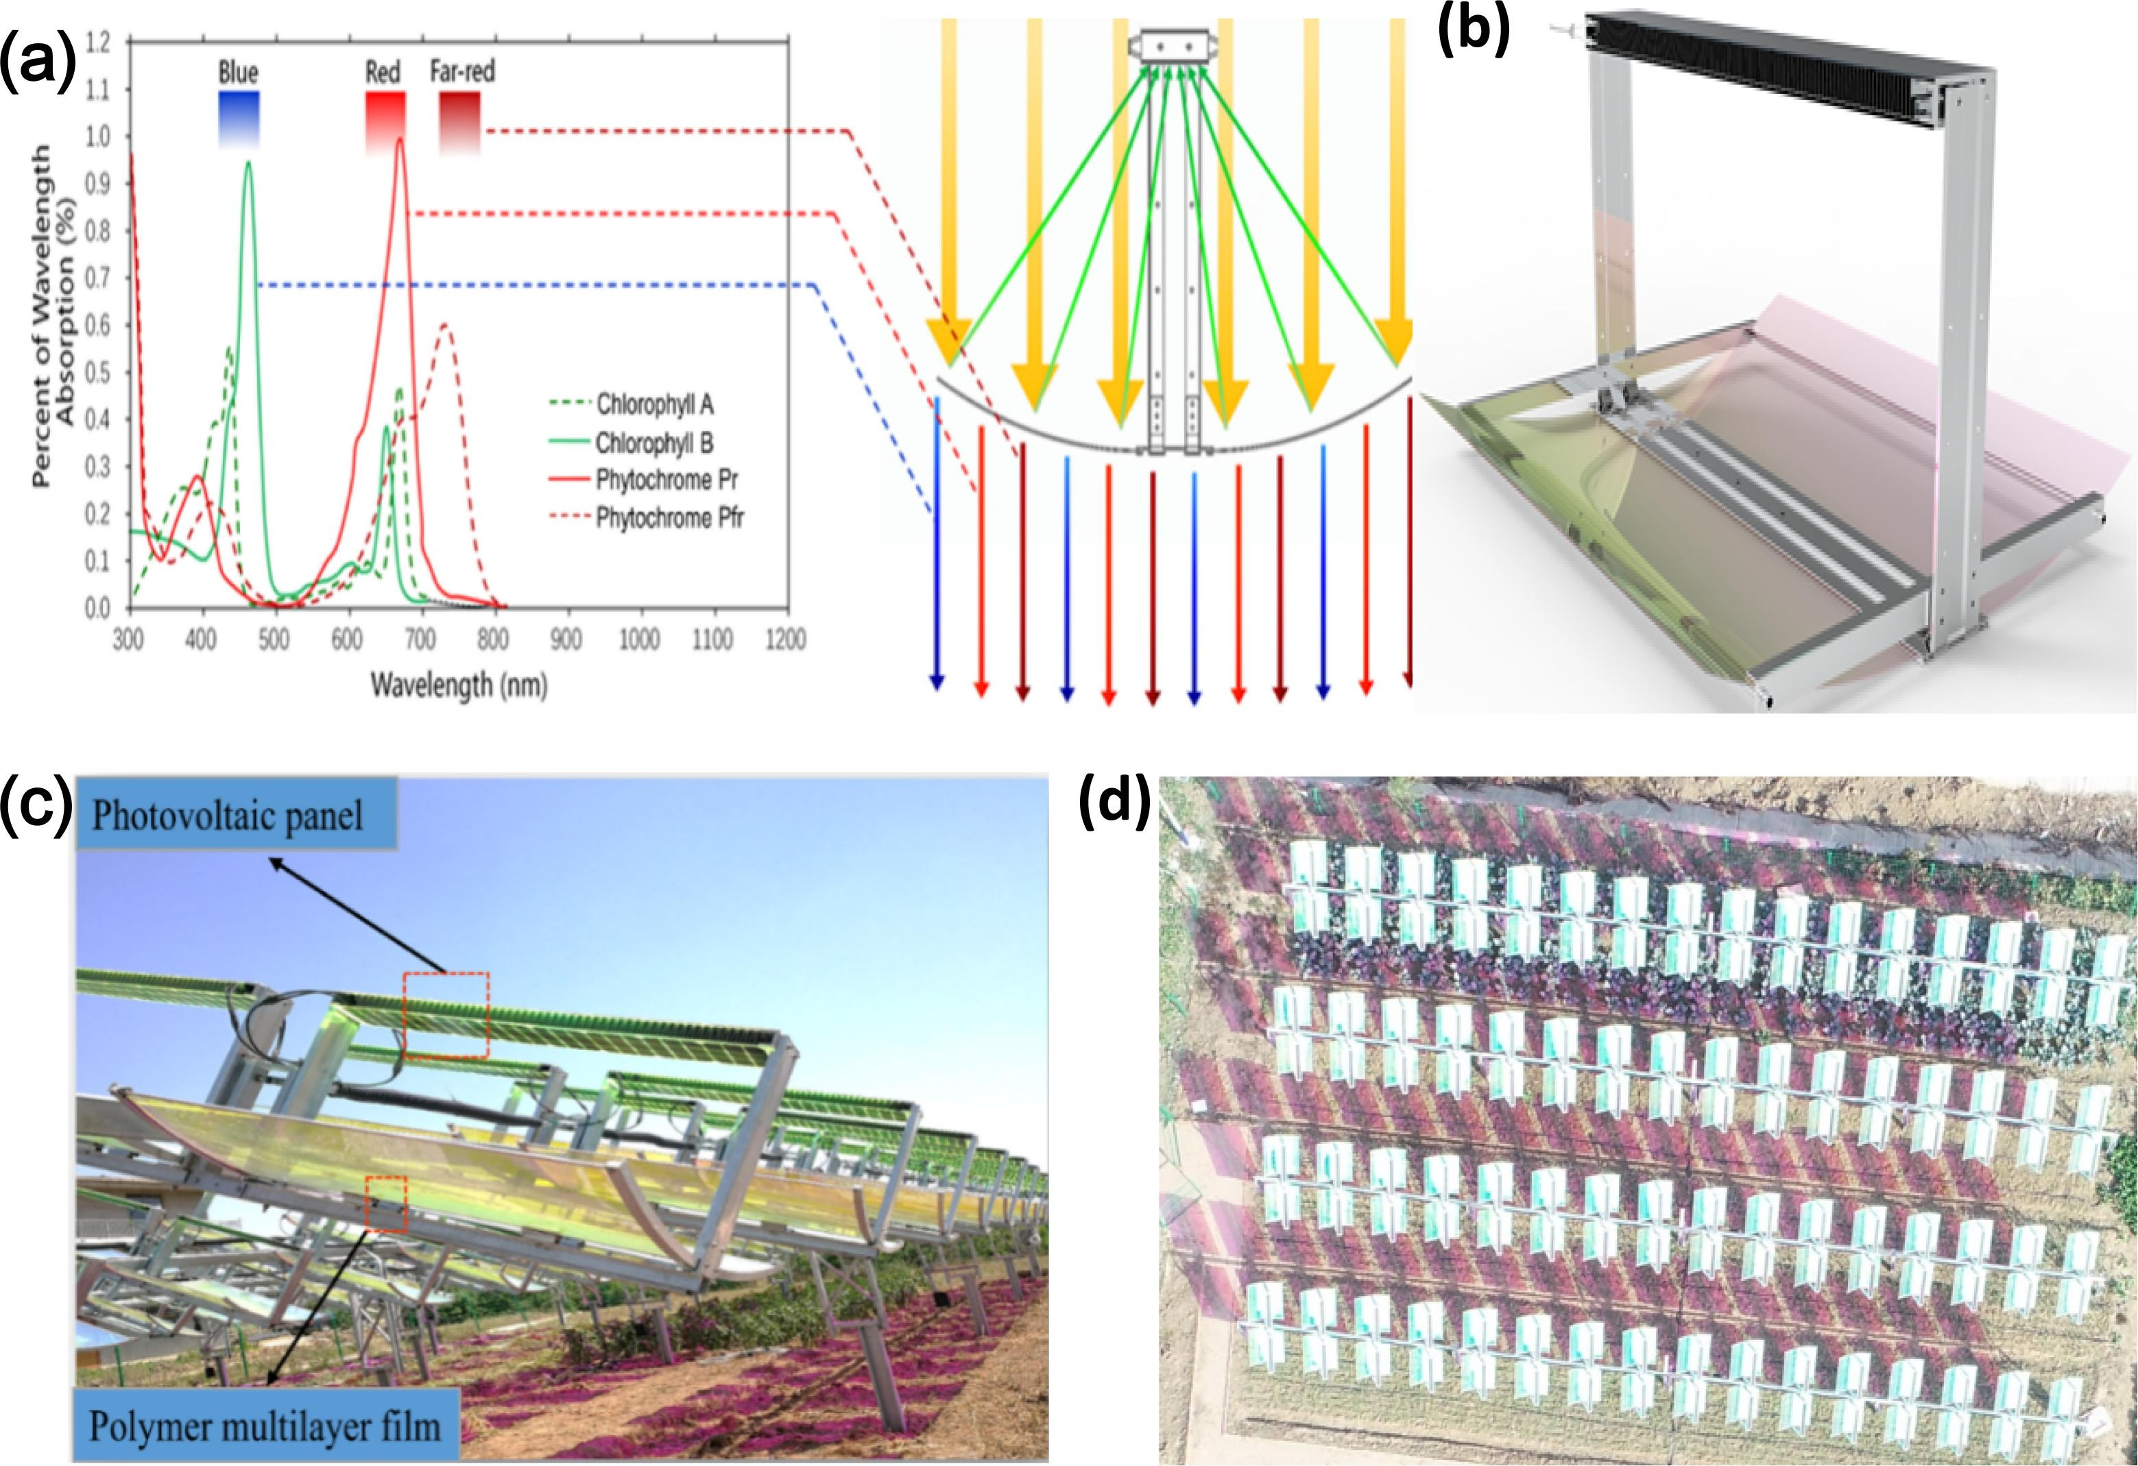
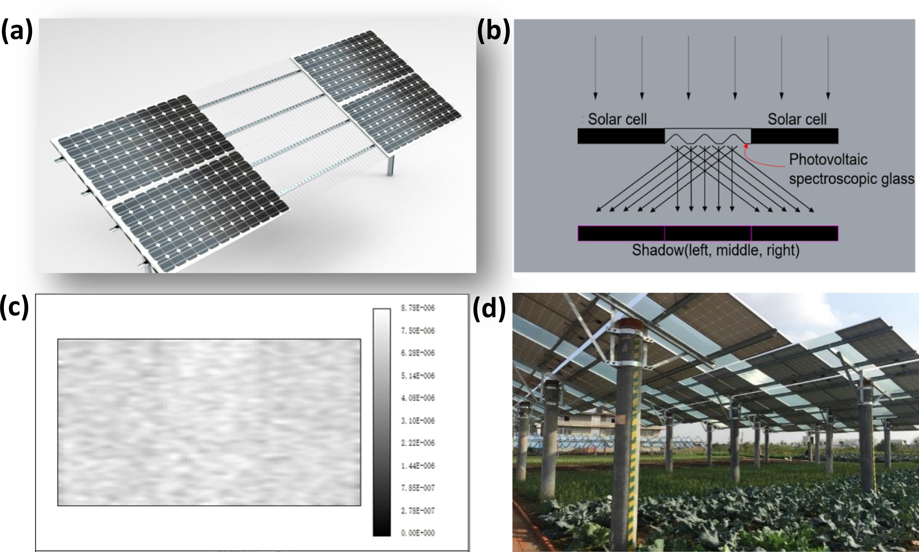
ASSESSING WATER CONSUMPTION IN AN AGRIVOLTAICS SETUP IN CHINA 10
Ali Abaker Omer, A., Liu, W., Li, M., Zheng, J., Zhang, F., Zhang, X., Osman Hamid Mohammed, S., Fan, L., Liu, Z., Chen, F., Chen, Y., & Ingenhoff, J. (2022). Water evaporation reduction by the agrivoltaic systems development. Solar Energy, 247, 13–23. https://doi.org/10.1016/j.solener.2022.10.022
Cumulative evaporation from soil and pan surfaces decreased by 21% and 14% under Concentrated-lighting Agrivoltaic System, and 33% and 19% under Even-lighting Agrivoltaic System
Concentrated Light Agrivoltaic System
Even Lighting Agrivoltaic System

Slide 12
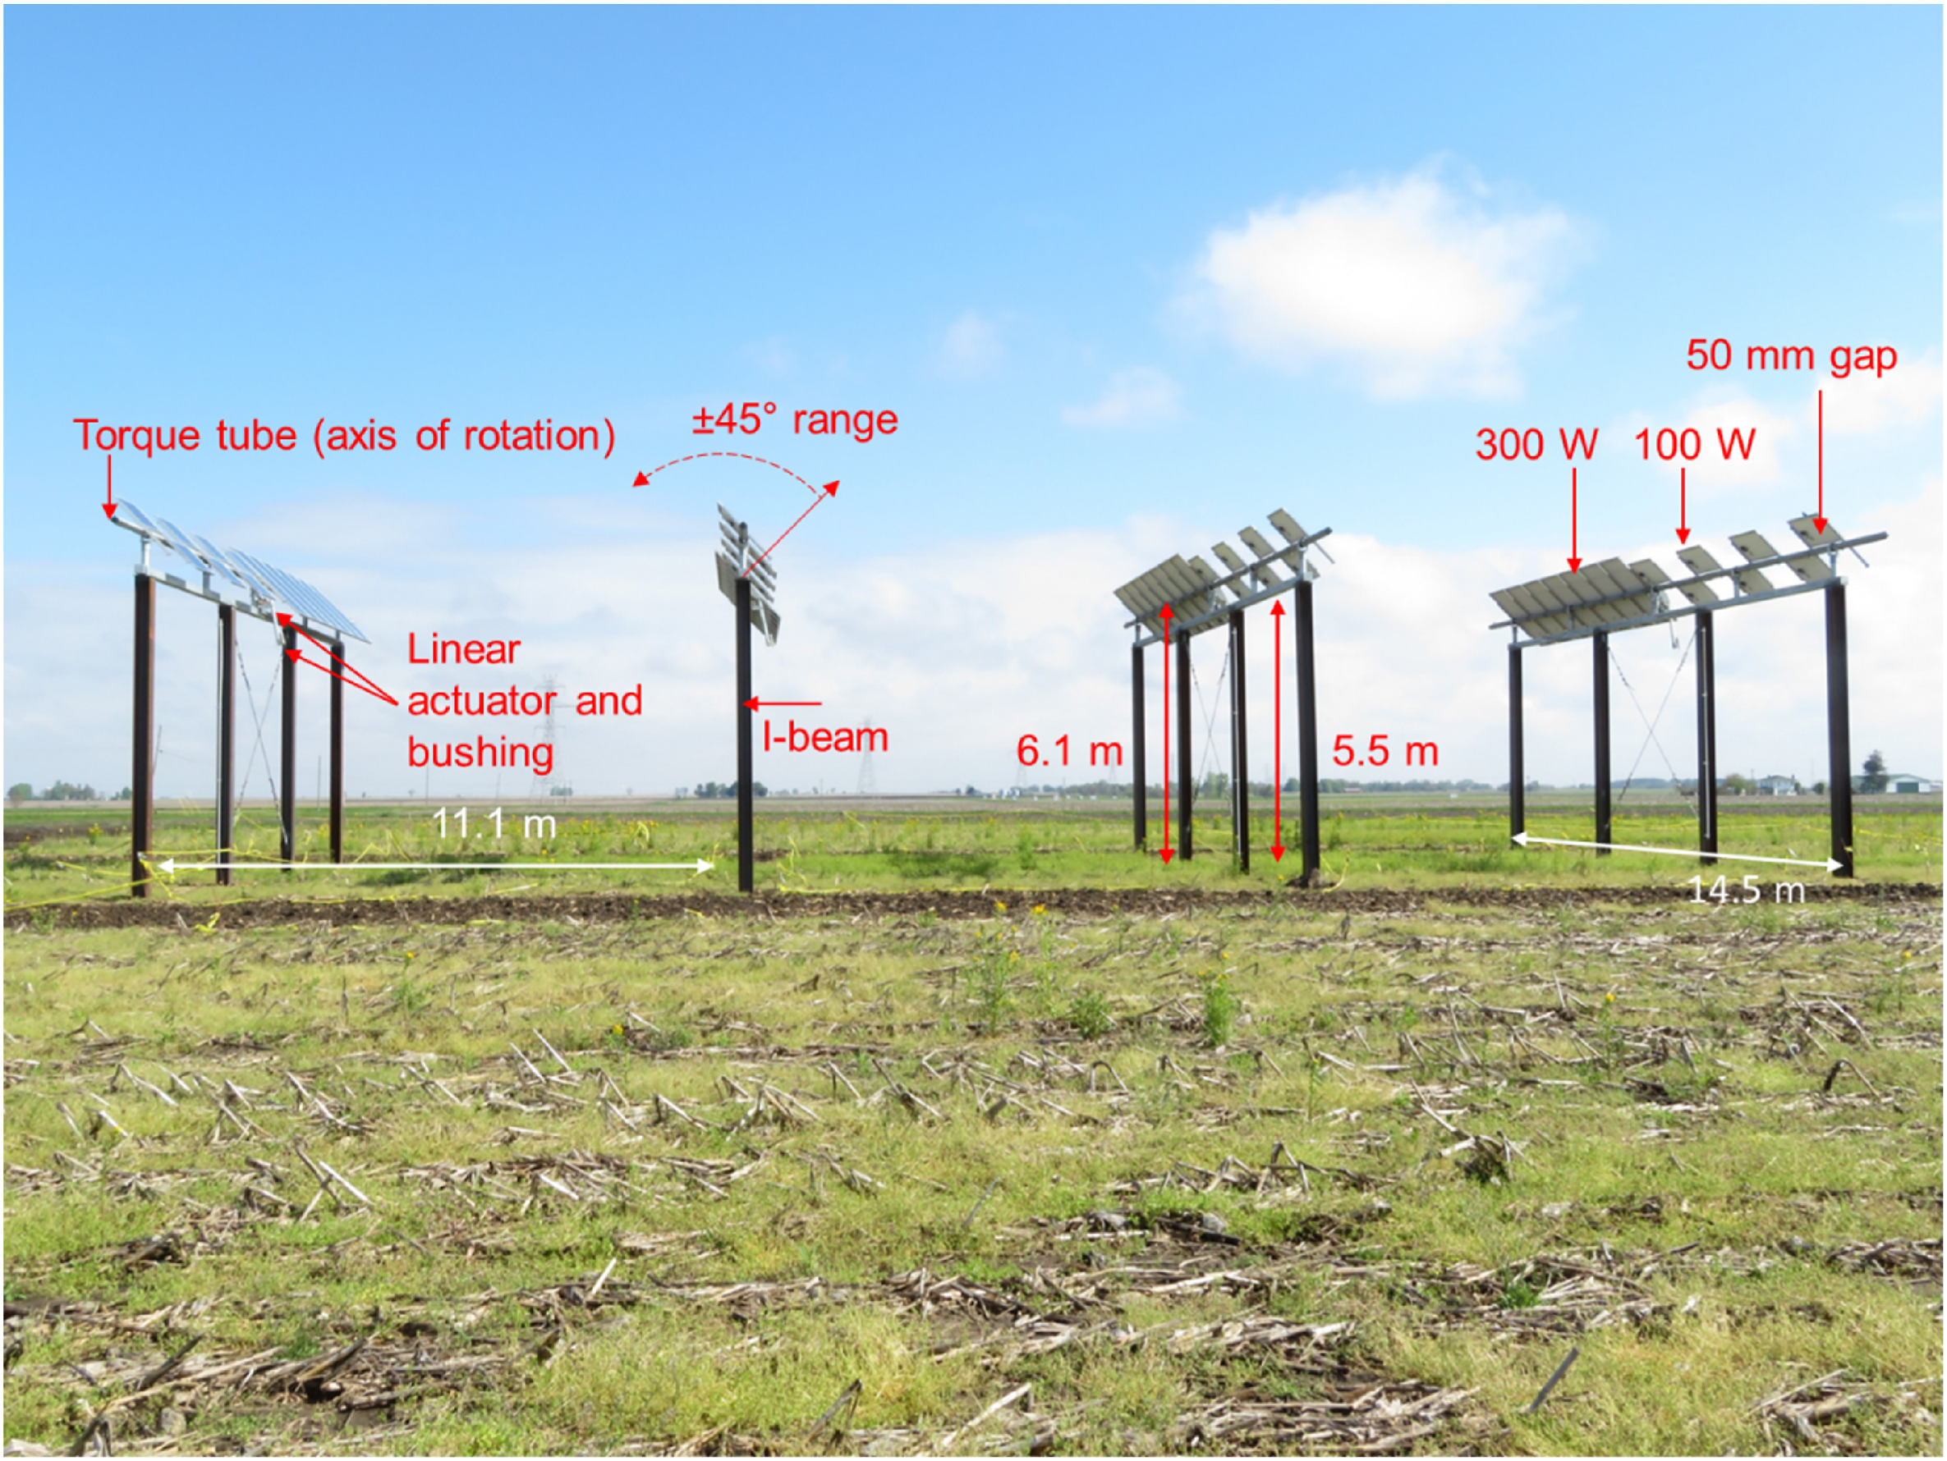
MAIZE AGRIVOLTAICS IN USA 11
Grubbs, E. K., Gruss, S. M., Schull, V. Z., Gosney, M. J., Mickelbart, M. V., Brouder, S., Gitau, M. W., Bermel, P., Tuinstra, M. R., & Agrawal, R. (2024). Optimized agrivoltaic tracking for nearly-full commodity crop and energy production. Renewable and Sustainable Energy Reviews, 191, 114018. https://doi.org/10.1016/j.rser.2023.114018
Purdue University Agronomy Center for Research and Education (ACRE); Crop: Maize; Single Axis Tracker
Control yield: 12.95 MT/ha; Agrivoltaic yield: 11.95 MT/ha
Agrivoltaic Racking
Agrivoltaic Experimental Setup

Slide 13
U.S. AGRIVOLTAICS MAP SUMMARY: NUMBER OF SITES 12
 | Number of Sites | Total MW | Total Acres | Total Hectares
Habitat | 399 | 3,067 | 17,763 | 7,188
Grazing | 127 | 3,552 | 26,492 | 10,720
Crop Production | 26 | 14 | 73 | 30
Greenhouse | 2 | .04 | .2 | .08
Totals* | 477 | 6,633 | 44,329 | 17,939
*Totals do not reflect the complete sum of the above categories as some sites have multiple agrivoltaic activities ongoing. These values are represented in their categories, but not duplicated in the sum totals.
Number of Sites
Number of Sites
Slide Credit: Jordan Macknick and Alexis Pascaris, National Renewable Energy Laboratory (NREL)

Slide 14
AGRIVOLTAICS IN CANADA – SPECIALIZED RACKING 13
Jamil U, Vandewetering N, Pearce JM (2023) Solar photovoltaic wood racking mechanical design for trellis-based agrivoltaics. PLOS ONE 18(12): e0294682. https://doi.org/10.1371/journal.pone.0294682
Specialized racking configurations for Agrivoltaics
T-shaped Rack
Sloped Rack
Inverse-Y Rack

Slide 15
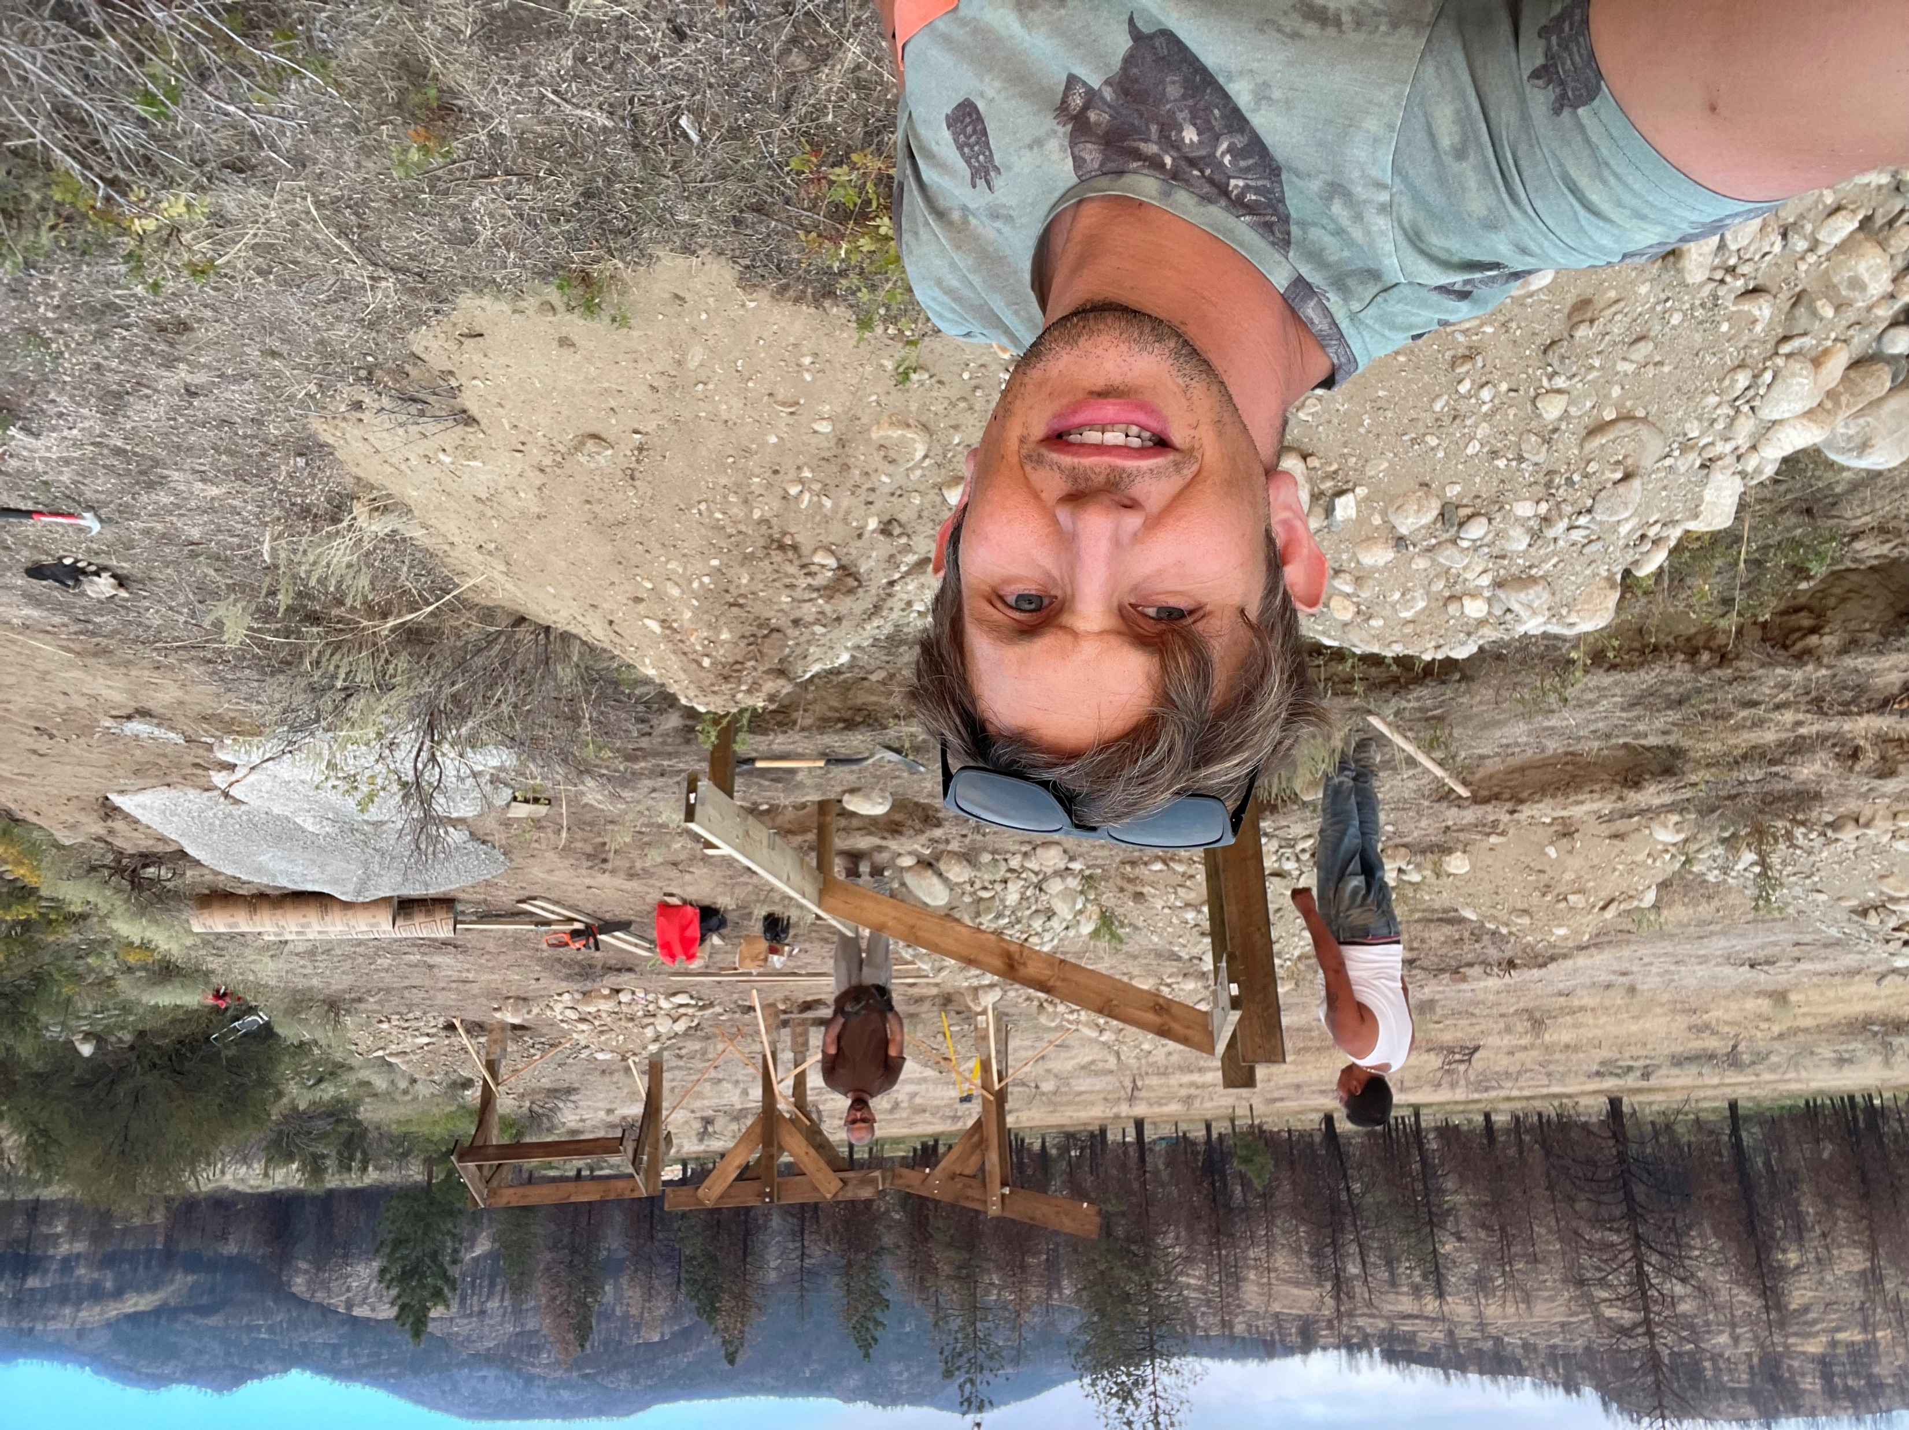
AGRIVOLTAICS IN OKANAGAN, BRITISH COLUMBIA 14
Pilot Project – Okanagan, BC, Canada
The first specialized Agrivoltaic racking in the province
Rack Building in Okanagan, BC

Slide 16
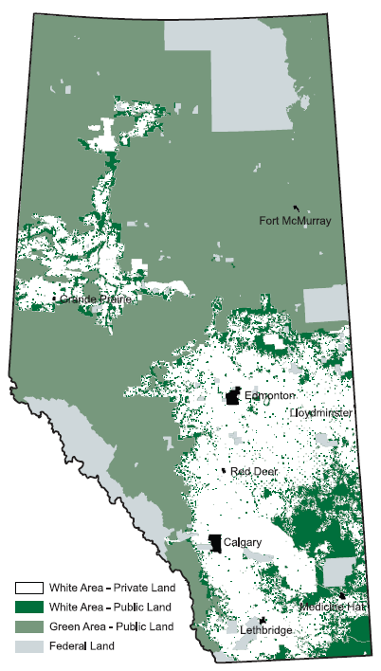
AGRIVOLTAICS IN ALBERTA – POLICY & LEGISLATION 15
Jamil U, Pearce JM. Energy Policy for Agrivoltaics in Alberta Canada. Energies. 2023; 16(1):53. https://doi.org/10.3390/en16010053
LAND USE FRAMEWORK (LUF)
Land is categorized as Green and White Area
Strategies which define utilization of land in province
MAINTAINING AGRICULTURAL LAND
Regional Planning
Conservation Directives
Conservation Easements for Agricultural Lands
MUNICIPAL GOVERNMENT ACT
The main legislative document oversighting municipalities in the region
BILL 22
The amendment unlocking provision for self-supply and export of electricity
Alberta, Canada

Slide 17
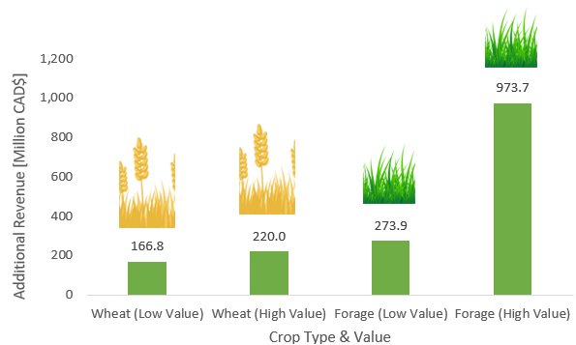
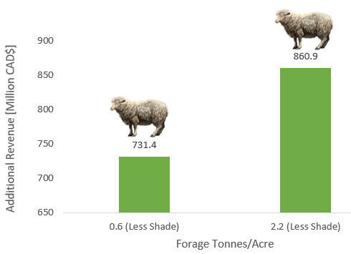
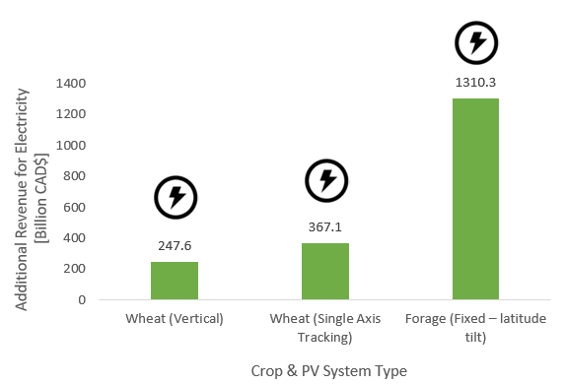
AGRIVOLTAICS IN SASKATCHEWAN 16
Jamil U, Pearce JM. Maximizing Biomass with Agrivoltaics: Potential and Policy in Saskatchewan Canada. Biomass. 2023; 3(2):188-216. https://doi.org/10.3390/biomass3020012
The study examines increased biomass yield in the region and its subsequent influence on livestock
Additional revenue (low and high) from additional wheat or forage
Additional revenue from sheep that can be grazed on land due to additional forage from agrivoltaic
Additional revenue from electricity generated from agrivoltaic

Slide 18
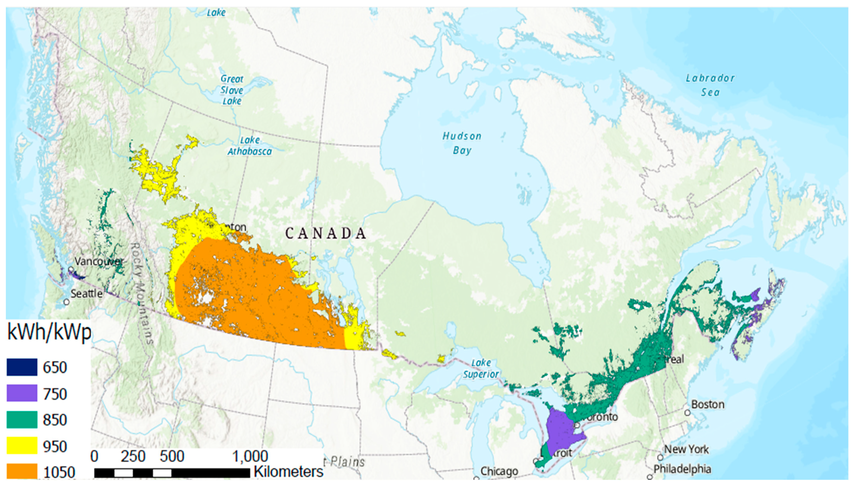
THE 4% SOLUTION FOR CANADA 17
Jamil U, Bonnington A, Pearce JM. The Agrivoltaic Potential of Canada. Sustainability. 2023; 15(4):3228. https://doi.org/10.3390/su15043228
28% to 43% of Canada’s electricity requirements can be catered with by adopting AV on 1% agricultural land
Less than 1% of agricultural land required to decarbonize electricity grid for all provinces, except for Alberta, British Columbia, and the Maritimes with vertical AV
Province | Vertical (%) | Single-Axis (%)
Ontario | 0.71 | 0.4
Alberta | 1.4 | 0.92
Saskatchewan | 0.26 | 0.17
Manitoba | 0.0036 | 0.0023
British Columbia | 1.12 | 0.72
Quebec | 0.067 | 0.044
Maritimes | 4.5 | 2.5
Percentage of agricultural land required to eliminate emissions from fossil fuel-based electricity generation in Canada
Potential of vertical, south-facing PVs in the farmland regions across Canada

Slide 19
DO AGRIVOTLAICS IMPROVE PUBLIC SUPPORT? 18
Pascaris, A. S., Schelly, C., Rouleau, M., & Pearce, J. M. (2022). Do agrivoltaics improve public support for solar? A survey on perceptions, preferences, and priorities. Green Technology, Resilience, and Sustainability, 2(1), 8. https://doi.org/10.1007/s44173-022-00007-x
Social acceptance and support is imperative for proliferation of any technology
Results show that 81.8% of population would be more likely to support solar development in their community if it is integrated agricultural production
Thus, agrivoltaics appears to be a key ingredient in transforming the energy and agricultural landscape of Canada; moving towards a renewable and sustainable future

Slide 20
THANK YOU

