Slide 1
University of Western Ontario Agrivoltaic conference
C. Baldus-Jeursen
December 11th, 2023

Slide 2
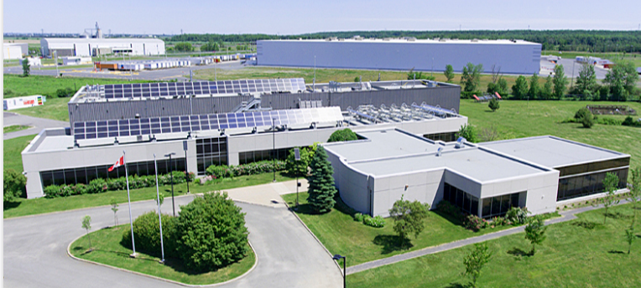
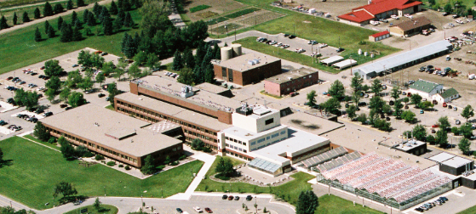
Natural Resources Canada
Canmet (Varennes): facilitate research, development and demonstration of agrivoltaic technologies through system testing and PV potential studies.
Address topics that would be high-risk, long-term, or not immediately profitable.
Participate in Canada’s agrivoltaic transition by providing data that can be used by other departments such as the Renewable and Electrical Energy Division (REED) and the Office of Energy Research and Development (OERD).
Possible partnership between Natural Resources Canada and Agriculture and Agri-Food Canada to combine farming and PV expertise.
Notes:
Canmet Varennes is primarily a research and deployment centre. We do not shape policy, but we provide data to those who do. We do not provide funding for projects.

Slide 3
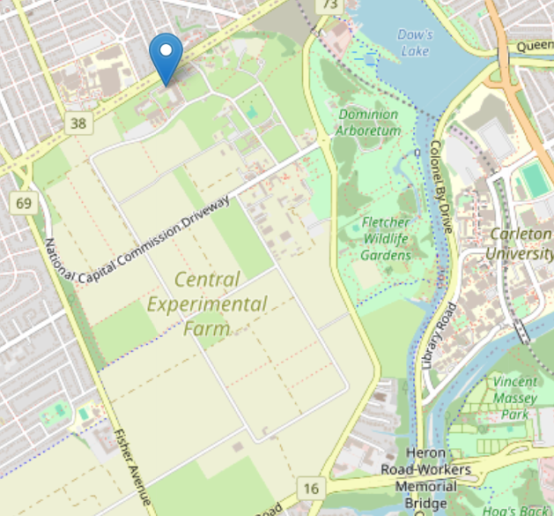
Central Experimental Farm
Site established in 1886 and currently operated as one of Agriculture and Agri-Food Canada's network of 20 research and development centres.
Ottawa Research and Development Centre (RDC) mandate: improved spring and winter wheat, oats, barley, corn, agronomic practices and technologies for eastern Canada.
RDC funding supports the agriculture and agri-food sectors.

Slide 4
Office of Energy Research and Development
The Office of Energy Research and Development (OERD) leads the Government of Canada’s efforts in delivering renewable energy RD&D funding, for example through mechanisms like the Energy Innovation Program.
With a focus on influencing the pace and direction of energy system transformation, OERD targets impactful technologies to maximize environmental and economic outcomes.
OERD invests in 13 federal departments and agencies to undertake RD&D, as well as Canadian small and medium enterprises, utilities, and other industries.
Invested approximately $500 million since 2016 across 300 projects. Results include direct/indirect employment, development of codes/standards/regulations, patents, licenses, and peer-reviewed publications.
Notes:
Renewable and Electrical Energy Division: mandate deals with inter-provincial electricity trades and Canada-US electricity trades. They also manage renewable energy deployment programs for utility-scale solutions, whereas OERD funds private demonstration projects and federal R&D related to energy.
The Energy Innovation Program’s Smart Grid call for proposals will provide support to the key technology, market, and regulatory innovations that address barriers to scale pilot projects into grid-wide deployments. The intended results include significant impacts to enhancing grid reliability, resiliency, and flexibility; energy affordability; enabling greenhouse gas (GHG) emission reductions; and making market conditions more favourable to scaling successful innovation

Slide 5
Additional programs
Smart Renewables and Electrification Pathways Program (canada.ca) – supports the permanent deployment of renewables (including solar) across the country. This program also supports communities and organizations with acquiring the knowledge and tools needed to develop renewable energy and grid modernization projects.
Clean Energy for Rural and Remote Communities Program (canada.ca) – accepting applications for research, development, and demonstration of clean energy projects in rural and remote communities.

Slide 6
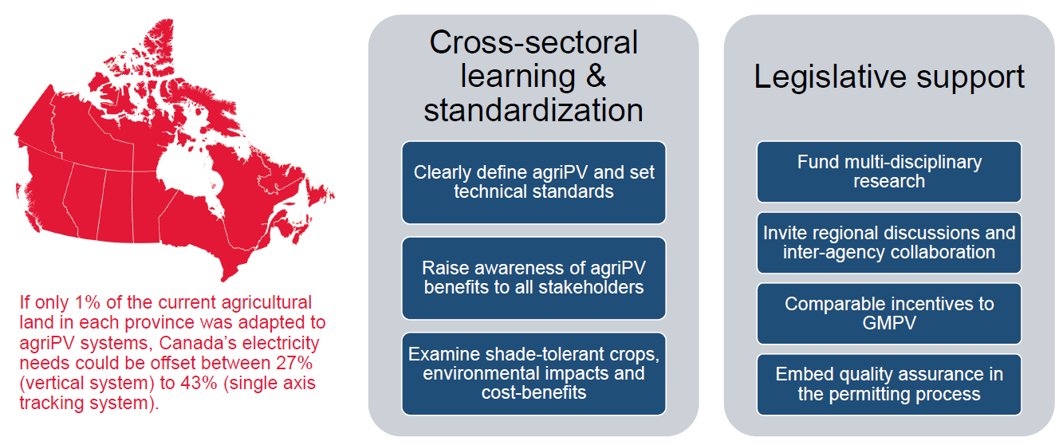
Preliminary studies & recommendations

Slide 7
Contact information
Christopher Baldus-Jeursen Photovoltaic Researcher Natural Resources Canada christopher.baldus-jeursen@nrcan-rncan.gc.ca Phone: 438-462-5782

