Slide 1
Leveraging Demand Side Resources & DERs
a utility perspective
Ivey Business School – Seventh Annual Workshop
on the Economics of Electricity Policy & Markets
Mon, 16 Oct 2023
Karynne Munroe
Manager, Emerging Technology & Funding
Nova Scotia Power Inc.

Slide 2
Nova Scotia Power –
balancing reliability with innovation

Slide 4
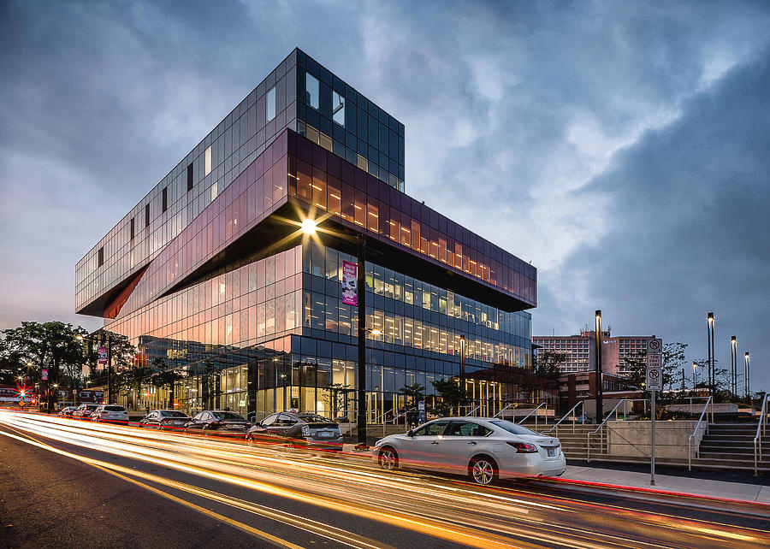
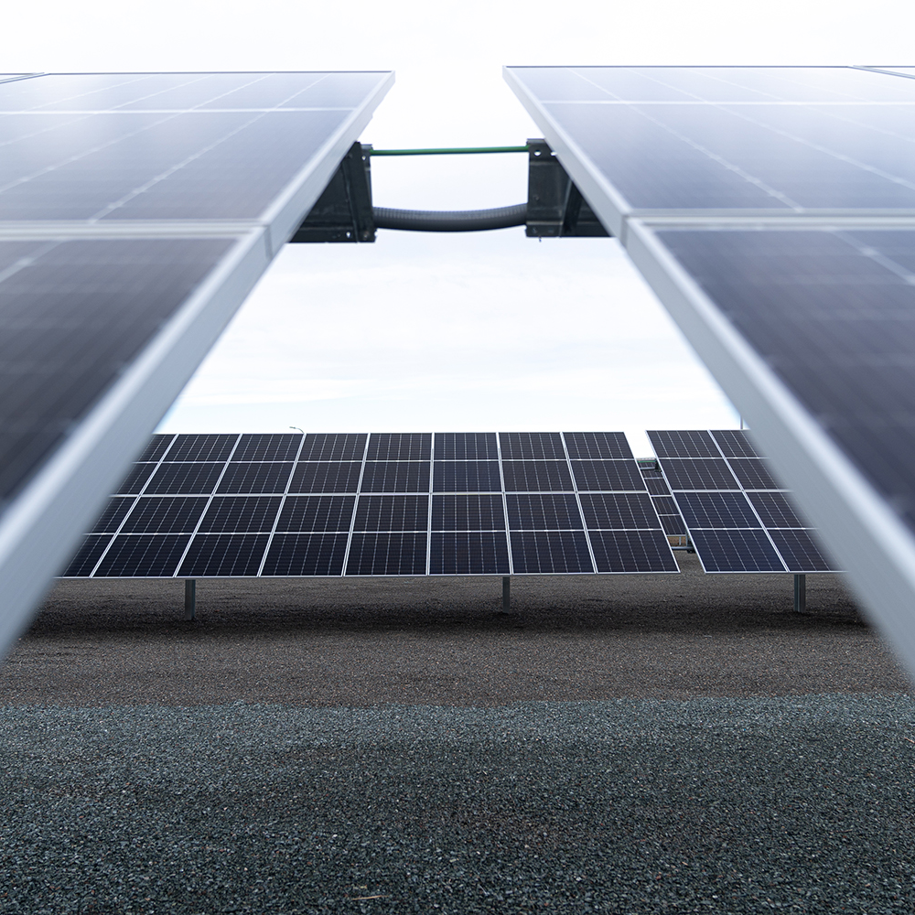
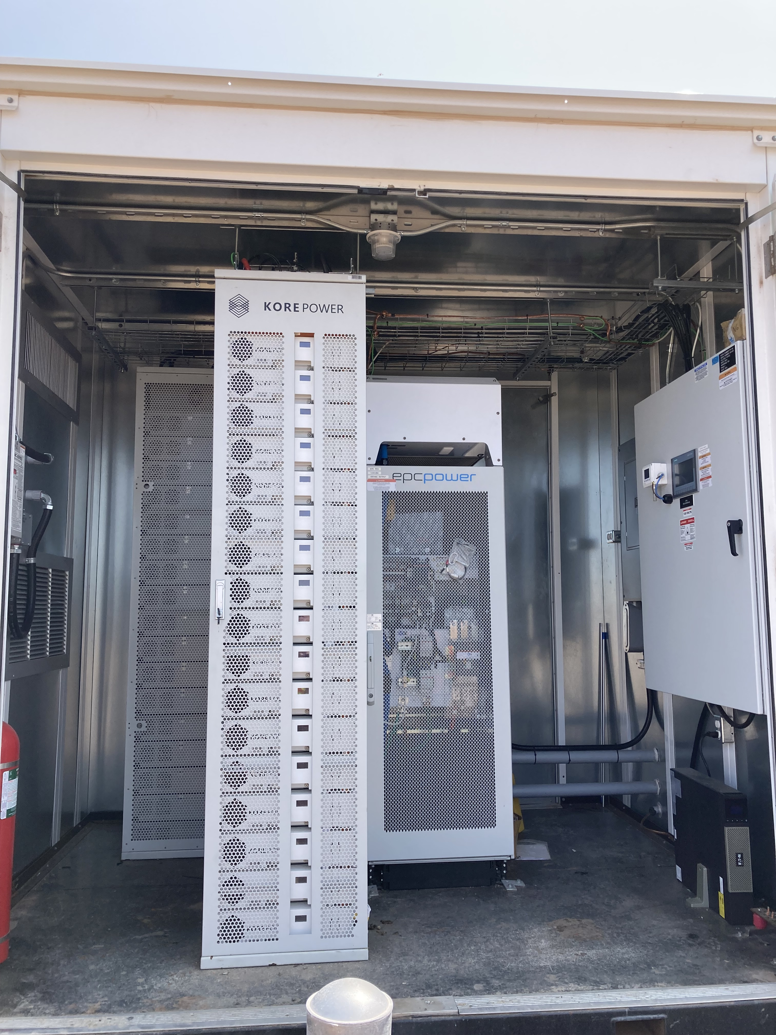
POWERING A GREEN NOVA SCOTIA, TOGETHER.
V2X BIDIRECTIONAL EV CHARGING
COMMERCIAL BUILDING DEMAND RESPONSE
COMMUNITY SOLAR GARDEN
DISTRIBUTED RESIDENTIAL BATTERY STORAGE VPP
COMMERCIAL & INDUSTRIAL
SOLAR + BATTERY
EV SMART CHARGING & TELEMATICS

Slide 5
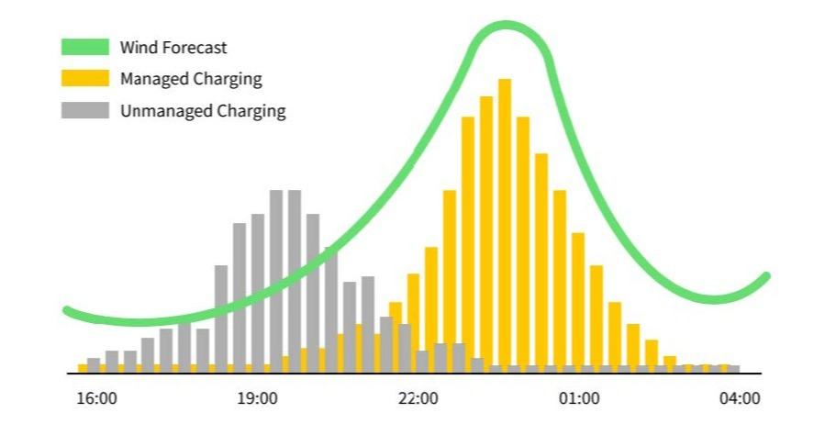
Electric Vehicle Charging –
follow the wind

Slide 6
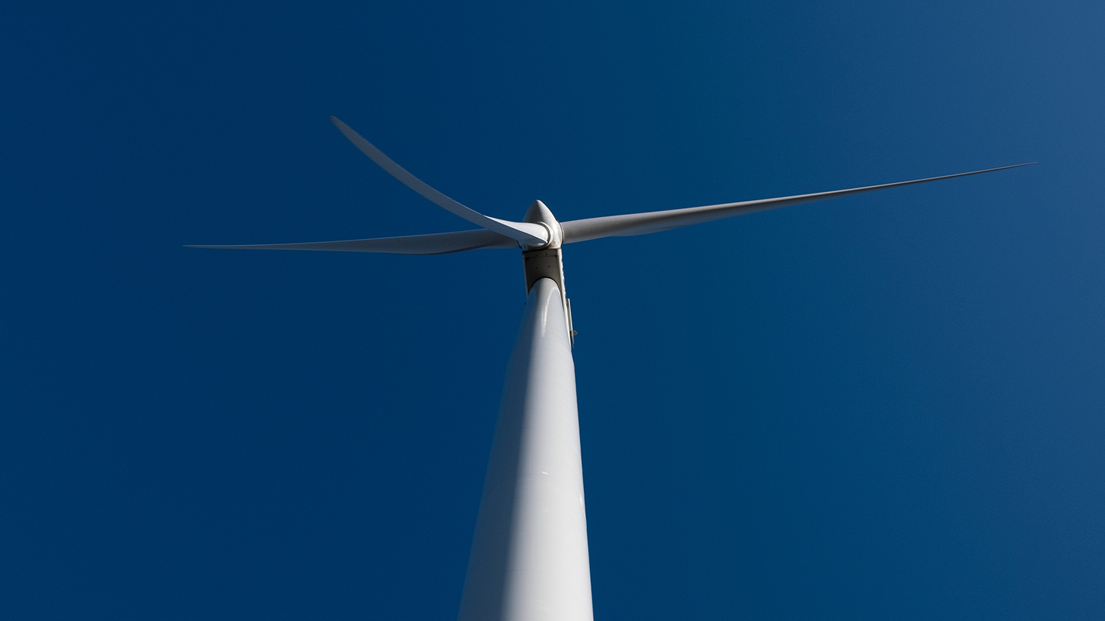
The Energy Landscape is Evolving –
and so are our customers

Slide 7
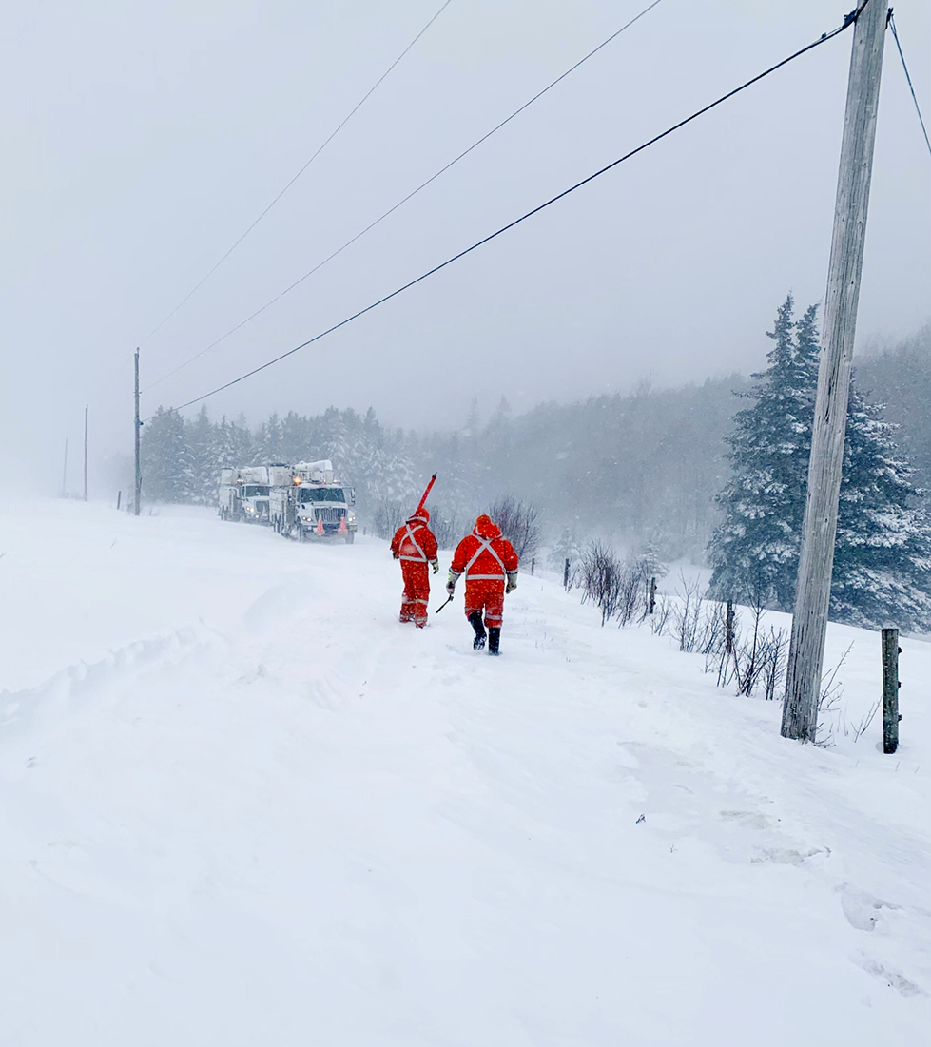
Working Together –
creating value on our journey toward a cleaner energy future

