Slide 1
Utilities and the Transition to a Distributed Energy Future
7th Annual Energy Workshop - Ivey Energy Policy and Management Centre
Daniel Carr
Head, Smart Cities
October 16, 2023
Notes:
Hi, my name is Daniel Carr, and I’m really pleased to be here with you today. I’m the Head of Smart Cities at Alectra Utilities, and electrification of transportation comprises most of my work. In my group, we do research, develop strategy and deploy demonstration projects, all with the goal of scaling up new business models and adopting new technologies.

Slide 2
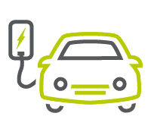
Presentation Overview
About Alectra
Implications of distributed energy
Insights from program experience
A view towards the future
Notes:
In my brief remarks before we get down to questions, I wanted to highlight a few areas I’m going to touch on.
First, intro Alectra for those who aren’t aware
Secondly, talk about the issues of distributd energy, and how those present themselves to us as a distribution utilty
Third, talk about our experience
Finally, close with some thoughts about where this might take us

Slide 3
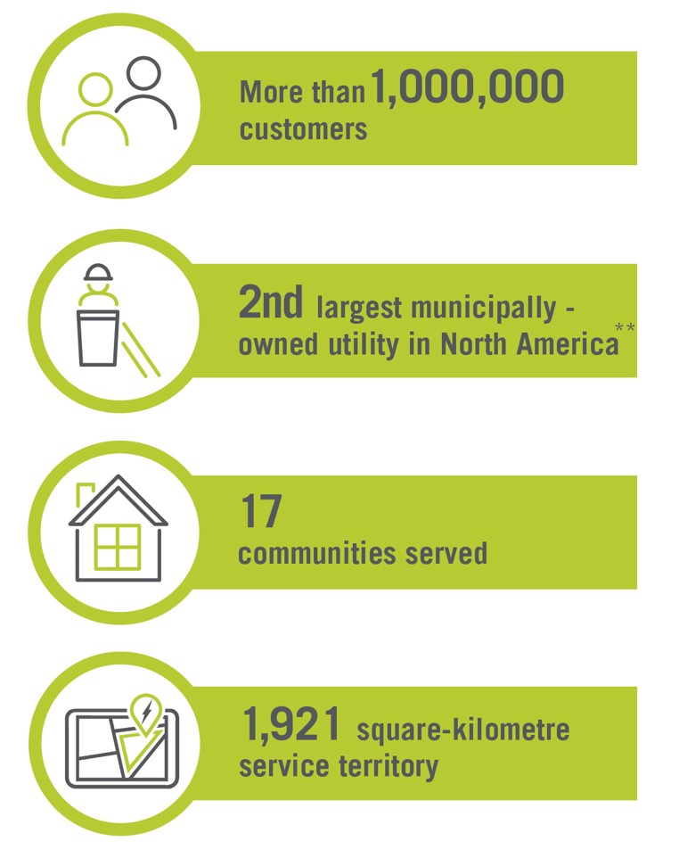
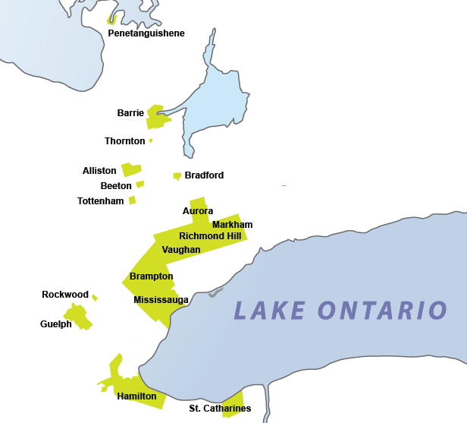
About Alectra
Alectra is an energy company that distributes electricity and provides innovative energy solutions to customers in the Greater Toronto and Hamilton area, with over C$4.8 billion in assets and 1,500 employees.
Alectra Utilities serves over 1 million residential and commercial customers by distributing electricity; regulated by the Ontario Energy Board.
Alectra Energy Solutions and Services provides innovative energy solutions, such as EV charging infrastructure, microgrids, energy storage, solar PV, metering, street lighting deployment services.
Notes:
So, what is Alectra? It is a relatively new company formed in 2017 through the merger of several electricity distribution companies spread across the greater Toronto and Hamilton area. We serve over now 1M customers in 17 communities in Southern Ontario
We have both a traditional distribution business, regulated by the Ontario Energy Board, as well as an unregulated affiliate that provides a variety of energy services to commercial and municipal customers. On account of the diversity of work that we do, we have a range of services and of specializations that we provide.
I’d like to thank my colleagues across both organizations for their ongoing support for electrification projects.

Slide 4
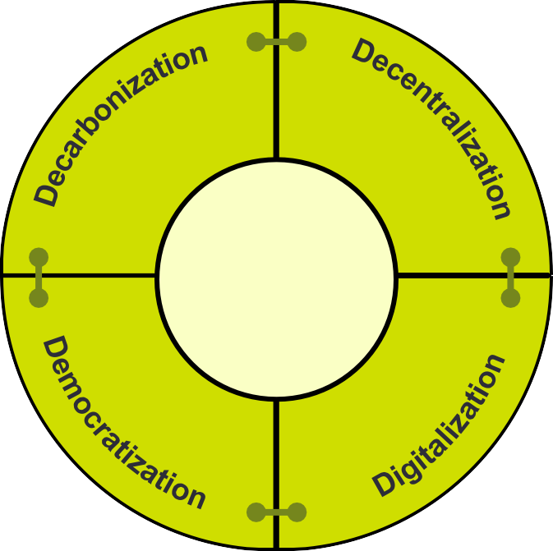
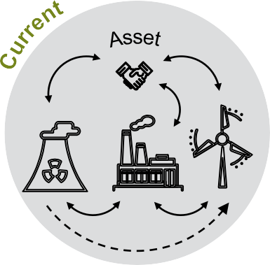
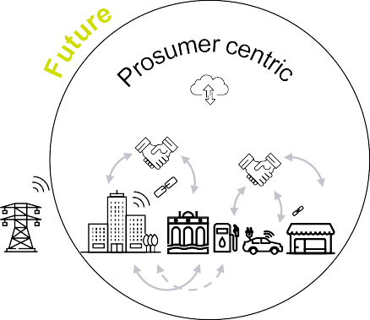
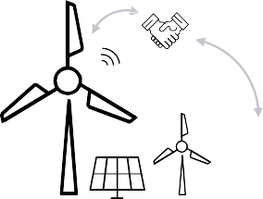
The Evolving Energy System
Interconnected digital technologies → 2-way flows of energy and information
→ new business models
Paradigm shift
Stakeholder
Expectations
Fossil fuel-dominated
centralized generation
Renewable-dominated
decentralized generation
Decarbonization
Decentralization
Digitalization
Democratization
Generation follows demand
Demand follows generation
Source: EY Knowledge, EY Countdown Clock Model, EY Navigating the Energy Transition Research
Notes:
I think most people in the room are familiar with these concepts and so I don’t want to go over in too much detail.
Salient for our discussion today – the growth of DERs and the changes this brings to our utility business model, because it’s not just this one thing ,but rather part of a broader shift that we refer to as the 4Ds.

Slide 5
What Energy Transition Means to Alectra Utilities
Greater infrastructure requirements
More load & local generation;
some of it flexible
Addressing customer needs in a new way
New business models
Notes:
Infrastructure: Evs are 1% of energy now, 20% in 20 years. Other loads not shrinking. On peak creates problems
So can we shift? Flexibility is available.
To do this, we need a relationship with the customer.
Recent survey – customers need to see our support and we need to find a way to fund it
The road to success leads through customer buy in – both for that relationship, and with OEB
That will provide the revenue we need
We now have this new type of load that’s growing exponentially, driven by policy goals like GHG reduction, and technology development coming from automakers recognizing that this is the superior technology over the long term. And this is going to have impacts on our distribution business, as well as our energy services business.
I’ll highlight some of the characteristics of these loads that make them unique:
Not necessarily attached to a structure, may be in parking lot or off the street
Assets are mobile – maybe they charge at work sometimes, at public locations sometimes, and at home sometimes.
Variable use profiles – different usage profiles. Fleets are different from residential, public charging is - different from workplace
Potentially very large. Heavy duty vehicles may each require a 1MW charge. So a fleet could become multiple megawatts where now there’s only an office with a few hundred kW.
Overall, I would describe this is as an opportunity. If we manage it well, we can benefit along with our customers with lower rates and more rliability. If we don’t, we’ll have higher costs and poorer service to our customers. This is the challenge that’s before us.

Slide 6
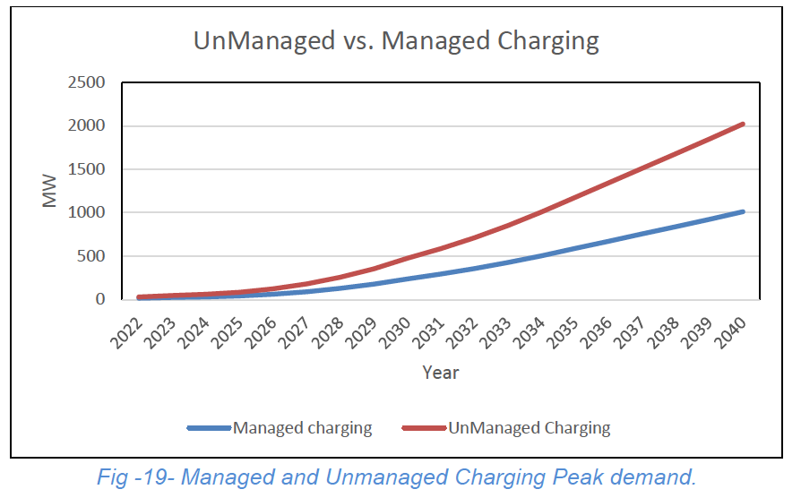
The Importance of Managing EV Charging
Managed charging and rates can reduce the impact of EVs on peak.
Lower peak demand means less additional infrastructure, leading to lower costs
Notes:
Focus – mitigating charging is critical. Reduce costs, operate more efficiently. Saves everyone money and can also save partiicpants
We are looking for
-funding
Pilots
Clean fuel standard
- standards

Slide 7
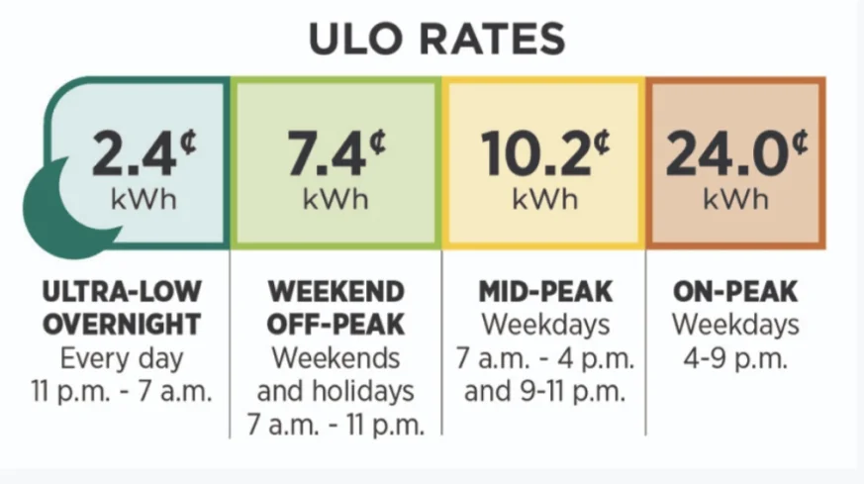
Ontario introduces Ultra Low Overnight (ULO) rate
Insights developed through Alectra’s RPP Roadmap pilot (sponsored by OEB) laid the groundwork for Ontario’s ULO plan
Benefits
~$90 savings per year
Shifting demand to overnight uses Ontario’s excess clean energy
~$5.7 million annual provincial savings in capacity costs
* Starting May 1, 2023, Ontario LDCs began to roll out the Ultra-Low Overnight (ULO) electricity price plan (deadline to offer is November 1, 2023) for residential customers
Notes:
The new Ultra low overnight rate is an example of a rate plan that is being brought in to encourage shifting consumption to off-peak periods through an ultra low rate.
It was inspired by a pilot that we ran over a number of years, that was sponsored through the OEB’s pilot.
while benefiting the electricity grid by shifting consumption to off-peak hours.

Slide 8
AlectraDrive @Home
A turnkey managed charging pilot program that provides subsidized EV charging equipment and/or pricing incentives in exchange for a better understanding of EV charging behaviour and flexibility ‘at home’.
Insights from 230+ EV drivers
The Roadmap
12 stations in 4 multi-residential buildings (MURBs)
17 stations in single-family homes (SFH)
Project support by NRCan EVID ($1.3) and IESO Grid Innovation Fund ($500k)
​
Investigation into the commercialization of managed charging programs to shift demand
Advocacy for multi-residential “make-ready” programs to simplify the customer experience
Notes:
This pilot is testing out 2 main approaches to encouraging customers to charge off-peak
It itself was inspired by our RPP Roadmap pilot ,but before ULO was real, and so it takes a different approach. But the results are indicative of what we expect to see with ULO. IT also provides insights into the customer engagement process which is so critical.
We have successfully installed 12 charging stations across 4 multi-residential buildings, and 17 in single-family homes we now have 30 drivers actively participating in the pilot program ending as of September 30, 2023. Additionally, we had over 200 drivers participating in the initial phase of the program that ended in November 2022. Instead of receiving subsidized EV charging equipment and participating in demand response events, these 200 or so drivers installed a device in their car that measured when and where they were charging, and drivers were either given incentives to shift their charging behaviour or were part of a control group that did not, so that we could compare results.
For a quick recap of why we did this, the idea behind @Home is threefold.
First, we wanted to design and provide a program that could be commercialized or to assess a solution that can be scaled at a provincial level to incentivize Ontarians to install EV chargers. This could manifest in a few ways, but an ideal outcome would be mirroring British Columbia’s “Make-ready” programs where they offer various financial incentives funded by the government to enable electrification through building assessments, EV charging station installations, and education & awareness.
Second, this program allowed us to assess various financial benefits or customer incentive models to encourage off-peak charging. The affect that pricing has on when a person plugs in their car is monumental as you will see in the findings slide coming up shortly.
Finally, we want to understand and demonstrate the value of distributed energy management systems technology for EV load management to reduce strain on our grid. To put it simply, we are going to be experiencing a shortfall in energy over the next decade and as we transition to transportation electrification, we are going to need managed charging methods to flatten our demand curve and promote charging during off-peak hours.

Slide 9
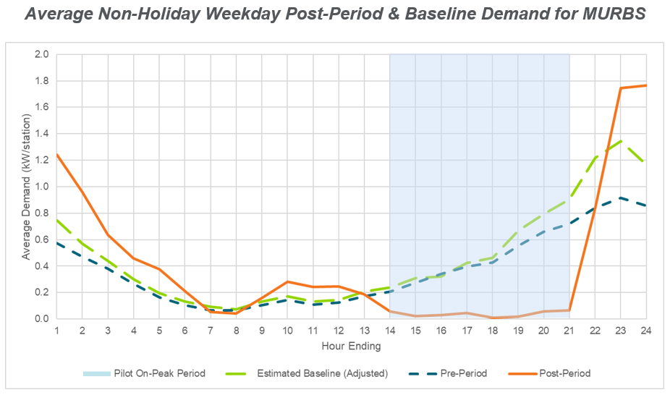
AlectraDrive @Home Group 1: Managed Charging
Initial Findings
Multi-unit residential buildings (MURB) participants are delivering a price-based demand reduction of approximately 91% of baseline during on-peak hours (1pm – 9pm on non-holiday weekdays).
Group 1: Smart Charging (MURB & SFH installs)
Group 2: Charge Rewards (loyalty program/point system)
Group 3: Control Group (no incentives)
Notes:
Our group 1 multi-res drivers, part of the subsidized EV charging station group, were told to charge as they normally would without any pricing or demand response events sent to their charging station. This created a baseline of data to compare to our treatment period once we started pricing and DR events in February of this year. Our off-peak hours where charging is completely free of any pricing or events is always 9 pm to 1 pm on weekdays, and all holidays and weekends. Anything outside of those hours once our treatment period started is now $4 an hour and $10 to charge during a DR event.
What we found was not completely surprising, but the degree to which we saw it – it was. Due to our pricing model, our multi-res drivers reduced charging during on-peak hours by 91% from our baseline. This is a clear indication that pricing is a massive incentive to charge off-peak. Remember that they are not being for any energy, only the $4 an hour cost outside of off-peak hours.
Due to our findings, our evaluator has suggested we shift our current DR event timing – 5pm to 9 pm, to a new schedule of 10 pm to midnight. This will allow us to not only test the technology we implemented to gather insights from DR events, but it will also show how this reduction in charging power during events may shift drivers to pay for their charge during on-peak hours where they will see 100% full power when charging as the DR events reduce power to the stations by 80%, prolonging the charging time.

Slide 10
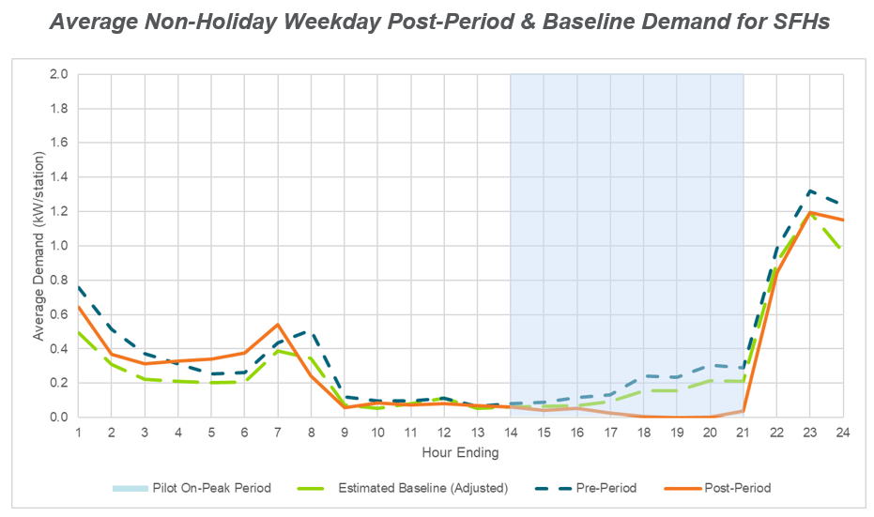
AlectraDrive @Home Group 1: Managed Charging
Initial Findings
Single Family Home (SFH) participants are delivering a price-based demand reduction of approximately 78% of baseline demand during on-peak hours.
Group 1: Smart Charging (MURB & SFH installs)
Group 2: Charge Rewards (loyalty program/point system)
Group 3: Control Group (no incentives)
Notes:
I won’t spend too much time here as you can see the results in the single-family homes are similar to multi-res, but we do see a less dramatic effect of pricing here where SFH customers are reducing their charging 78% of baseline during on-peak hours. The reason for this is that SFH customers are charged $2 an hour instead of the $4 an hour seen with multi-res.

Slide 11
AlectraDrive @Home Group 2: Telematics
Initial Findings
Participants receiving a telematics-based incentive are delivering a demand reduction of approximately 40% of baseline demand during on-peak hours.
Notes:
This is the telematics based approach. Instead of a charger, customres just charged as normal, and we were able to track their charging through an onbaoard device that would track charging events and allow us to see when they were charging – on peak or off.

Slide 12
Solutions from the Grid-Edge: DSO Model
Total DSO
Alectra successfully piloted the Total DSO model with the IESO, with funding support from IESO and NRCan.
We procured, contracted and deployed 10 MW of local capacity in 2021 and 15 MW in 2022 respectively, coming in well under budget.
We are now working with government, agency and industry stakeholders to explore how this model could be leveraged and expanded across Ontario.
TO
IESO
Transmission
Distribution
LDC
DSO
LEGEND
Aggregators
Energy & $ Exchange
Information
Distributed Energy Resources
Notes:
WE did the NWA pilto with IESO and NRCan, to demonstrate the viability of a distribution level market.
IT ran over 2 seasons, and had approximately 8 MW of demand response during events. Events were run between 5-10 times per year, generally summer during peak AC periods.
Customers were really happy, mostly already did DR for IESO.
It has spurred a lot of discussion with IESO, other LDCs about whether this presages the future.

Slide 13
Implications for the Future
Distributed energy resources…
Can benefit customers and the electricity system
Poses challenges to traditional utility processes and business models
Utilities currently have neither a mandate nor a remunerative incentive to manage load
Multiple potential approaches – what’s the right one?:
Demand management programs?
Distributed system operator?
Others?
Things are not standing still…
Notes:
DERs are great.
But what are we supposed to do about them?
We can’t spend our money on them and get paid, like we do
We have no money coming in for them – could we? What’s the mechanism?
We think a DSO is great because it lets us buy the best resources and get compensated for them. This is done in Europe with a lot of success, though of course there are lots of various experiences there and I won’t pretend to be an expert.

Slide 14
Solutions from the Grid-Edge: Video
(Video here)
Notes:
This short video illustrates the evolution we see happening.

