Slide 1
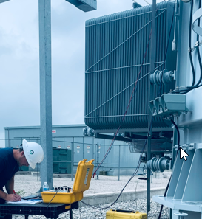
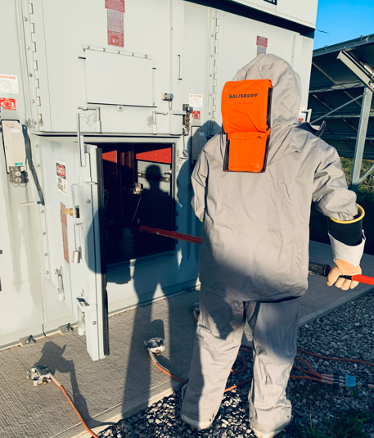
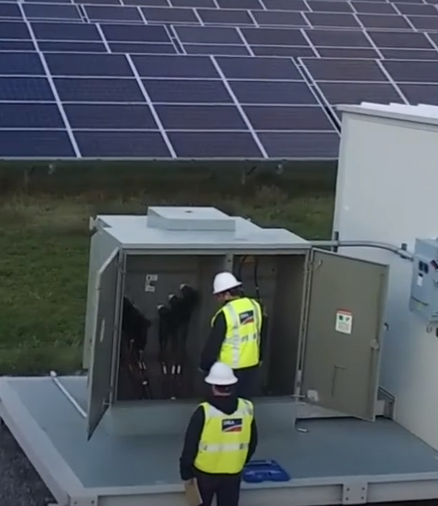
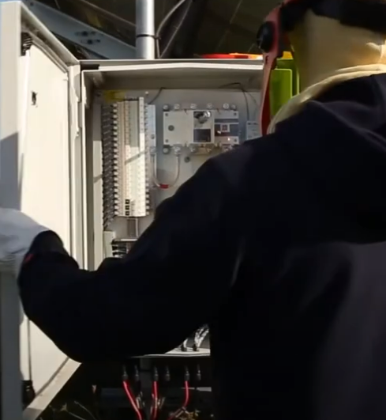
Kristofer Marr
Sr. O&M Engineer & Site Supervisor
Grand Renewable Solar (G.R.S)
Solar Operations & Maintenance Specialist

Slide 2
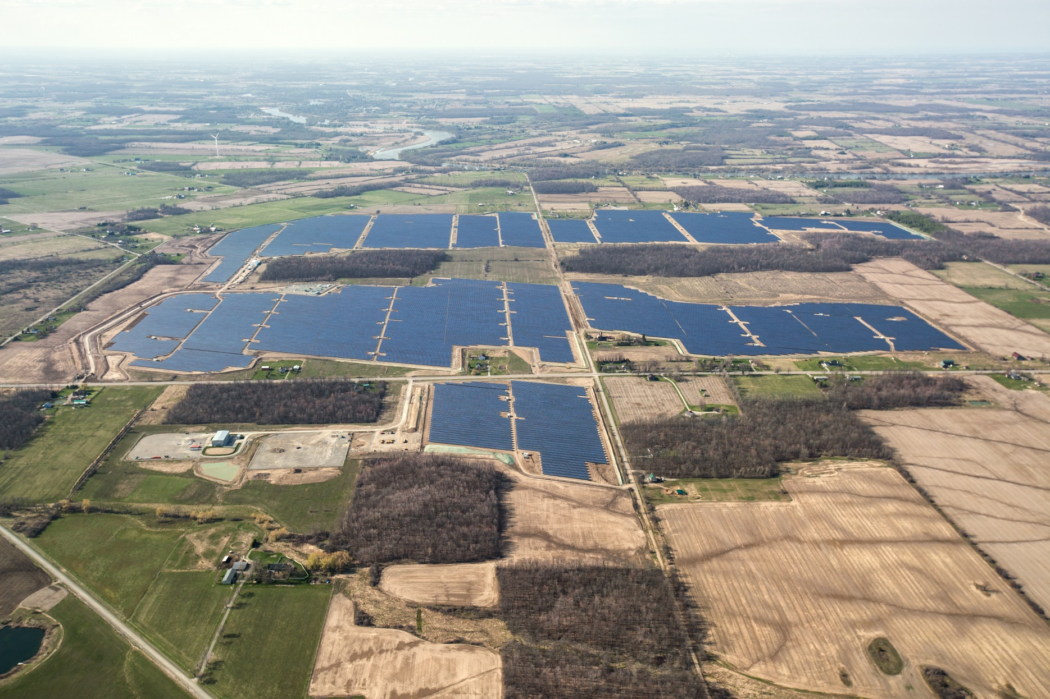
Grand Renewable Solar Arial View
O&M Office Building
Grand Renewable Solar Site Aerial View (Fall 2015)

Slide 3
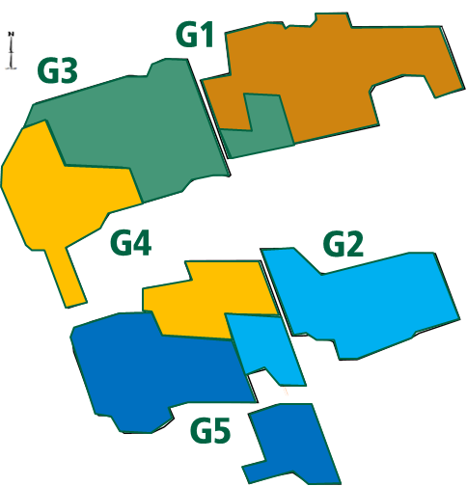
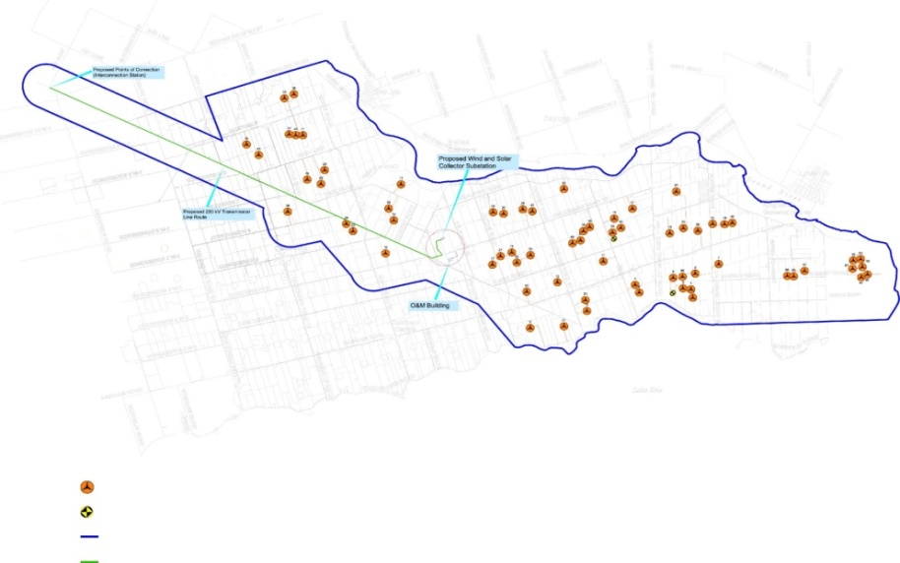
Site Information and Layout
Overview
G.R.S has a Site capacity of 100MW_{AC} comprised of five 20MW_{AC} sections which are represented in the adjacent site layout and occupies ~800 acres
The site has roughly 450,000 panels, 98,000 piles, 130 x 800KW Inverters
The 230KV collector substation is located in the middle of the site and connects to the transmission line
Project is connected to the power grid by a 20 km 230 kV transmission line
The solar facility produces enough energy to power ~17,000 homes, will offset ~162,000 tons of CO2 which is the equivalent of taking 29,610 cars of the roads.
Solar Farm Layout
Transmission Line Layout
Substation Collector
Interconnection Station
Grand Renewable Solar Project
Wind and Solar Collector Substation
230 KV Transmission Line Route
O&M Building
GRWLP (Turbine Layout)
Site Boundary
Transmission Line
Perimeter of Project
O&M Building
Notes:
3

Slide 4
Agrivoltaics In Action
Vegetation Control Experiences

Slide 5
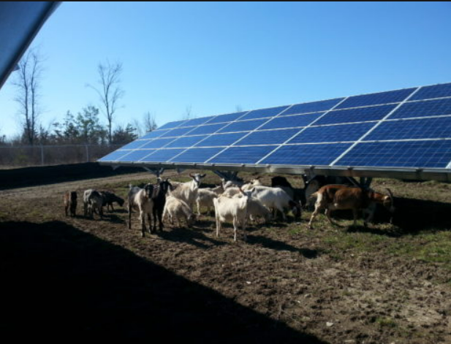
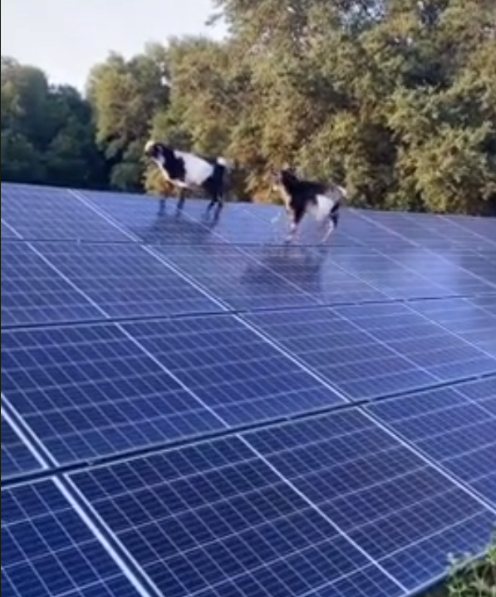
2015-2016
Goat Grazing
Pros
Cons
Rescue Goats were used by the operator
Witnessed timid and malnourished goats regain health
Very friendly Animals and easy to work around
Safe and vast area for animals roam
Operator error resulted in poor grazing performance
Goats would jump on solar modules
Goats would chew and disconnect PV wires
Notes:
5

Slide 6
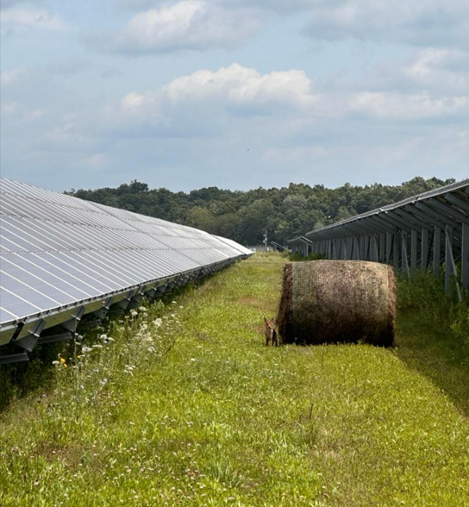
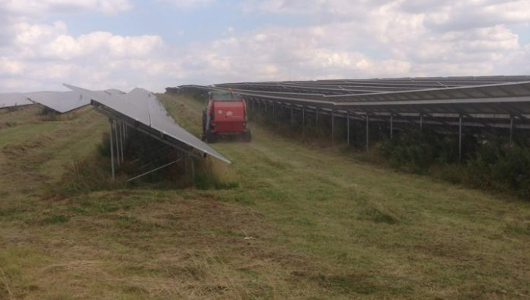
2018 – 2020
PV Haying Operation
Pros
Cons
Supported Local Farmers with acreage to farm
Farmer would notify if any site issues seen (visual support)
Farmer provided services for snowplowing and civil work
Fire Risk
Hay bails would block rows for site team maintenance
Tick Population increased
Mechanical cutting still required along leading edge
Quality of hay was low (Original seed mix not optimal)
Notes:
6

Slide 7
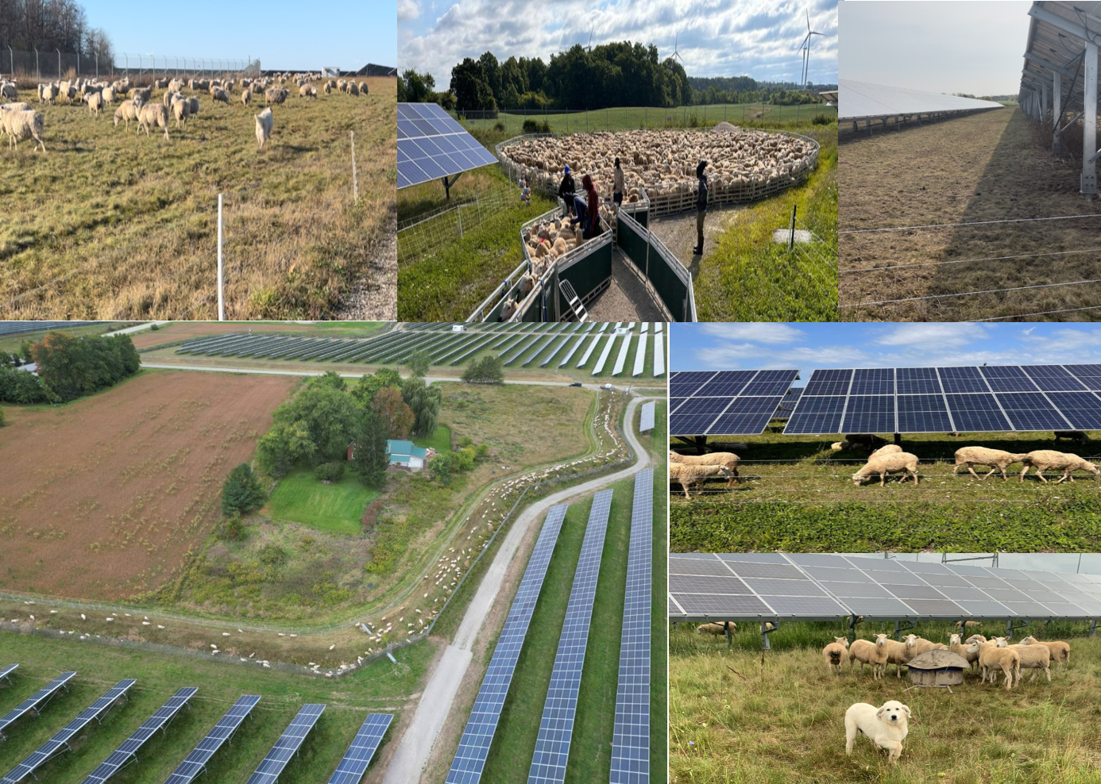
Pros
2021 – Present
Sheep Grazing
Sheep provide uniform vegetation control
Tick Population drastically reduced
Sheep shearing onsite
Contractors can provide extra services
Additional set of eyes for site team
Sheep graze under panels and where mechanical cutting is not practical
Notes
GRS first sheep grazing attempt failed
Operator plays a major role in the grazing quality (LaraCosta’s innovative approach)
Many sheep are required for quality grazing on large Solar Plants
(For GRS approx. 3500-4000 Lambs)
Notes:
7

Slide 8
Thank You Argrivoltaics Canada
Sincerely,
Kristofer Marr, C.E.T, ME.

